Slide 1
Performance Based Maintenance Contract (PBMC) & e-MARG
13th November, 2019

Slide 2
Performance Based Maintenance Contract (PBMC) & eMARG
Thousands of roads in the state are under maintenance
Need to maintain roads
Performance Based Maintenance Contracts (PBMC)
Challenges in maintenance of roads
eMARG: e-governance solution for monitoring of PMGSY roads
Remember: Payments through eMARG is one of the pre-requisites for any sanction under PMGSY III

Slide 3
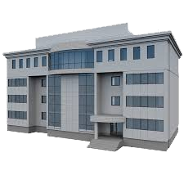
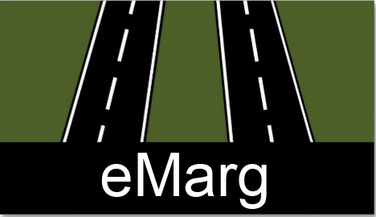
Stakeholders
SRRDA/PIU
PFMS/ Bank
Contractor
Citizen
NRIDA, MoRD
NIC

Slide 4
Functional Features
Individual User registration, Packaging of roads etc.
Roles-based Scope & Services ( District, State, National, Administrator )
System generated bills based on CA maintenance rates.
Facility to contractors for online submission of bills & tracking
Routine & Feedback Inspections through Mobile App
Index-based Performance Evaluation

Slide 5
Tasks Involved
Bill Submission
Routine Inspection
Performance Evaluation
Bill Payment
By Contractor
Monthly
By any PIU Officer (Including JE/Sub Engineer, AE, AEE, EE)
Bi-monthly
By any PIU Officer (Including JE/Sub Engineer, AE, AEE, EE)
Six monthly
To be finalized by PIU In charge
By AO based on PE of PIU In charge
Six monthly

Slide 6
Bill Submission
By contractor
Using eMARG log in
Frequency of the bill submission
Monthly

Slide 7
Routine Inspection
Inspecting Officer
Any officer including JE, AE, AEE, EE
Field based using App
(Geo-tagged & time stamped photographs)
Minimum Frequency of the Routine Inspection
Bi-Monthly
Unit for the inspection
Per kilometer
Criteria for grading
Satisfactory / Unsatisfactory for five parameters
Intimation to contractor in case of ‘Unsatisfactory’ remarks by inspecting officer for any of the activities/parameters

Slide 8
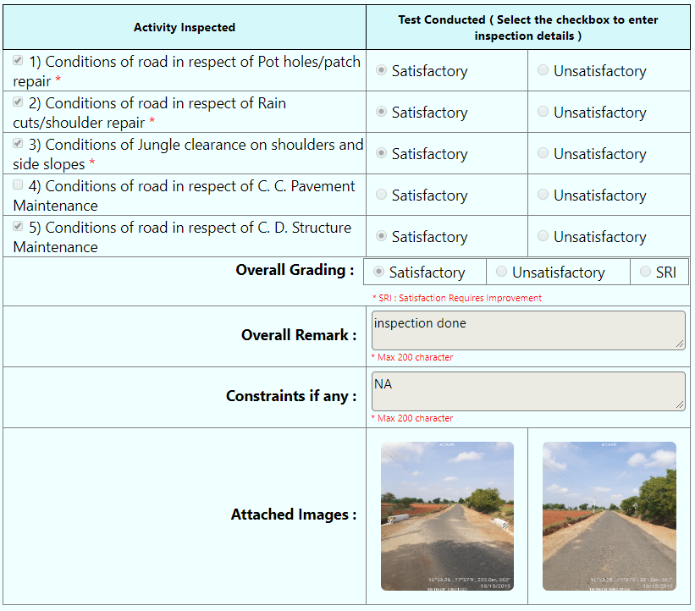

Slide 9
Performance Evaluation
Inspecting Officer
Any officer including JE, AE, AEE, EE
PBMC Marking Scheme
Desk Based
All the photographs and grading from routine inspections will be displayed on the screen
Frequency of the Performance Evaluation
Six Monthly
Unit of Inspection
Per kilometer
Finalization of the Performance evaluation
By EE/GM/PIU In charge
All the photographs and remarks of activities from routine inspections & performance evaluation will be displayed on the screen for finalization of score
Option to change the marks given by PIU In charge with justification

Slide 10
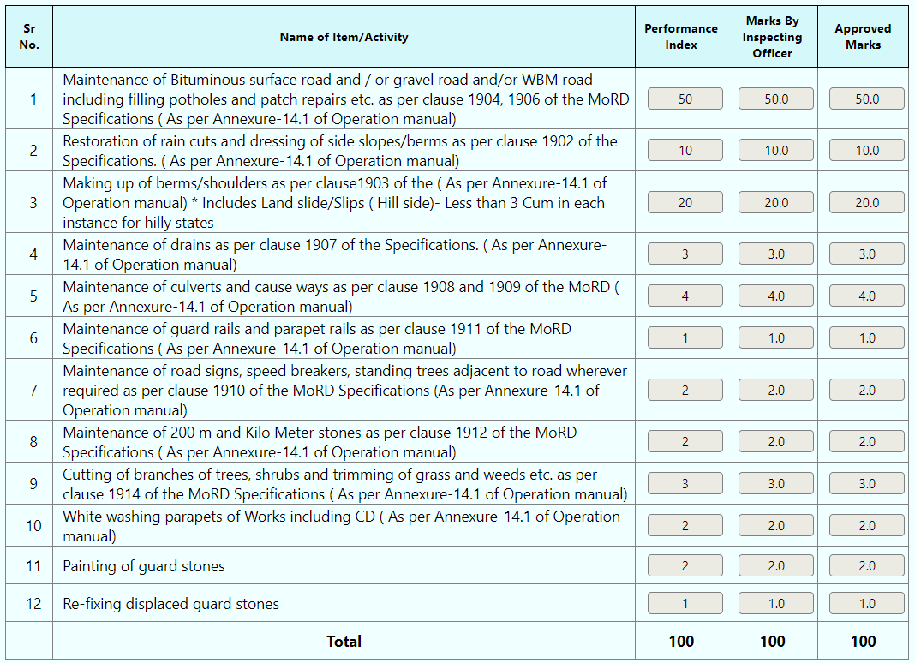

Slide 11
Bill Payment
System Generated bills
Six monthly payment to the contractor
Criteria for payment
No Payment for less than 80 marks in Performance Evaluation
If a stretch (of a kilometer) gets less than 80 marks, no payment for that stretch
If any two stretches of the road get less than 80 marks in a PE, no payment for the complete road
If same stretch gets less than 80 marks in consecutive PE, no payment for the complete road in later PE
For more than 80 marks, proportionate payment of the marks obtained

Slide 12
Bill Generation & Digital Payment
Online Bill Submission
Payment Inspection
Bill Approval
Voucher Generation
Contractor
Scroll
Generation
Money Transfer

Slide 13
Activity | Concerned Person | Frequency | Nature of activity | Length Requirement
Bill Submission | Contractor | Monthly | Using eMARG log in | No length requirement One bill to be submitted for a road
Routine Inspection | JE/Sub E/AE/AEE | Minimum frequency : Bi-monthly Using mobile app | Need two photographs per kilometer S/U remarks for the prescribed activities | Kilometer Wise
Additional Feedback Inspection | JE/Sub E/AE/AEE/EE/ and above | Any time | Need photographs and remark along with the photographs | No requirement as such As per convenience of the inspecting officer
Performance Evaluation | JE/Sub E/AE/AEE | Six monthly | Desk Based (Requires no additional photographs) | Kilometer Wise
 | EE/PIU In Charge and above | Six monthly (Finalization)

Slide 14
THANK YOU!

