Slide 1
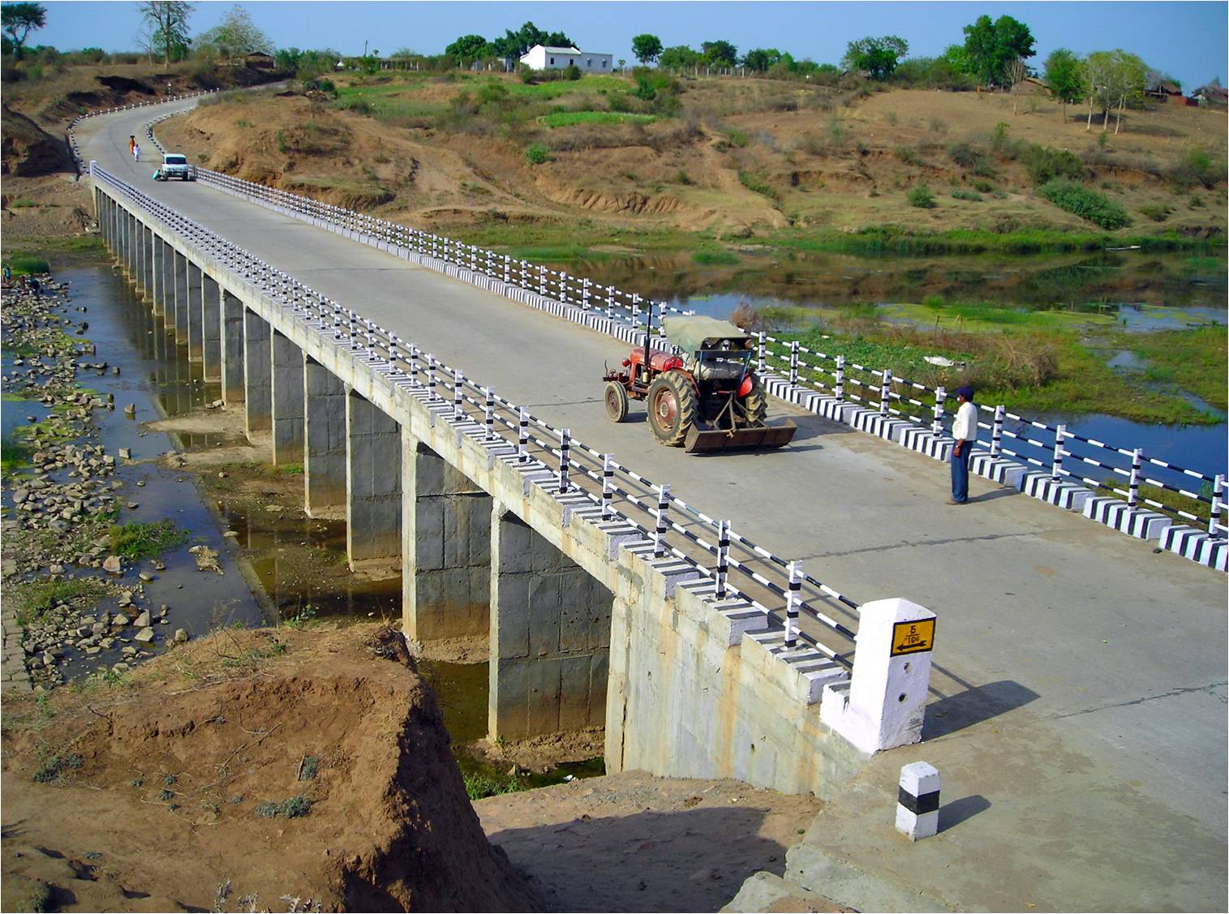
Pradhan Mantri Gram Sadak Yojana
eMARG
(electronic Maintenance of Rural Roads under PMGSY)
Reports and Dashboards
EXCELLENCE IN GOVERNMENT PROCESS REENGINEERING FOR DIGITAL TRANSFORMATION

Slide 2
eMARG Electronic Maintenance of Rural Roads
Minimum Government, Maximum Governance
IT re-engineering for all functions related to the execution, monitoring and management of rural road maintenance centered around outcomes and evidence
End to end digitization of all processes related to maintenance from billing, verification of work, final payment to contractors and monitoring.
Fusion of multiple e-governance technologies such as Web ERP, GIS, mobile apps, SMS, digital payments and accounting.
Creation of Login credentials for all the stake holders
Contractor
Field Engineer
District In-Charge
Account Officers
State HQ
NRIDA
MORD
Stakeholders

Slide 3
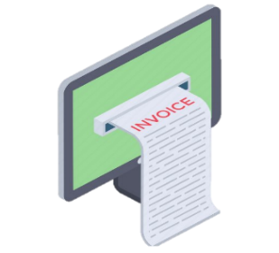
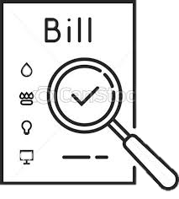
eMARG Work Flow
Start
Online Registration of Contractor
Generation of eBills by software
Submission of eBills by contractor on click of a button
Digital Payment to contractor in his account
Start
Inspections done through Mobile App by uploading photos
Outcomes Based Performance Evaluation of Road for giving marks out of 100 based on Inspections conducted
Processing of Bills based on Marks obtained in Performance Evaluation

Slide 4
Reports and Modules for Monitoring the maintenance of PMGSY Roads

Slide 5
1. Getting the condition of road by having a virtual walk through on Google Map
Steps:
Login to eMARG
Query and Report
Inspection
DLP
Inspection Analysis

Slide 6
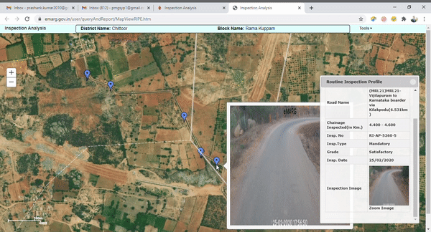
ROUTINE INSPECTIONS – ROAD PICTURES AVAILABLE ON GIS FOR MONITORING

Slide 7
2. Comparing the marks given to the road in Performance Evaluation and the actual condition of road
Steps:
Login to eMARG
Query and Report
Inspection
DLP
Performance Evaluation

Slide 8
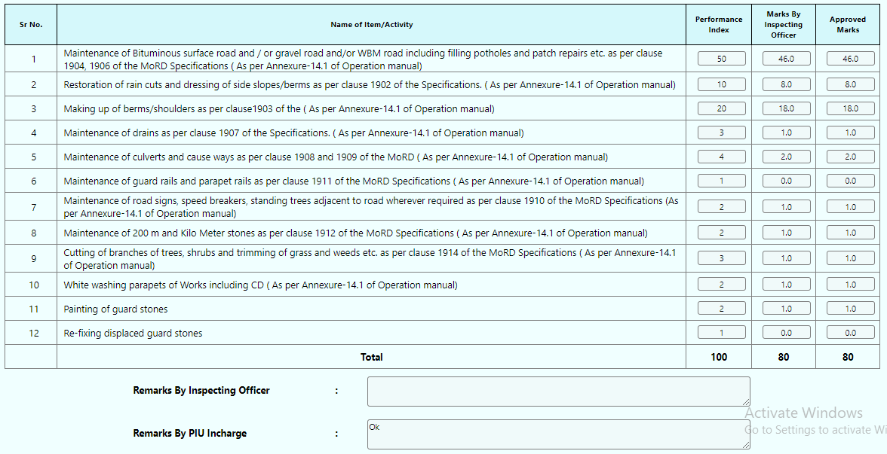
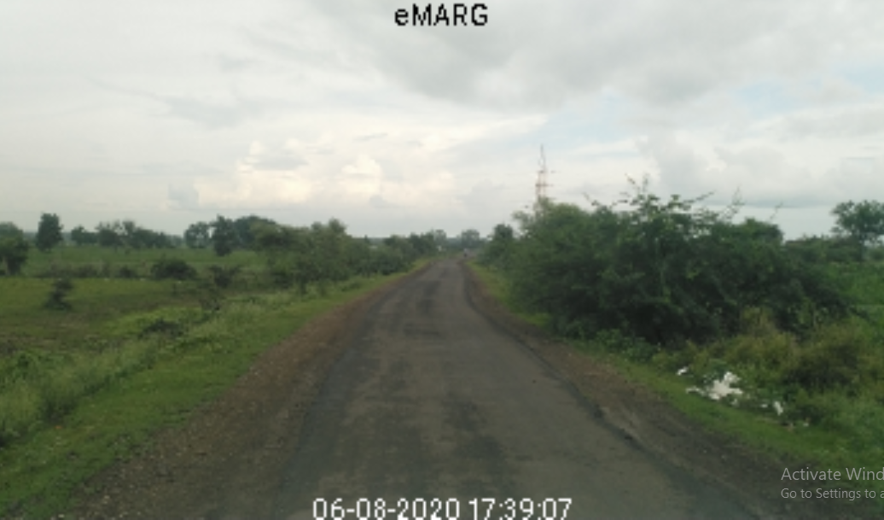
Comparing the Photograph and Marks given to road

Slide 9
3. PIU wise details of No. of RI not conducted
Steps:
Login to eMARG
Query and Report
Inspection
DLP
Routine Inspection (M) status (state wise)

Slide 10
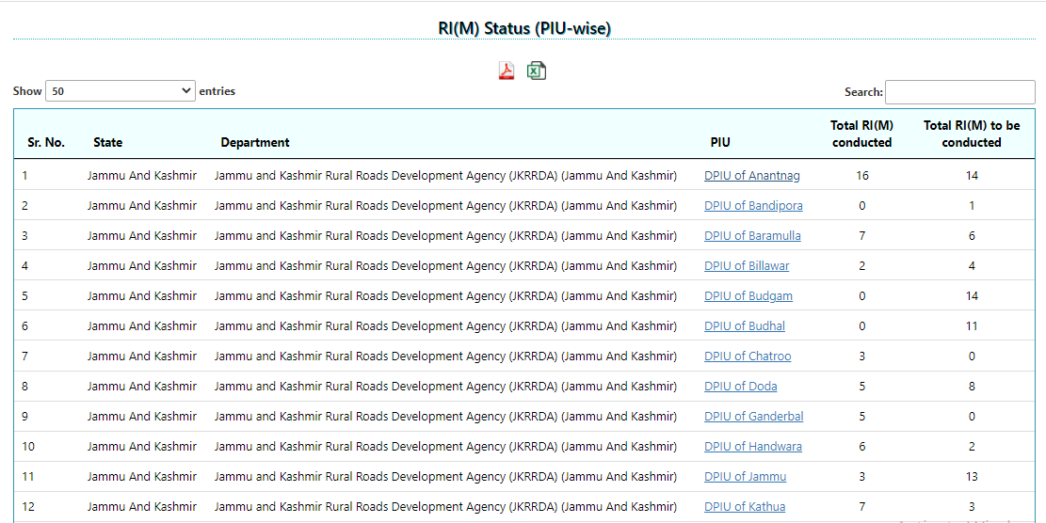
RI not conducted by PIUs
Total RI(M) not conducted

Slide 11
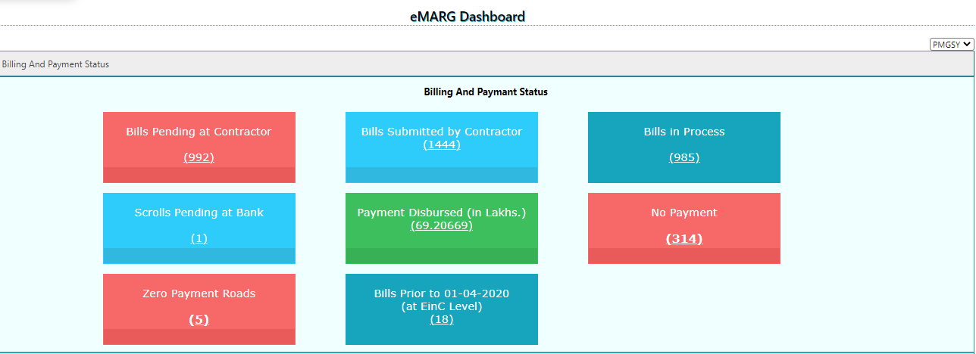
4. eMARG Dashboard
Bills Pending at contractor for submission

Slide 12
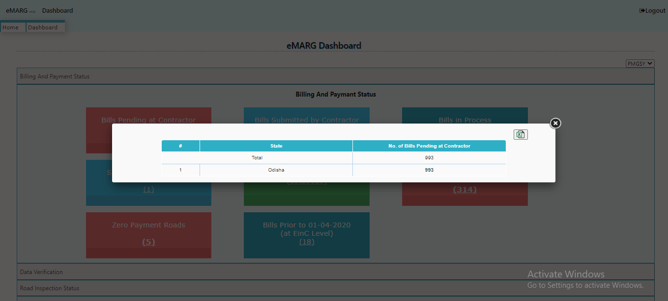
4. eMARG Dashboard

Slide 13
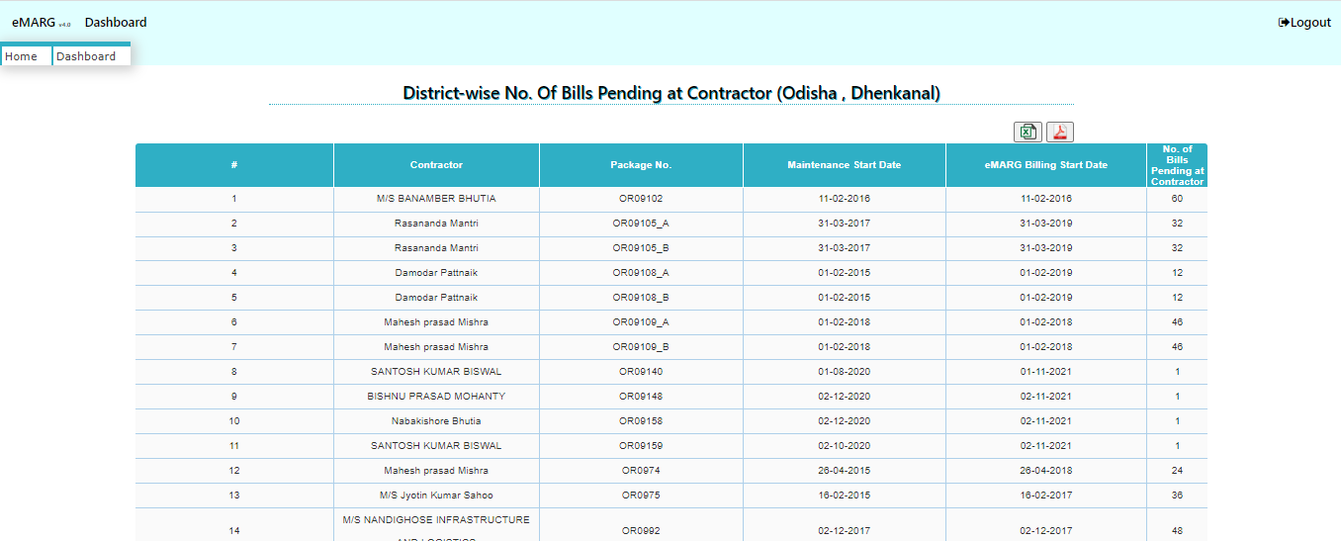
4. eMARG Dashboard

Slide 14
4. eMARG Dashboard
No. of 6 monthly vouchers on which payment is not yet done

Slide 15
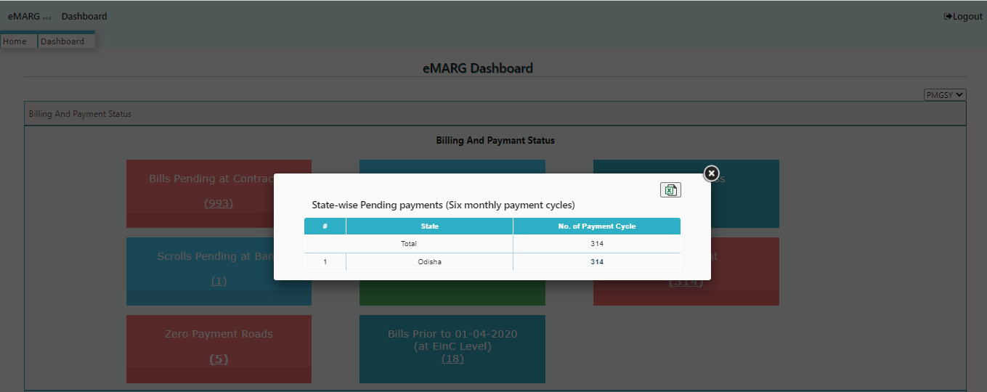
4. eMARG Dashboard

Slide 16
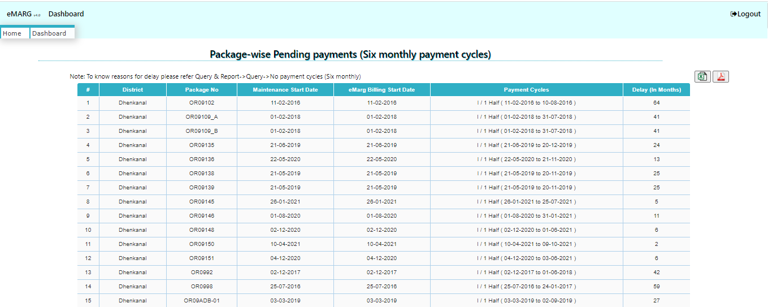
4. eMARG Dashboard

Slide 17
4. eMARG Dashboard

Slide 18
PIU TASK SHEET

Slide 19
PIU TASKSHEET
What is PIU Task Sheet?
Both PIU staff and PIU In-charge have some fixed set of tasks to perform on eMARG for making payments
Whenever a PIU staff or PIU In-charge logs in to eMARG, on his screen a detailed task list appears which are pending at their respective levels for completion
How to use the Task Sheet?
Step-1: Log in to eMARG with PIU Staff/PIU In-charge Login

Slide 20
PIU TASKSHEET
Step-1: Click on the “PIU Name”

Slide 21
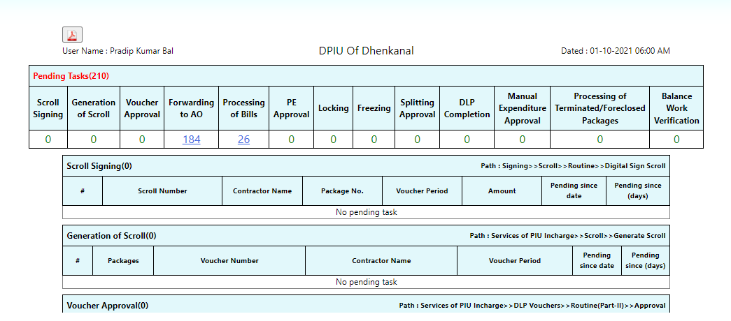
PIU TASKSHEET
Step-2: No. of Pending tasks are displayed along with the details. Take a printout by Clicking on the “PDF” Icon

Slide 22
PIU TASKSHEET
Step-3: Click on the hyperlink of any of the Pending task and you will come directly to the page from where the task is to be performed

Slide 23
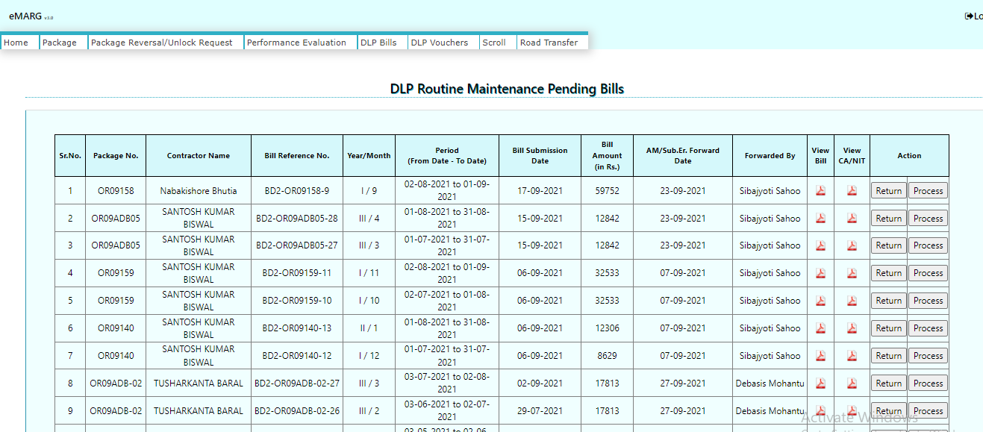
PIU TASKSHEET

Slide 24
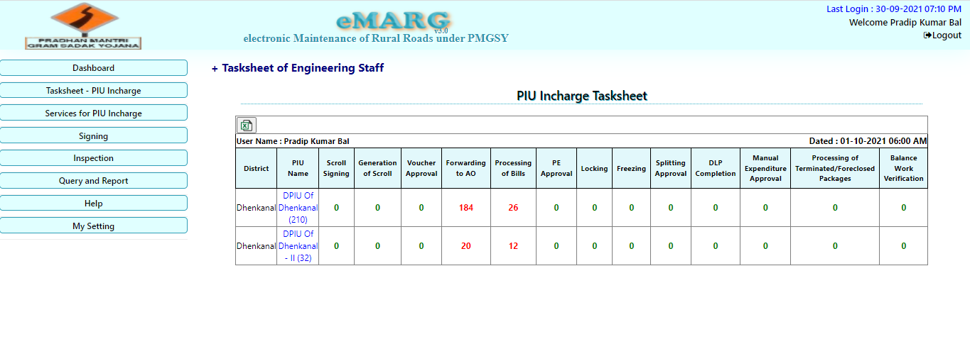
USE OF PIU TASKSHEET FOR MONITORING
PIU In-Charge can see the No. of tasks pending at PIU Staff by Clicking on “Task sheet of Engineering Staff”

Slide 25
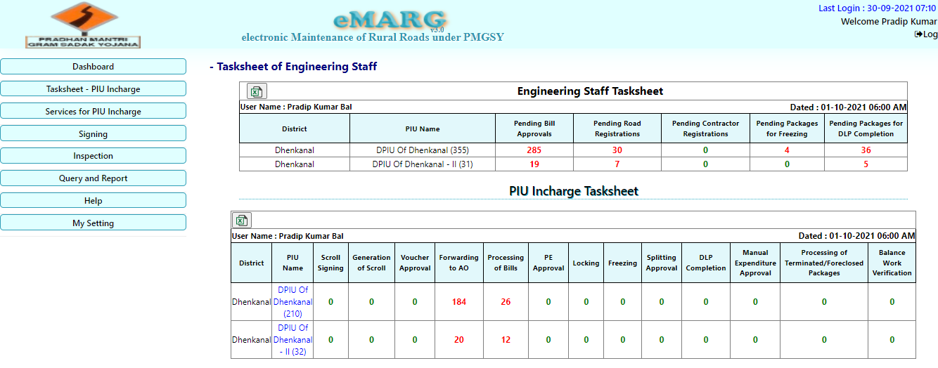
USE OF PIU TASKSHEET FOR MONITORING
PIU In-Charge can see the No. of tasks pending at PIU Staff by Clicking on “Task sheet of Engineering Staff”

Slide 26
USE OF PIU TASKSHEET FOR MONITORING
NMO can see the tasks pending at PIU Staff and PIU In-charge of the entire state

Slide 27
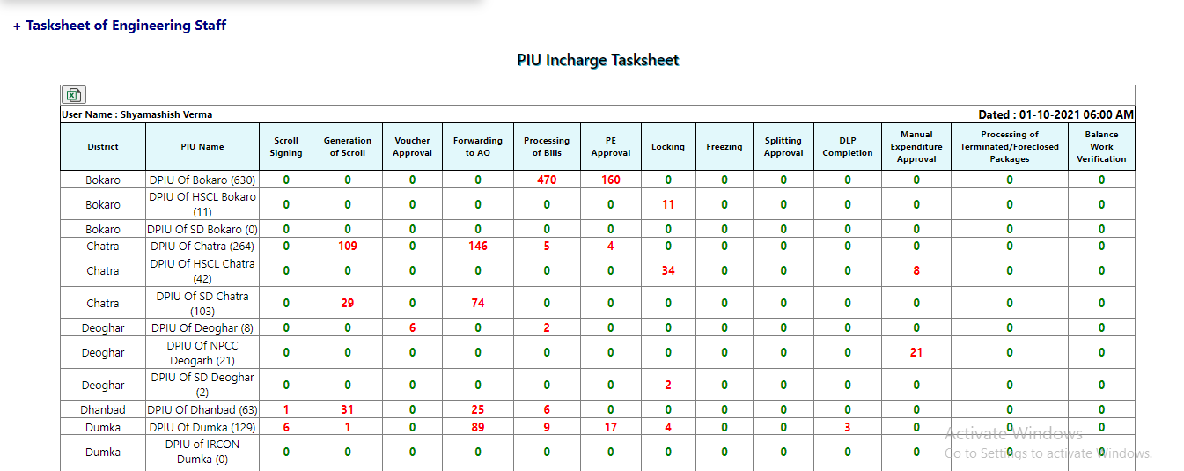
USE OF PIU TASKSHEET FOR MONITORING
Click on “Task sheet of Engineering staff” to see the tasks pending on PIU Staff

Slide 28
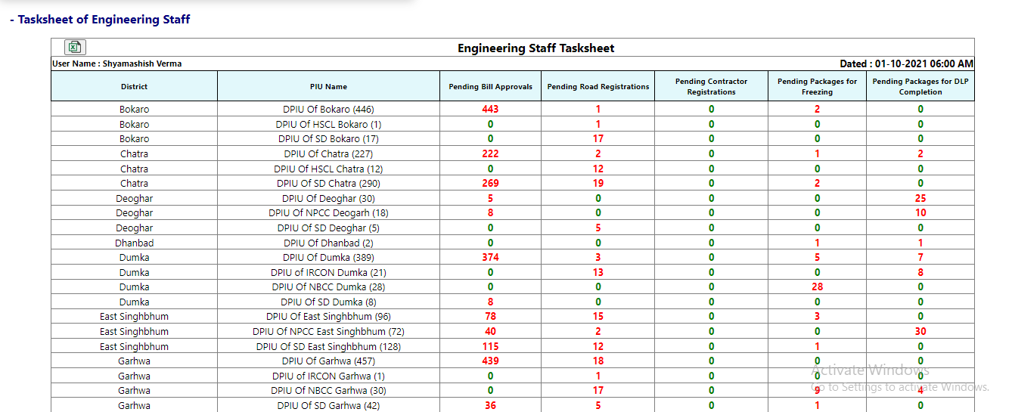
USE OF PIU TASKSHEET FOR MONITORING
NMO can see the tasks pending at PIU Staff and PIU In-charge of the entire state

