Slide 1
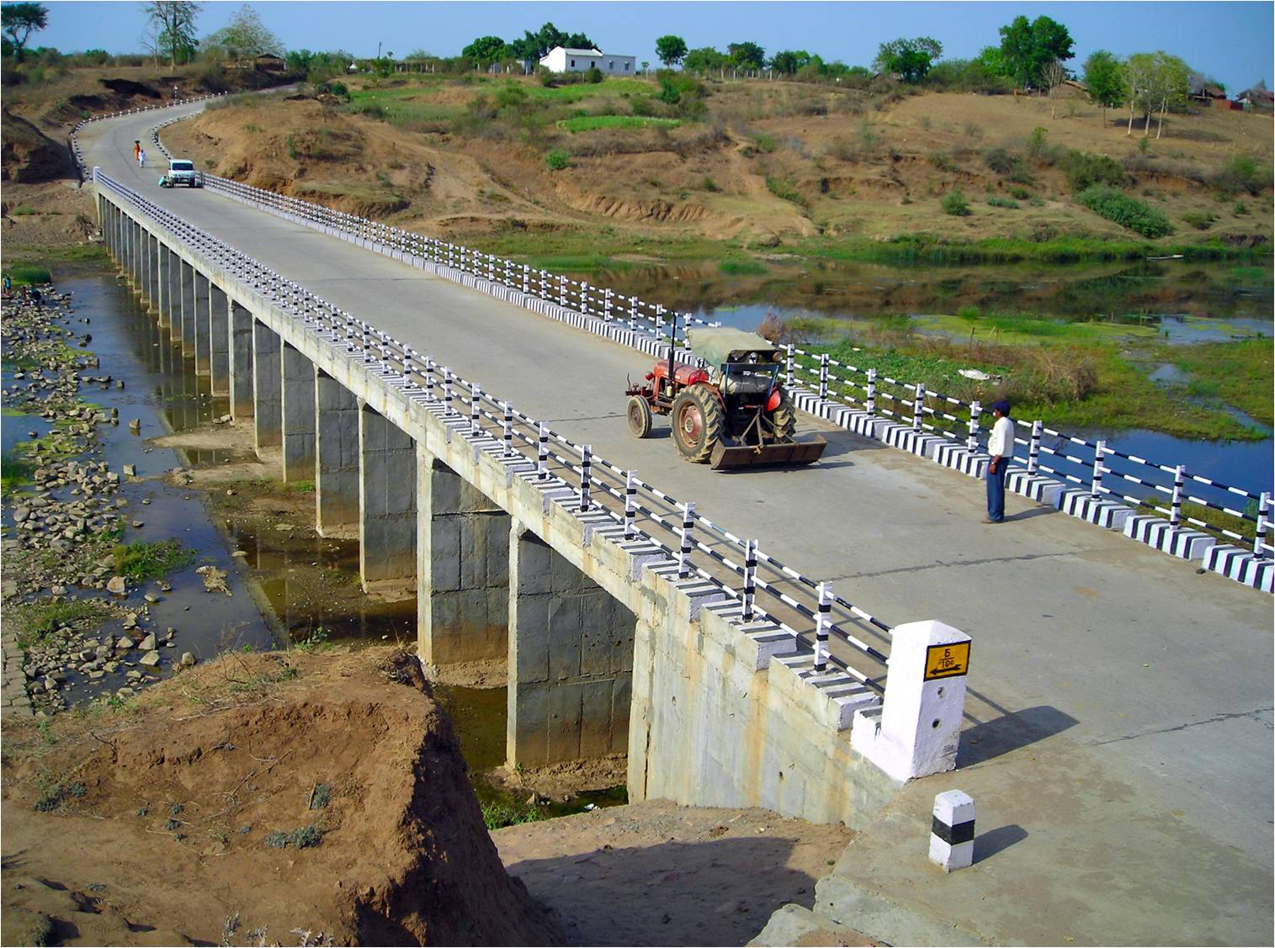
Pradhan Mantri Gram Sadak Yojana
eMARG
(electronic Maintenance of Rural Roads under PMGSY)
eMARG ADDITIONAL MODULES
THE ROAD TO DIGITAL TRANSFORMATION

Slide 2
Additional Modules to Address the Exceptional Cases

Slide 3
PARTIAL/FULL TRANSFER OF ROADS TO OTHER DEPARTMENT DURING DLP

Slide 4
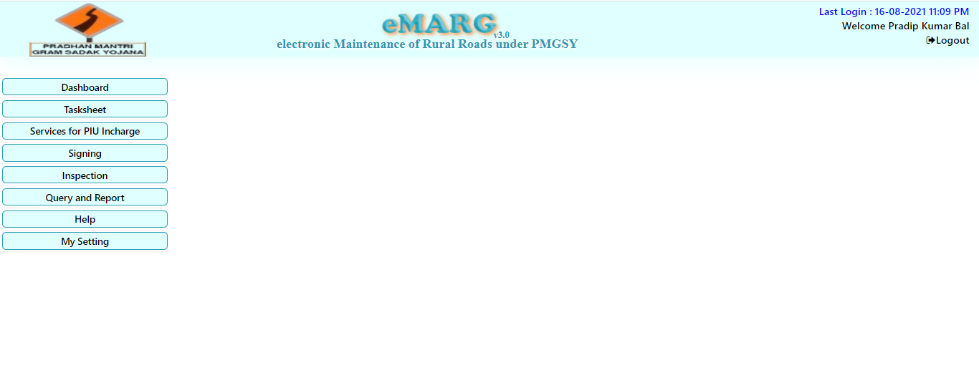
PARTIAL/FULL TRANSFER OF ROADS TO OTHER DEPARTMENT DURING DLP
Who will do the transfer of road?
The PIU In-charge will do the transfer of road
How to transfer the road?
Step-1: Go to “Services for PIU Incharge”

Slide 5
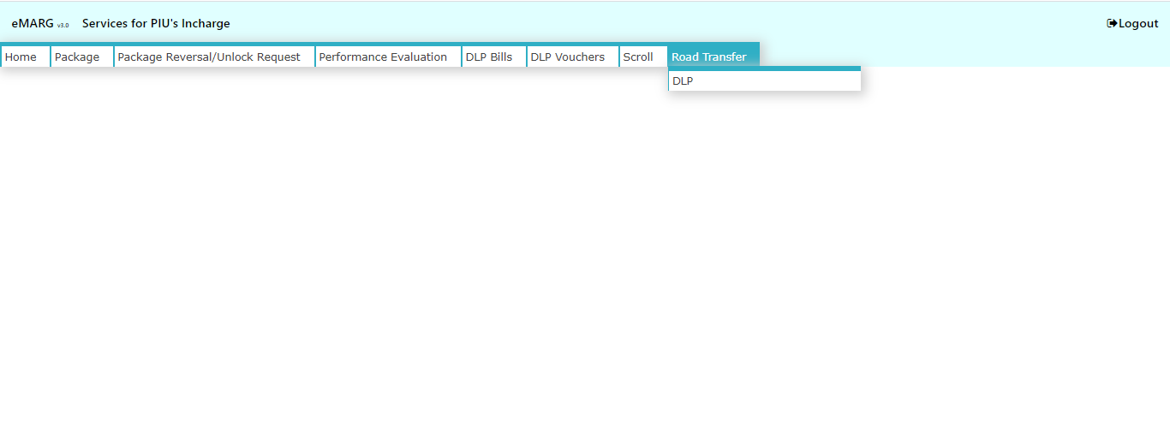
PARTIAL/FULL TRANSFER OF ROADS TO OTHER DEPARTMENT DURING DLP
Step-2: Go to “Road Transfer”------>”DLP”

Slide 6
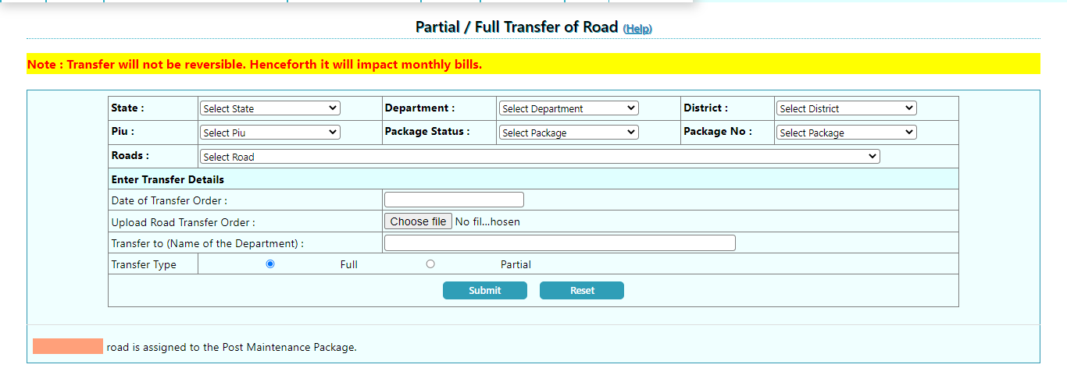
PARTIAL/FULL TRANSFER OF ROADS TO OTHER DEPARTMENT DURING DLP
Step-4: If Full Road is to be transferred
Select State/Department/District/PIU/Package Status (Whether ongoing or DLP Completed)/Package No./Road that is to be transferred
Enter Transfer Details and select “Full” if full road is to be transferred to other department and click on “Submit”

Slide 7
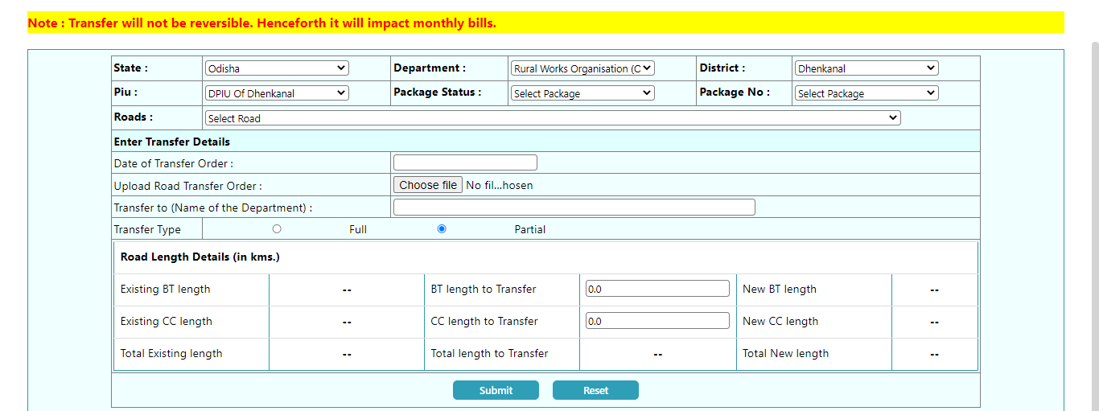
PARTIAL/FULL TRANSFER OF ROADS TO OTHER DEPARTMENT DURING DLP
Step-5: If Partial Road Length is to be transferred
Select State/Department/District/PIU/Package Status (Whether ongoing or DLP Completed)/Package No./Road that is to be transferred
Enter Transfer Details and select “Partial” if partial road length is to be transferred to other department
Enter the total BT Length and CC Length to transfer and Click on “Submit”

Slide 8
DLP PACKAGE TERMINATION/FORECLOSURE

Slide 9
DLP PACKAGE TERMINATION/FORECLOSURE
What to do if a package is already pushed to eMARG and Routine Maintenance activities/Payments have also started but now the contract with the existing contractor needs to be terminated due to any reason during the DLP period?
 | Two Options are possible
S.No | Options | Solution
1 | Either the contract will be signed with a new contractor for remaining duration | Terminate the contract with the existing contractor and create the balance work in eMARG
2 | No new contract will be signed and no payment will be done for the remaining duration | Foreclose the package in eMARG

Slide 10
DLP PACKAGE TERMINATION/FORECLOSURE
Who will Terminate/ Foreclose the package?
The PIU Staff will start the process and PIU In-charge will do the transfer of road
How to Terminate/Foreclose?
Step-1: Go to “Services for PIU Staff”

Slide 11
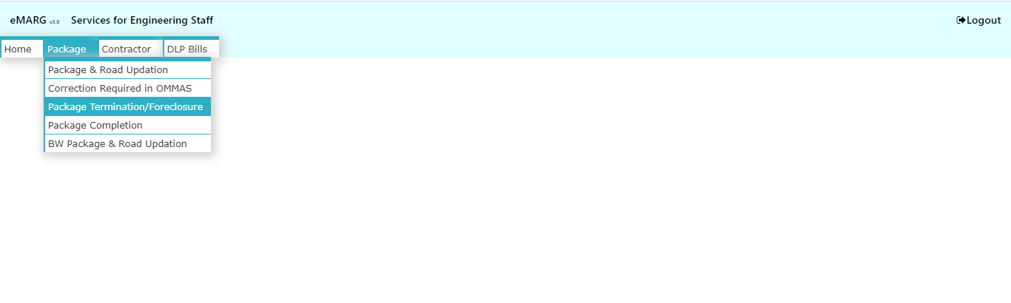
DLP PACKAGE TERMINATION/FORECLOSURE
Step-2: Go to “Package Termination/ Foreclosure”

Slide 12
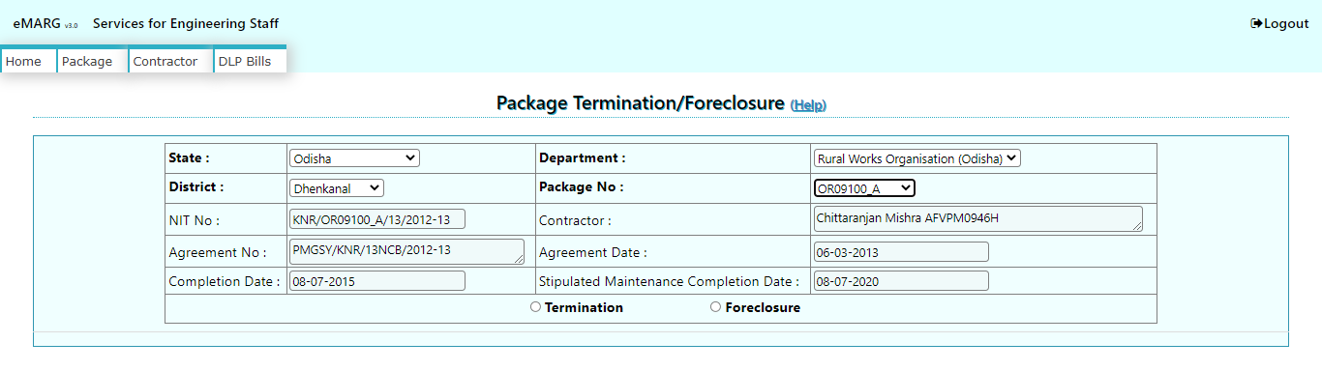
DLP PACKAGE TERMINATION/FORECLOSURE
Step-3: Select “State”, “Department”, “District”, “Package No.” and Click on “Termination/Foreclosure” as applicable

Slide 13
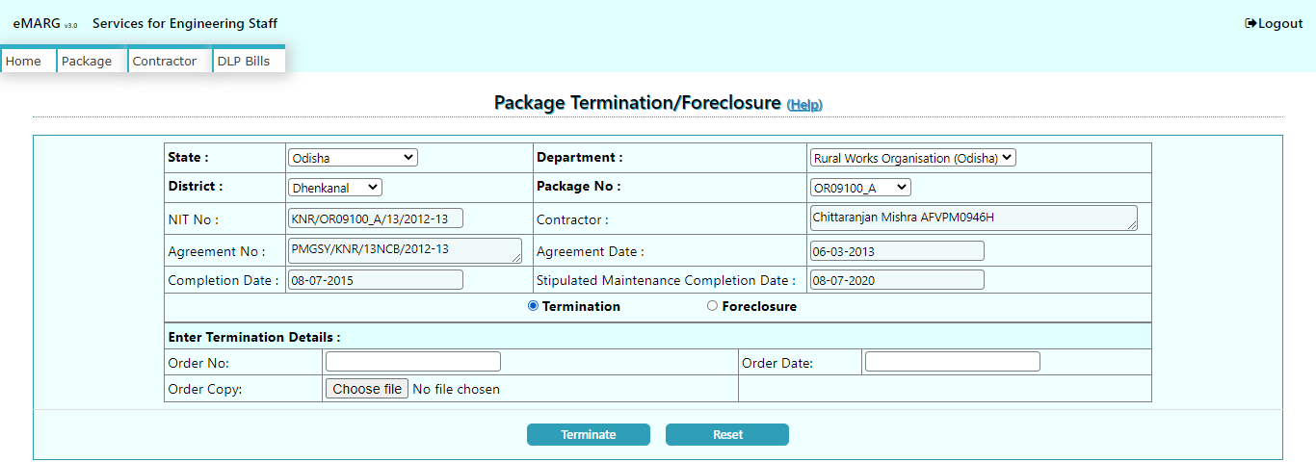
DLP PACKAGE TERMINATION/FORECLOSURE
Step-4: Enter the Termination Details and click on “Terminate” if the package is to terminated

Slide 14
DLP PACKAGE TERMINATION/FORECLOSURE
Step-4: Enter the Foreclosure Details and click on “Foreclose” if the package is to be foreclosed

Slide 15
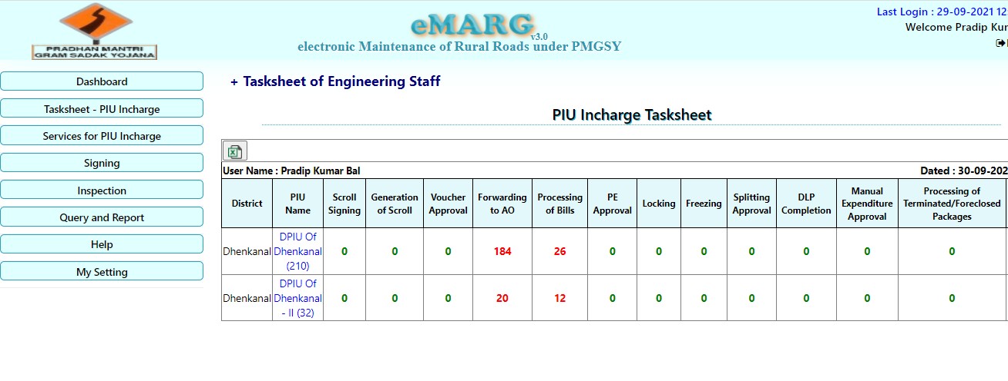
DLP PACKAGE TERMINATION/FORECLOSURE: Action on the Terminated Package
Step1: eMARG Login of PIU In-charge---------> Select “Services for PIU Incharge”

Slide 16
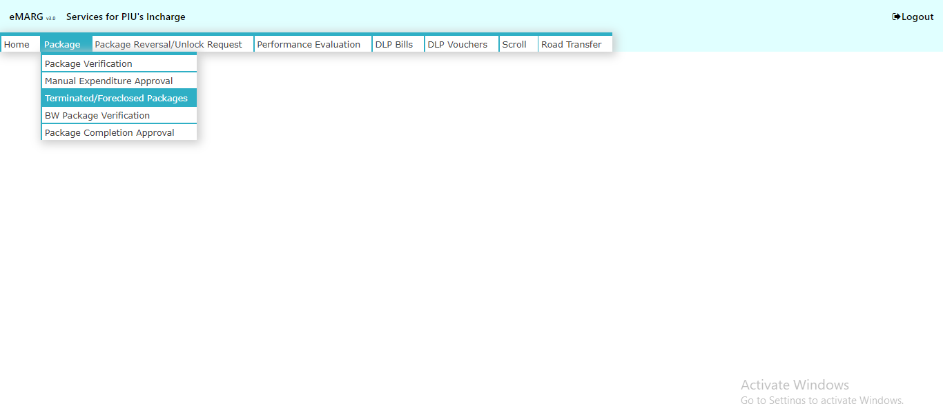
DLP PACKAGE TERMINATION/FORECLOSURE: Action on the Terminated Package
Step2: Go to “Package”------>”Terminated/Foreclosed Packages”

Slide 17
DLP PACKAGE TERMINATION/FORECLOSURE: Action on the Terminated Package
Step3: Select Package Details and click on “Reinstate”/ “Create Balance Work Package”/ “Shift Roads for Post Maintenance” as applicable

Slide 18
DLP PACKAGE TERMINATION/FORECLOSURE: Action on the Terminated Package
Once a package is Terminated then following three cases are possible for it:
S.No | Option | Case in which the option is to be used
1 | Reinstate | If the terminated package needs to be reset back to normal package due to any reason like The package was terminated earlier and the contractor goes to court against termination and he wins the case By mistake the package was wrongly terminated
2 | Create Balance Work Package | If the package has been terminated from the existing contractor during DLP and for the remaining period if the work is awarded to some other contractor then for the remaining time period balance work has to be created for the package
3 | Shift Roads for Post Maintenance | If no further routine maintenance has to be carried out on the terminated package then the road can be shifted directly for Post DLP Maintenance
The terminated package is available in PIU In-charge login for taking any of the above mentioned three actions

Slide 19
DLP PACKAGE TERMINATION/FORECLOSURE: Action on the Terminated Package
Step3: Select Package Details and click on “Reinstate”/ “Create Balance Work Package”/ “Shift Roads for Post Maintenance” as applicable

Slide 20
DLP PACKAGE TERMINATION/FORECLOSURE: Action on the Terminated Package
Step4: If “Reinstate” is chosen then Enter the reinstate order details and click on “Submit”

Slide 21
DLP PACKAGE TERMINATION/FORECLOSURE: Action on the Terminated Package
Step4: Click on “Yes” if “Shift Roads for Post Maintenance” is selected

Slide 22
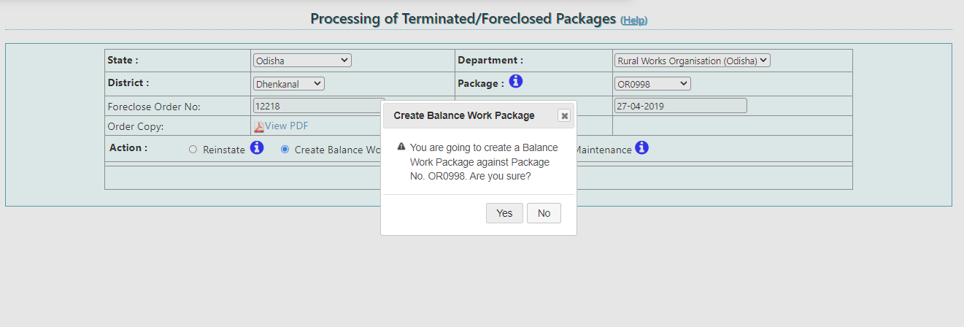
DLP PACKAGE TERMINATION/FORECLOSURE: Action on the Terminated Package
Step5: Click on “Yes” if “Create Balance Work” is selected

Slide 23
DLP PACKAGE TERMINATION/FORECLOSURE: Creating Balance Work for Terminated Package
Who will Create Balance Work for “Terminated Package”?
The PIU Staff will start the process and PIU In-charge will approve the process
How to Create Balance Work?
Step1: eMARG Login of PIU Staff---------> Select “Services for Engineering Staff”

Slide 24
DLP PACKAGE TERMINATION/FORECLOSURE: Creating Balance Work for Terminated Package
Step2: Go to “Package”---------> Select “BW Package & Road Updation”

Slide 25
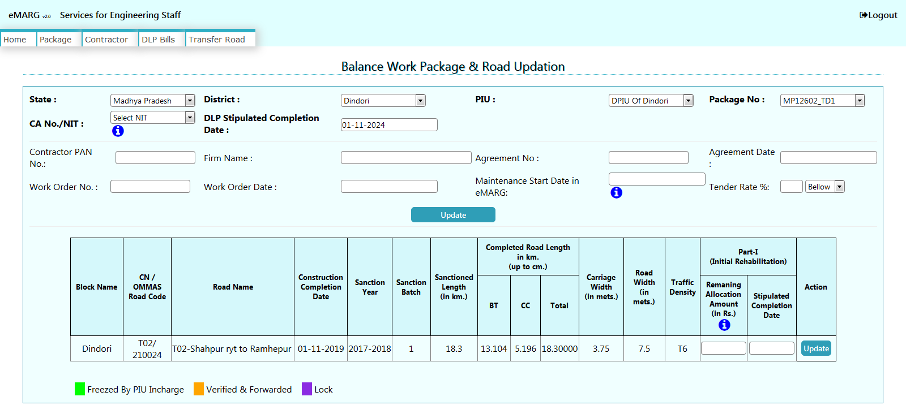
DLP PACKAGE TERMINATION/FORECLOSURE: Creating Balance Work for Terminated Package
Step2:
Select “State”/”District”/”PIU” and Select Package No. (For terminated Package “_TD1” is added in end of the original Package No.)
Update the details of Balance Works
Update the details of Initial Rehabilitation (IR) if applicable

Slide 26
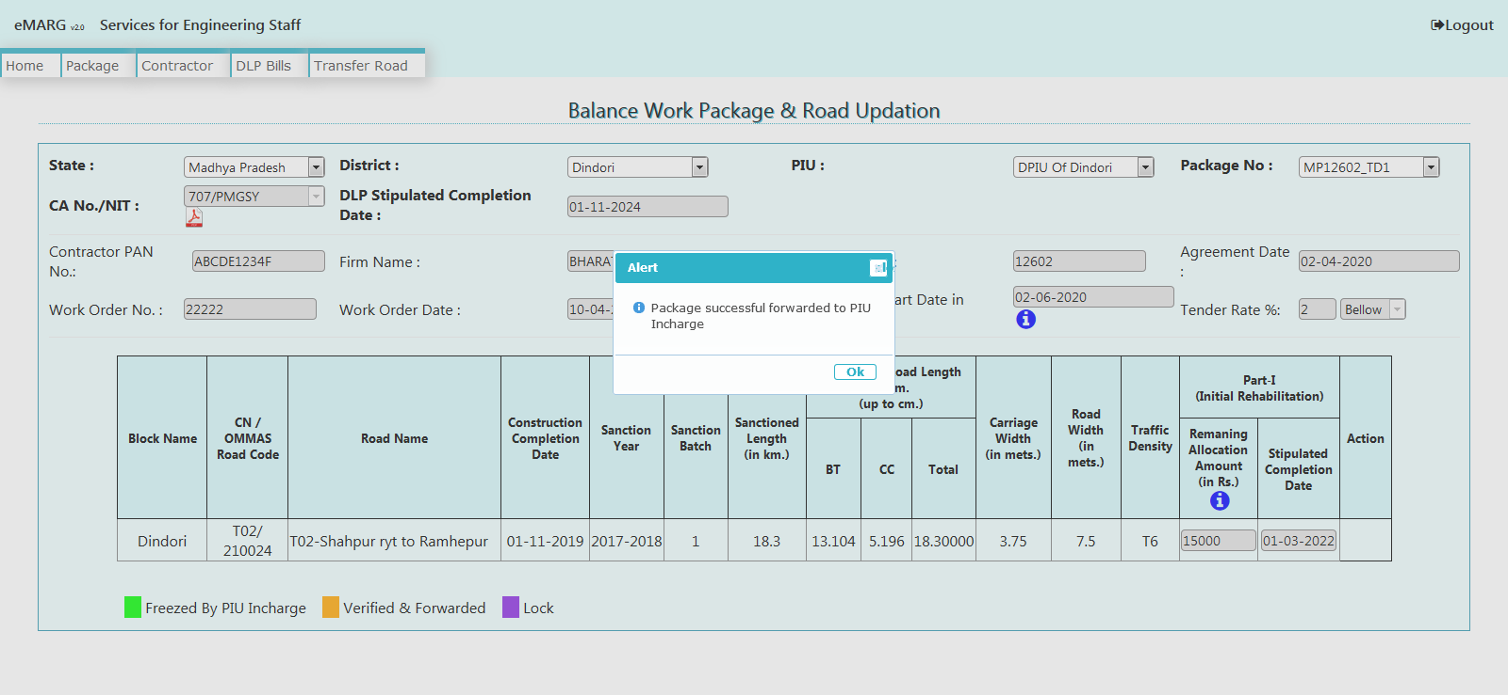
DLP PACKAGE TERMINATION/FORECLOSURE: Creating Balance Work for Terminated Package
Step3: After successful updation of Package Details and Road Details, Verify & Forward button is enabled. Click it to forward the package to PIU In-charge.

Slide 27
DLP PACKAGE TERMINATION/FORECLOSURE: Creating Balance Work for Terminated Package
Step4: Approval of Balance Work Package by PIU In-Charge. Go to “Services for PIU In-charge”

Slide 28
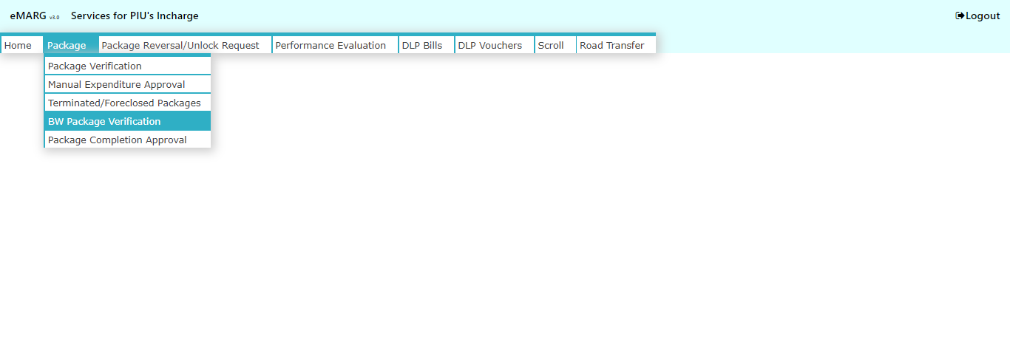
DLP PACKAGE TERMINATION/FORECLOSURE: Creating Balance Work for Terminated Package
Step5: Go to “Package”------>”BW Package Verification”

Slide 29
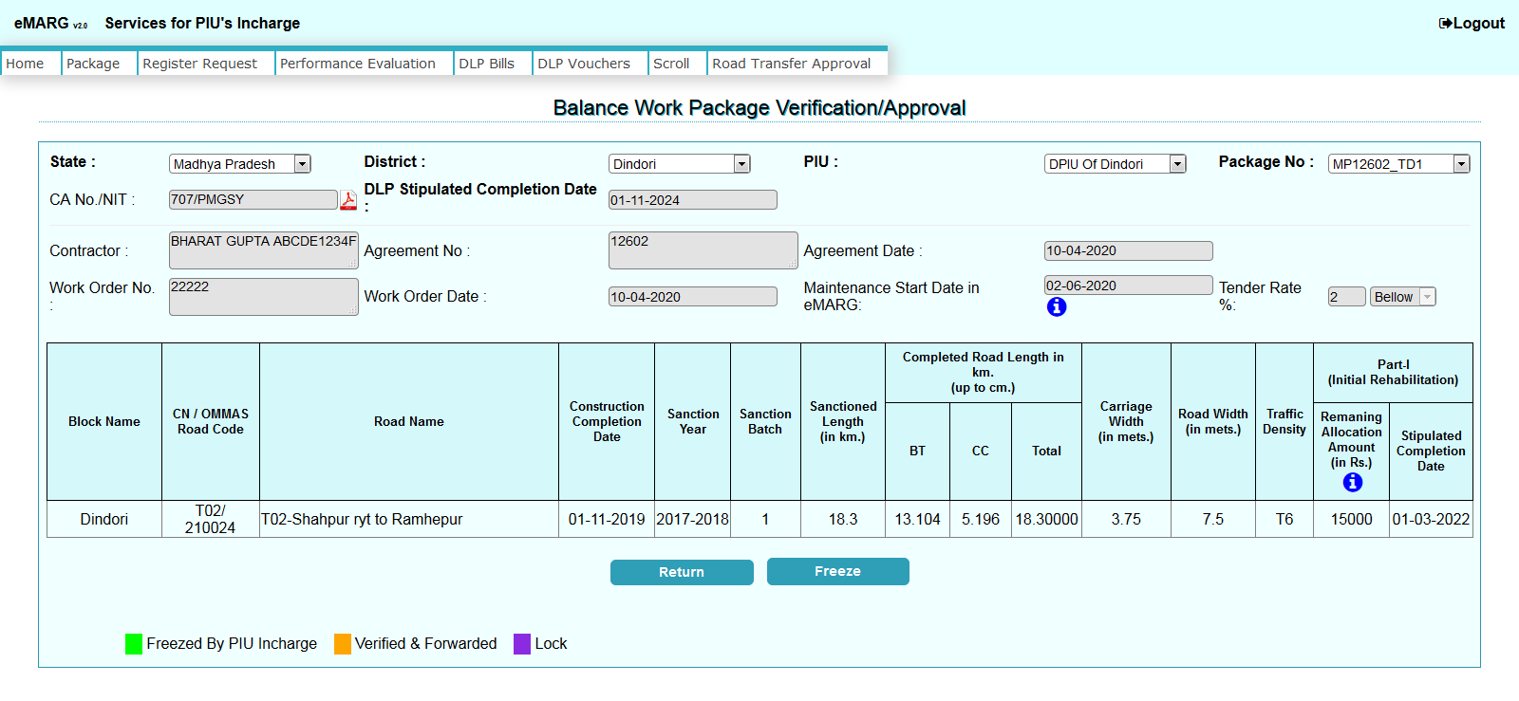
DLP PACKAGE TERMINATION/FORECLOSURE: Creating Balance Work for Terminated Package
Step6: Click on “Freeze” if the details are correct and “Return” if the details are not correct

Slide 30
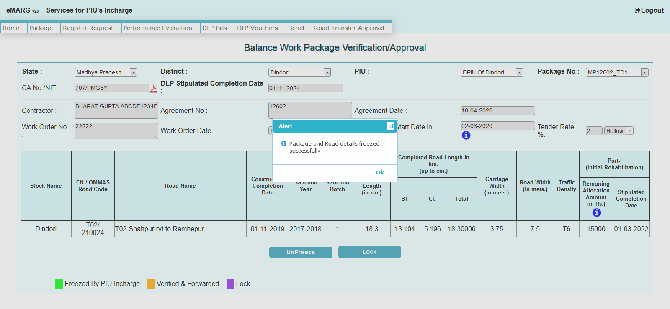
DLP PACKAGE TERMINATION/FORECLOSURE: Creating Balance Work for Terminated Package
Step7: Message will be displayed that Package has been freezed

Slide 31
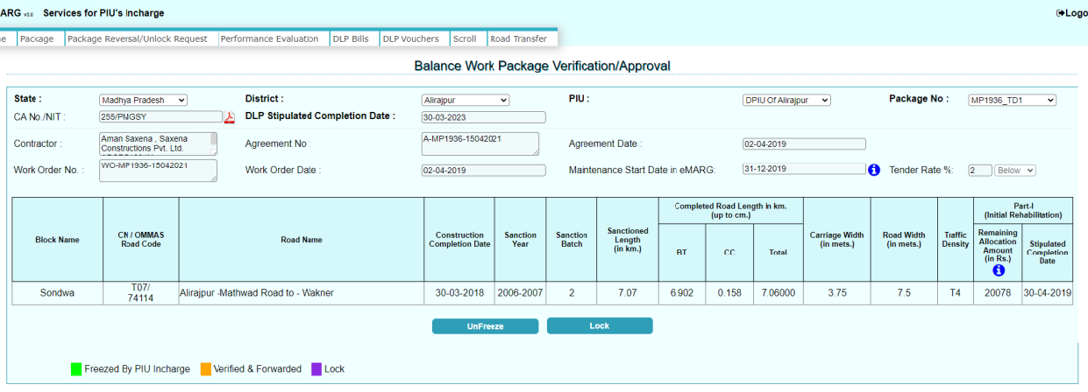
DLP PACKAGE TERMINATION/FORECLOSURE: Creating Balance Work for Terminated Package
Step8: Click on “Lock” if the Details are correct or “Unfreeze” if the details are wrong

Slide 32
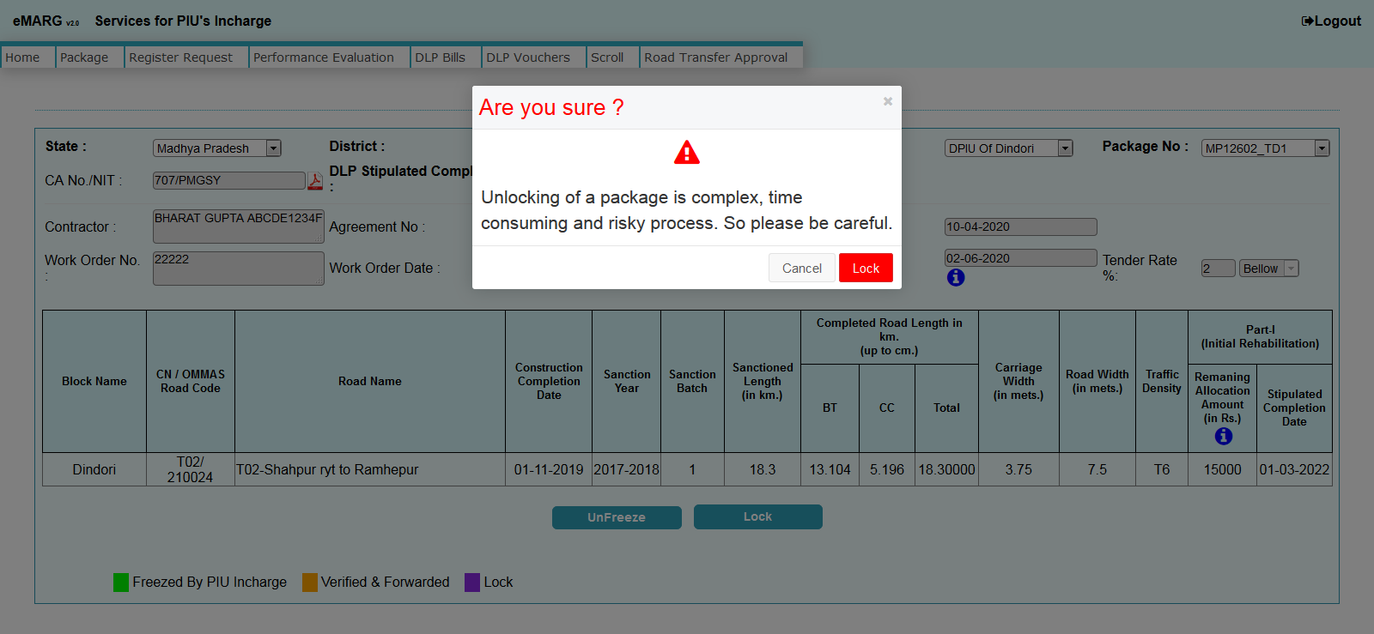
DLP PACKAGE TERMINATION/FORECLOSURE: Creating Balance Work for Terminated Package
Step9: Message will be displayed that “Are you sure?” Click on “Lock” only if you are sure about the information

Slide 33
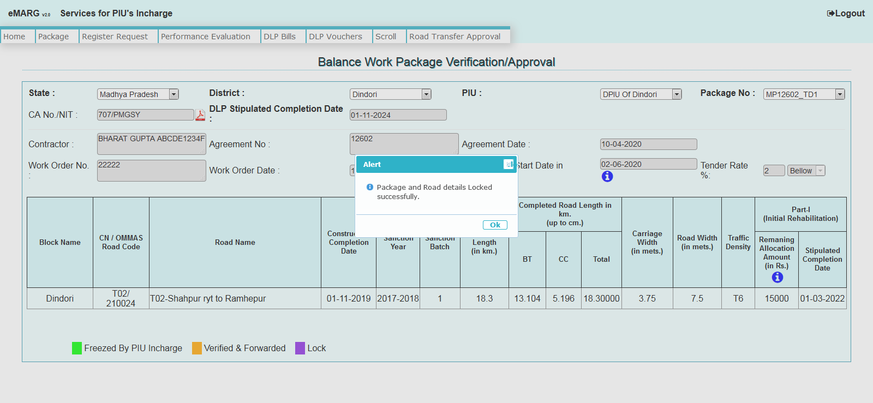
DLP PACKAGE TERMINATION/FORECLOSURE: Creating Balance Work for Terminated Package
Step10: Message will be displayed that “package is Locked successfully”

Slide 34
DLP PACKAGE TERMINATION/FORECLOSURE: Bill Submission of IR (Part-I)
After Locking the Package will be available for Bill submission by the contractor for Routine Maintenance (Part-II) and PIU Staff for IR (Part-I) bill submission
Step1: eMARG Login of PIU Staff---------> Select “Services for Engineering Staff”

Slide 35
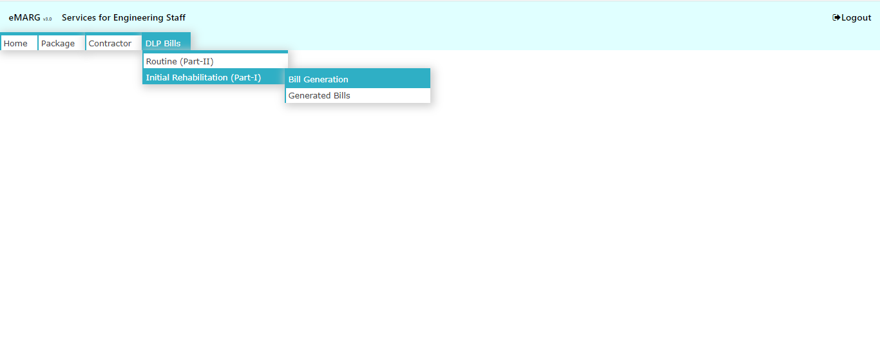
DLP PACKAGE TERMINATION/FORECLOSURE: Bill Submission of IR (Part-I)
Step2: Go to “DLP Bills”------>”Initial Rehabilitation (Part-I)”------>”Bill Generation”

Slide 36
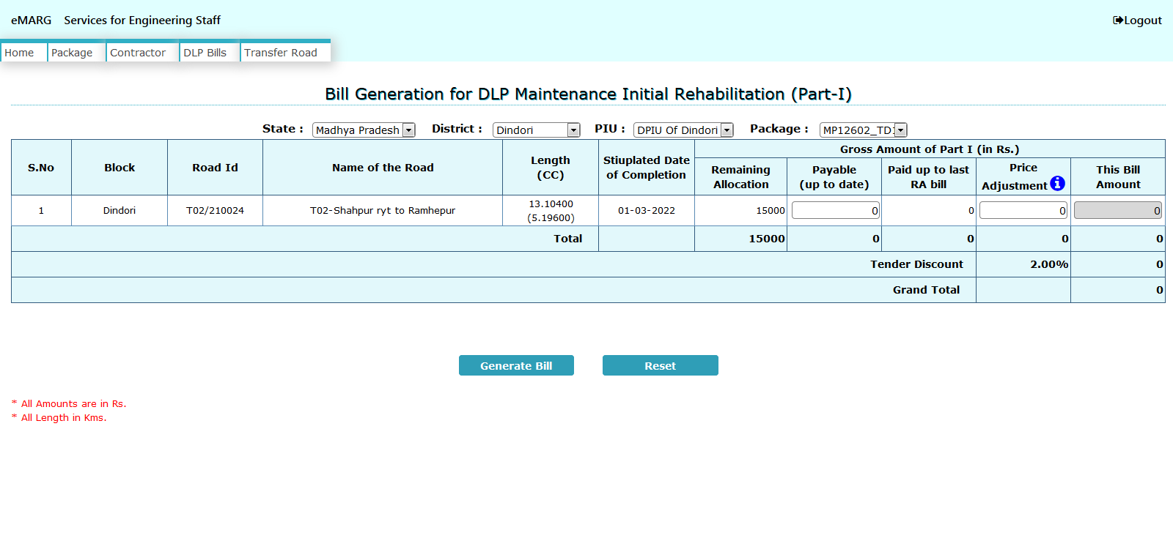
DLP PACKAGE TERMINATION/FORECLOSURE: Bill Submission of IR (Part-I)
Step3: Select Package No. and enter the details and click on “Generate Bill”

Slide 37
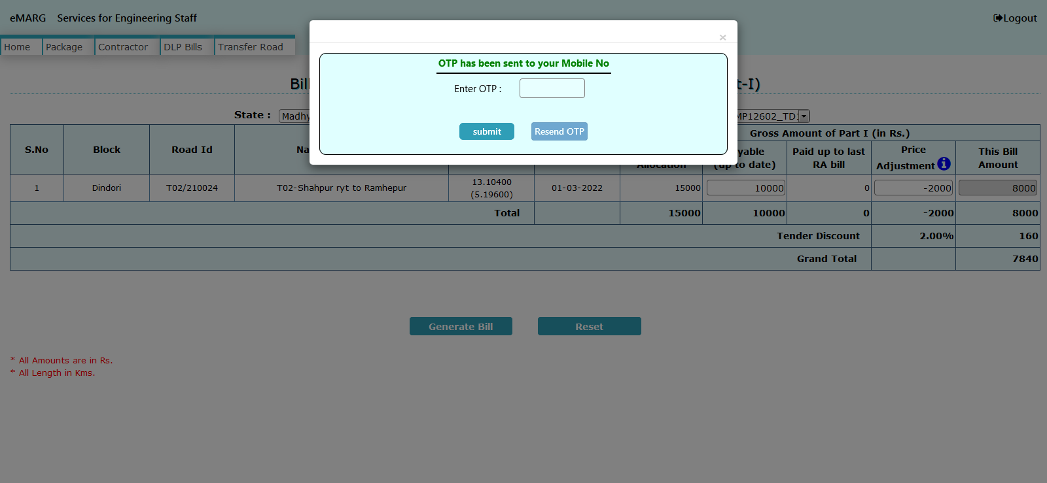
DLP PACKAGE TERMINATION/FORECLOSURE: Bill Submission of IR (Part-I)
Step4: Enter OTP and the bill will be sent to PIU In-charge for approval

Slide 38
DLP PACKAGE TERMINATION/FORECLOSURE: Bill Submission of IR (Part-I)
Step5: Go to “Services for PIU In-charge”

Slide 39
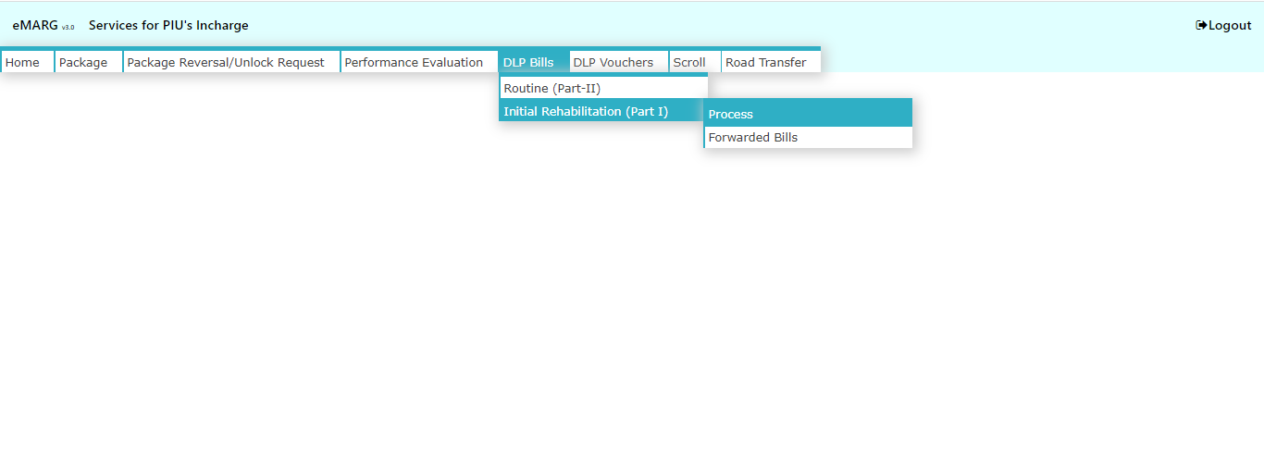
DLP PACKAGE TERMINATION/FORECLOSURE: Bill Submission of IR (Part-I)
Step6: Go to “DLP Bills”------>”Initial Rehabilitation (Part-I)”------>”Process”

Slide 40
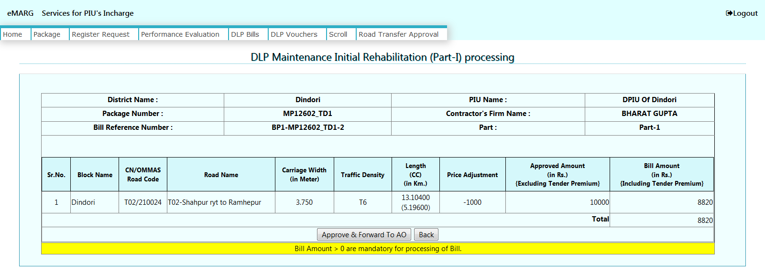
DLP PACKAGE TERMINATION/FORECLOSURE: Bill Submission of IR (Part-I)
Step7: Click on “Approve & Forward to AO”
NOTE: Once a bill is forwarded to AO then the process of voucher and scroll generation is same as that for Routine Maintenance Bills

