Slide 1
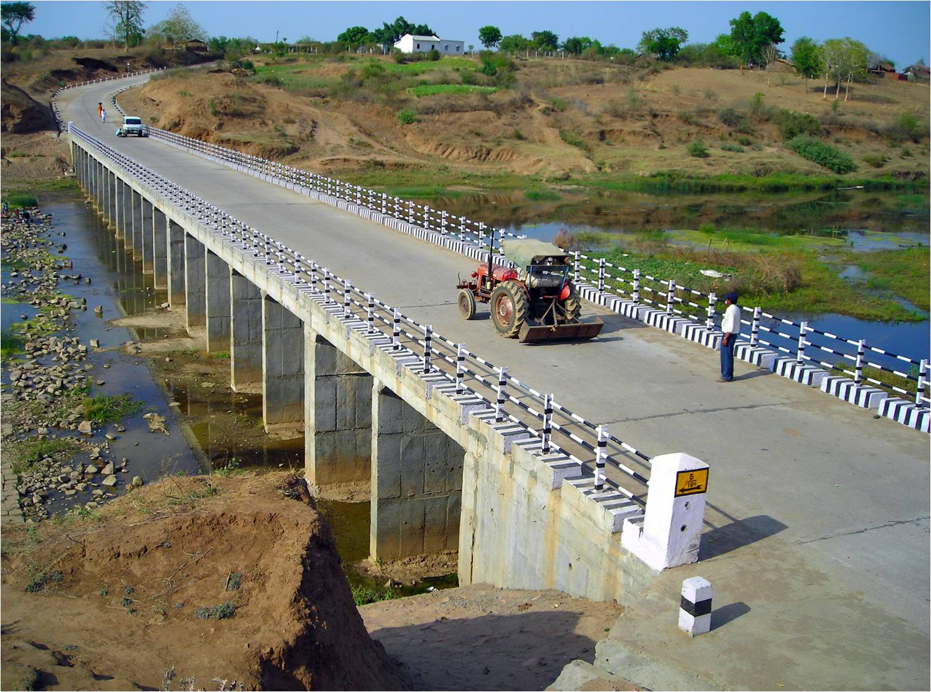
Pradhan Mantri Gram Sadak Yojana
eMARG
(electronic Maintenance of Rural Roads under PMGSY)
eMARG WORK FLOW
THE ROAD TO DIGITAL TRANSFORMATION

Slide 2
eMARG
WORK FLOW
(www.emarg.gov.in)

Slide 3
TYPES OF USERS INVOLVED IN WORKING IN eMARG
SRRDA
DPIU
BANK USER
Chief Engineer/ EinC
PIU Staff (JE/AE/AEE/AM)
IT Nodal Officer (ITNO)
PIU In-charge (EE/GM)
Nodal Maintenance Officer (NMO)
Account Officer (AO)
Finance Controller (FC)

Slide 4
LIST OF ACTIVITIES
NIT CREATION
PACKAGE FREEZING
CONTRACTOR REGISTRATION
LOCKING OF PACKAGE
ROAD REGISTRATION
MANUAL EXPENDITURE
ROUTINE INSPECTION (RI)
BILL SUBMISSION
PERFORMANCE EVALUATION (PE)
BILL VERIFICATION & FORWARD
BILL PROCESSING
VOUCHER GENERATION
SCROLL GENERATION
PACKAGE COMPLETION

Slide 5
NIT CREATION

Slide 6
NIT CREATION
NIT CREATION
What is NIT?
PACKAGE FREEZING
CONTRACTOR REGISTRATION
For every package the amount to be paid to contractor for 5 years is fixed. In contract document the amount for individual 5 years is mentioned.
NIT is the document that is created in eMARG in which the amount to be paid to contractor for individual 5 years is mentioned.
In the later stage, this NIT document is mapped to the package so that the software knows that what amount is to be finally paid to the contractor and accordingly it can generate the monthly bills to be submitted by the contractor
LOCKING OF PACKAGE
ROAD REGISTRATION
MANUAL EXPENDITURE
ROUTINE INSPECTION (RI)
BILL SUBMISSION
PERFORMANCE EVALUATION (PE)
BILL VERIFICATION & FORWARD
Two cases possible for creation of NIT:
BILL PROCESSING
Every individual package has its own rate
NIT needs to be created for every single package
VOUCHER GENERATION
SCROLL GENERATION
Some packages of similar Surface type (BT/CC), CW width and traffic density may have same rates
One NIT can be created for similar types of packages and can be mapped to multiple packages later on
PACKAGE COMPLETION

Slide 7
NIT CREATION
NIT CREATION
Who will create NIT?
PACKAGE FREEZING
NIT will be created by the Nodal Maintenance Officer (NMO) of SRRDA
The rates are to be entered as “per year and per km wise”
CONTRACTOR REGISTRATION
Example:
LOCKING OF PACKAGE
Package No. | Road Name | Sanctioned Length | Year-1 cost | Year-2 Cost | Year-3 Cost | Year-4 Cost | Year-5 Cost
123 | ABC | 10 | 120000 | 130000 | 140000 | 150000 | 160000
ROAD REGISTRATION
MANUAL EXPENDITURE
ROUTINE INSPECTION (RI)
BILL SUBMISSION
Rates to enter in NIT:
Year-1 | =(120000/10) | 12000
Year-2 | =(130000/10) | 13000
Year-3 | =(140000/10) | 14000
Year-4 | =(150000/10) | 15000
Year-5 | =(160000/10) | 16000
PERFORMANCE EVALUATION (PE)
BILL VERIFICATION & FORWARD
BILL PROCESSING
VOUCHER GENERATION
SCROLL GENERATION
If there are more than one roads in a package and per km rate is different for all the roads then at first the package is needed to be split in OMMAS at road level
PACKAGE COMPLETION

Slide 8
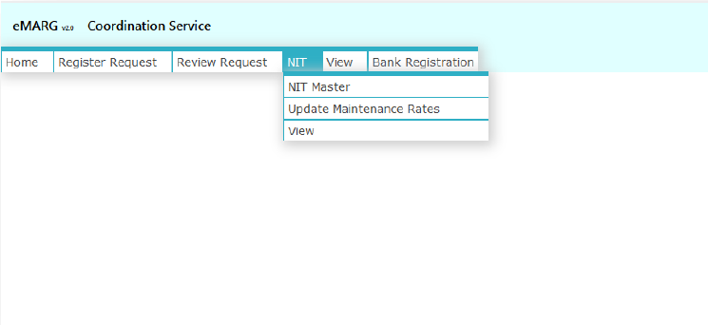
NIT CREATION
NIT CREATION (by NMO)
PACKAGE FREEZING
How to create NIT?
CONTRACTOR REGISTRATION
STEP 1: ADD NIT Master
Entering only the NIT No. and Date for its identification
LOCKING OF PACKAGE
ROAD REGISTRATION
MANUAL EXPENDITURE
1. eMARG Login of NMO------->Go to “NIT”------->Select “NIT Master”
ROUTINE INSPECTION (RI)
BILL SUBMISSION
PERFORMANCE EVALUATION (PE)
BILL VERIFICATION & FORWARD
BILL PROCESSING
VOUCHER GENERATION
SCROLL GENERATION
PACKAGE COMPLETION

Slide 9
NIT CREATION
NIT CREATION (by NMO)
PACKAGE FREEZING
2. Update the CANo./NIT and NIT Date and click on save
CONTRACTOR REGISTRATION
LOCKING OF PACKAGE
ROAD REGISTRATION
MANUAL EXPENDITURE
ROUTINE INSPECTION (RI)
BILL SUBMISSION
PERFORMANCE EVALUATION (PE)
BILL VERIFICATION & FORWARD
BILL PROCESSING
VOUCHER GENERATION
SCROLL GENERATION
PACKAGE COMPLETION

Slide 10
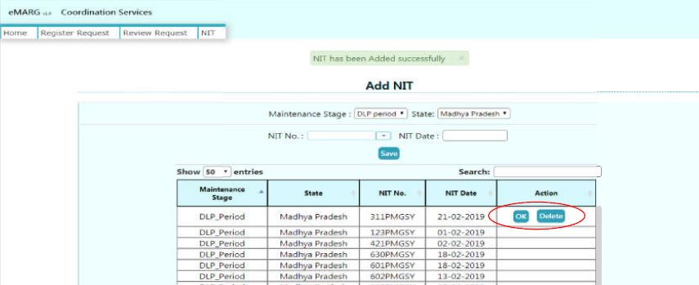
NIT CREATION
NIT CREATION (by NMO)
PACKAGE FREEZING
3. If the entries of NIT No. and NIT Date are correct then click OK or click Delete
CONTRACTOR REGISTRATION
LOCKING OF PACKAGE
ROAD REGISTRATION
MANUAL EXPENDITURE
ROUTINE INSPECTION (RI)
BILL SUBMISSION
PERFORMANCE EVALUATION (PE)
BILL VERIFICATION & FORWARD
BILL PROCESSING
VOUCHER GENERATION
SCROLL GENERATION
PACKAGE COMPLETION

Slide 11
NIT CREATION
NIT CREATION (by NMO)
PACKAGE FREEZING
STEP 2: ENTRY OF MAINTENANCE RATES
Entering the per km per year rates for 5 years
CONTRACTOR REGISTRATION
1. eMARG Login of NMO------->Go to “NIT”------->Select “Update Maintenance Rates”
LOCKING OF PACKAGE
ROAD REGISTRATION
MANUAL EXPENDITURE
ROUTINE INSPECTION (RI)
BILL SUBMISSION
PERFORMANCE EVALUATION (PE)
BILL VERIFICATION & FORWARD
BILL PROCESSING
VOUCHER GENERATION
SCROLL GENERATION
PACKAGE COMPLETION

Slide 12
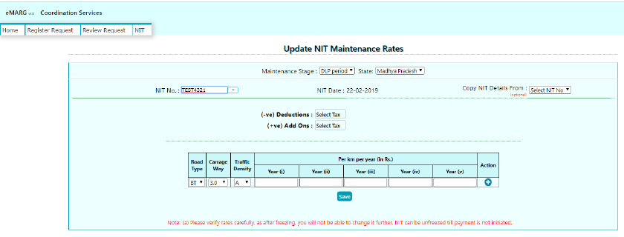
NIT CREATION
NIT CREATION (by NMO)
PACKAGE FREEZING
2. Select NIT No. from Drop down and enter rates
CONTRACTOR REGISTRATION
LOCKING OF PACKAGE
ROAD REGISTRATION
MANUAL EXPENDITURE
ROUTINE INSPECTION (RI)
BILL SUBMISSION
PERFORMANCE EVALUATION (PE)
BILL VERIFICATION & FORWARD
NOTE:
If the per km rates are not fixed already in the contract and if only final lump sum amount for every year is fixed then please divide the lump sum rates by the sanctioned length of the package for which NIT is being entered
BILL PROCESSING
VOUCHER GENERATION
SCROLL GENERATION
PACKAGE COMPLETION

Slide 13
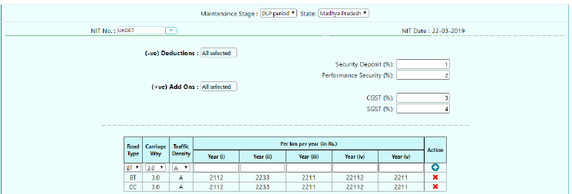
NIT CREATION
NIT CREATION (by NMO)
PACKAGE FREEZING
3. Option of Add Ons and Deductions
CONTRACTOR REGISTRATION
LOCKING OF PACKAGE
ROAD REGISTRATION
MANUAL EXPENDITURE
ROUTINE INSPECTION (RI)
BILL SUBMISSION
PERFORMANCE EVALUATION (PE)
BILL VERIFICATION & FORWARD
(+ve) Add Ons: CGST & SGST
(-ve) Deductions:
Security Deposit & Performance Security
BILL PROCESSING
If the CGST and SGST are not included in the rates entered above and they need to be entered on the overall rate in terms of %, then use the option of (+ve) Add ons
Not applicable for the on going DLP Packages and to be left blank (even if any value is entered then also will not affect the bill amount)
VOUCHER GENERATION
SCROLL GENERATION
PACKAGE COMPLETION

Slide 14
NIT CREATION
NIT CREATION (by NMO)
PACKAGE FREEZING
4. Save the Details
CONTRACTOR REGISTRATION
LOCKING OF PACKAGE
ROAD REGISTRATION
MANUAL EXPENDITURE
ROUTINE INSPECTION (RI)
BILL SUBMISSION
PERFORMANCE EVALUATION (PE)
BILL VERIFICATION & FORWARD
BILL PROCESSING
VOUCHER GENERATION
SCROLL GENERATION
PACKAGE COMPLETION

Slide 15
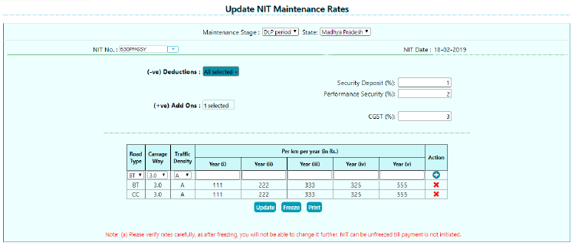
NIT CREATION
NIT CREATION (by NMO)
PACKAGE FREEZING
STEP 3: FREEZING OF NIT
CONTRACTOR REGISTRATION
1. Click on Freeze
LOCKING OF PACKAGE
ROAD REGISTRATION
MANUAL EXPENDITURE
ROUTINE INSPECTION (RI)
BILL SUBMISSION
PERFORMANCE EVALUATION (PE)
BILL VERIFICATION & FORWARD
BILL PROCESSING
VOUCHER GENERATION
SCROLL GENERATION
PACKAGE COMPLETION

Slide 16
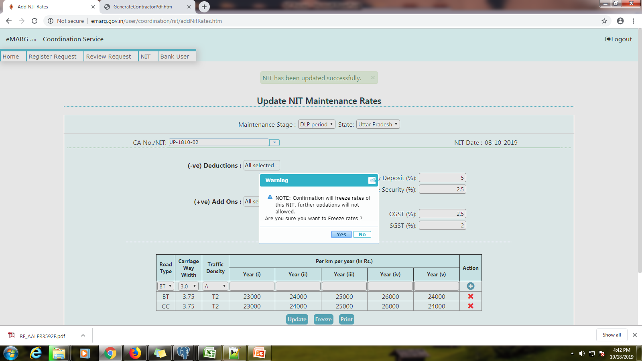
NIT CREATION
NIT CREATION (by NMO)
PACKAGE FREEZING
CONTRACTOR REGISTRATION
LOCKING OF PACKAGE
ROAD REGISTRATION
MANUAL EXPENDITURE
ROUTINE INSPECTION (RI)
BILL SUBMISSION
PERFORMANCE EVALUATION (PE)
BILL VERIFICATION & FORWARD
BILL PROCESSING
VOUCHER GENERATION
SCROLL GENERATION
PACKAGE COMPLETION

Slide 17
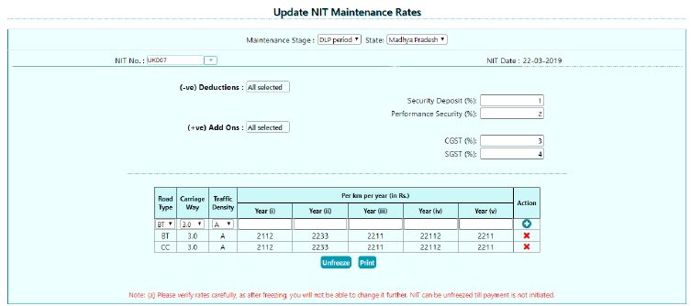
NIT CREATION
NIT CREATION (by NMO)
Freezing of NIT is mandatory before initiating the bill generation process
NIT can be unfreezed (in case the rates have been wrongly entered) till the payment is not initiated
PACKAGE FREEZING
CONTRACTOR REGISTRATION
LOCKING OF PACKAGE
ROAD REGISTRATION
MANUAL EXPENDITURE
ROUTINE INSPECTION (RI)
BILL SUBMISSION
PERFORMANCE EVALUATION (PE)
BILL VERIFICATION & FORWARD
BILL PROCESSING
VOUCHER GENERATION
SCROLL GENERATION
PACKAGE COMPLETION

Slide 18
PACKAGE FREEZING

Slide 19
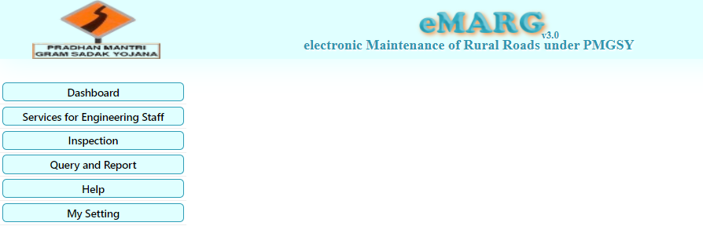
NIT CREATION
FREEZING OF PACKAGE BY PIU STAFF and PIU IN-CHARGE
What is Freezing of Package?
PACKAGE FREEZING
Activities to be performed in Freezing of Package:
Mapping the NIT to the package
Verifying the data of the package
CONTRACTOR REGISTRATION
LOCKING OF PACKAGE
Who will Freeze the Package?
Two Step Process in which the AE/AM/JE (PIU staff) initiates the process and is finally approved by PIU In charge (Executive Engineer)
ROAD REGISTRATION
MANUAL EXPENDITURE
ROUTINE INSPECTION (RI)
How to Freeze the Package?
BILL SUBMISSION
Process Initiation by PIU Staff (AE/AM/JE)
Step1: eMARG Login of AE/AM/JE----------> Select “Services for Engineering Staff”
PERFORMANCE EVALUATION (PE)
BILL VERIFICATION & FORWARD
BILL PROCESSING
VOUCHER GENERATION
SCROLL GENERATION
PACKAGE COMPLETION

Slide 20
NIT CREATION
FREEZING OF PACKAGE BY PIU STAFF and PIU IN-CHARGE
PACKAGE FREEZING
Step2: Go to “Package” ---------->Select “Package & Road Updation”
CONTRACTOR REGISTRATION
LOCKING OF PACKAGE
ROAD REGISTRATION
MANUAL EXPENDITURE
ROUTINE INSPECTION (RI)
BILL SUBMISSION
PERFORMANCE EVALUATION (PE)
BILL VERIFICATION & FORWARD
BILL PROCESSING
VOUCHER GENERATION
SCROLL GENERATION
PACKAGE COMPLETION

Slide 21
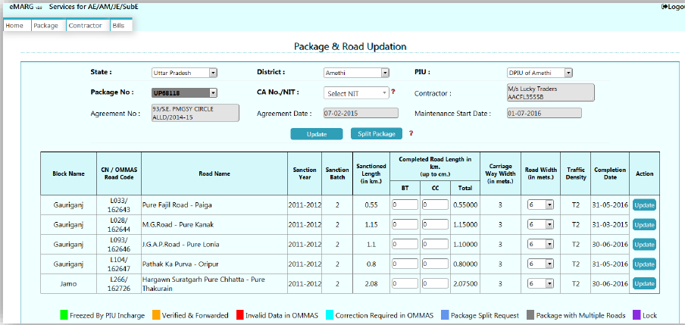
NIT CREATION
FREEZING OF PACKAGE BY PIU STAFF and PIU IN-CHARGE
Step3:
Select “State/District/PIU/Package No.” and then Check every details of the package like Contractor Details, Completion Length, CW width, Traffic Density, Completion Date
If any correction is required in any of the data then do not proceed further and mark that package for correction first
PACKAGE FREEZING
CONTRACTOR REGISTRATION
LOCKING OF PACKAGE
ROAD REGISTRATION
MANUAL EXPENDITURE
ROUTINE INSPECTION (RI)
BILL SUBMISSION
PERFORMANCE EVALUATION (PE)
BILL VERIFICATION & FORWARD
BILL PROCESSING
VOUCHER GENERATION
SCROLL GENERATION
PACKAGE COMPLETION

Slide 22
NIT CREATION
FREEZING OF PACKAGE BY PIU STAFF and PIU IN-CHARGE
How to Mark a Package for correction of Data (BY AM/AE/JE)
PACKAGE FREEZING
Go to “Package” ---------->Select “Correction Required in OMMAS”
CONTRACTOR REGISTRATION
LOCKING OF PACKAGE
ROAD REGISTRATION
MANUAL EXPENDITURE
ROUTINE INSPECTION (RI)
BILL SUBMISSION
PERFORMANCE EVALUATION (PE)
BILL VERIFICATION & FORWARD
BILL PROCESSING
VOUCHER GENERATION
SCROLL GENERATION
PACKAGE COMPLETION

Slide 23
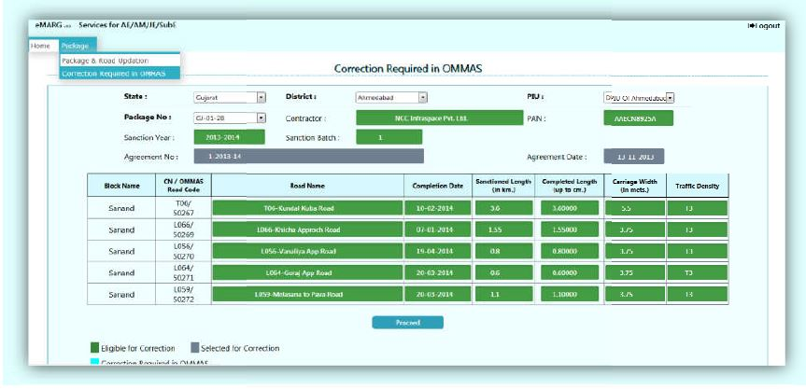
NIT CREATION
FREEZING OF PACKAGE BY PIU STAFF and PIU IN-CHARGE
PACKAGE FREEZING
CONTRACTOR REGISTRATION
LOCKING OF PACKAGE
ROAD REGISTRATION
MANUAL EXPENDITURE
ROUTINE INSPECTION (RI)
BILL SUBMISSION
PERFORMANCE EVALUATION (PE)
BILL VERIFICATION & FORWARD
BILL PROCESSING
Fields which are eligible for correction are marked in green
Select any field and the colour of the field will change to grey
VOUCHER GENERATION
SCROLL GENERATION
PACKAGE COMPLETION

Slide 24
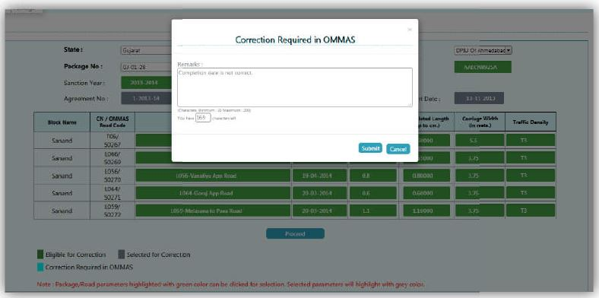
NIT CREATION
FREEZING OF PACKAGE BY PIU STAFF and PIU IN-CHARGE
PACKAGE FREEZING
CONTRACTOR REGISTRATION
LOCKING OF PACKAGE
ROAD REGISTRATION
MANUAL EXPENDITURE
ROUTINE INSPECTION (RI)
BILL SUBMISSION
PERFORMANCE EVALUATION (PE)
BILL VERIFICATION & FORWARD
BILL PROCESSING
Add the remarks and submit
VOUCHER GENERATION
SCROLL GENERATION
PACKAGE COMPLETION

Slide 25
NIT CREATION
FREEZING OF PACKAGE BY PIU STAFF and PIU IN-CHARGE
Step4: If all details are correct and no correction is required in any data
Select “State/District/PIU/Package No.” ------>Select “Correct NIT from dropdown”-----> Click “Update”
PACKAGE FREEZING
CONTRACTOR REGISTRATION
LOCKING OF PACKAGE
ROAD REGISTRATION
MANUAL EXPENDITURE
ROUTINE INSPECTION (RI)
BILL SUBMISSION
PERFORMANCE EVALUATION (PE)
BILL VERIFICATION & FORWARD
BILL PROCESSING
VOUCHER GENERATION
SCROLL GENERATION
PACKAGE COMPLETION

Slide 26
NIT CREATION
FREEZING OF PACKAGE BY PIU STAFF and PIU IN-CHARGE
PACKAGE FREEZING
Step5: For each road
Enter “BT Length & CC Length”------>Select “Road Width”--------> Click on “Update”
CONTRACTOR REGISTRATION
LOCKING OF PACKAGE
ROAD REGISTRATION
MANUAL EXPENDITURE
ROUTINE INSPECTION (RI)
BILL SUBMISSION
PERFORMANCE EVALUATION (PE)
BILL VERIFICATION & FORWARD
BILL PROCESSING
VOUCHER GENERATION
SCROLL GENERATION
PACKAGE COMPLETION

Slide 27
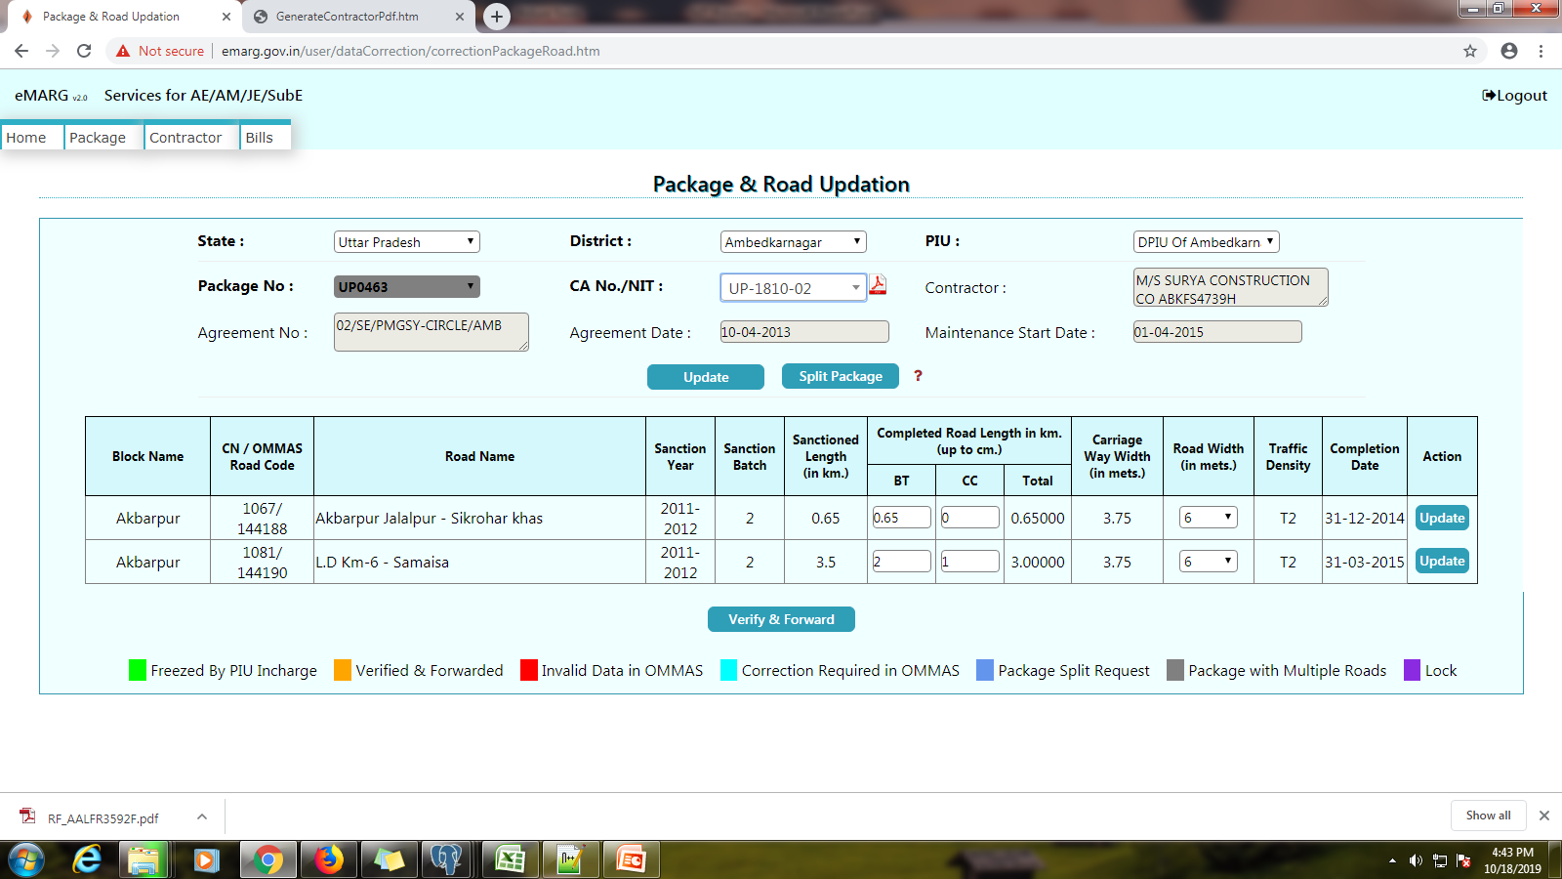
NIT CREATION
FREEZING OF PACKAGE BY PIU STAFF and PIU IN-CHARGE
PACKAGE FREEZING
Step6: Click on “Verify & Forward” to send it for approval of PIU In-charge
CONTRACTOR REGISTRATION
LOCKING OF PACKAGE
ROAD REGISTRATION
MANUAL EXPENDITURE
ROUTINE INSPECTION (RI)
BILL SUBMISSION
PERFORMANCE EVALUATION (PE)
BILL VERIFICATION & FORWARD
BILL PROCESSING
VOUCHER GENERATION
SCROLL GENERATION
PACKAGE COMPLETION

Slide 28
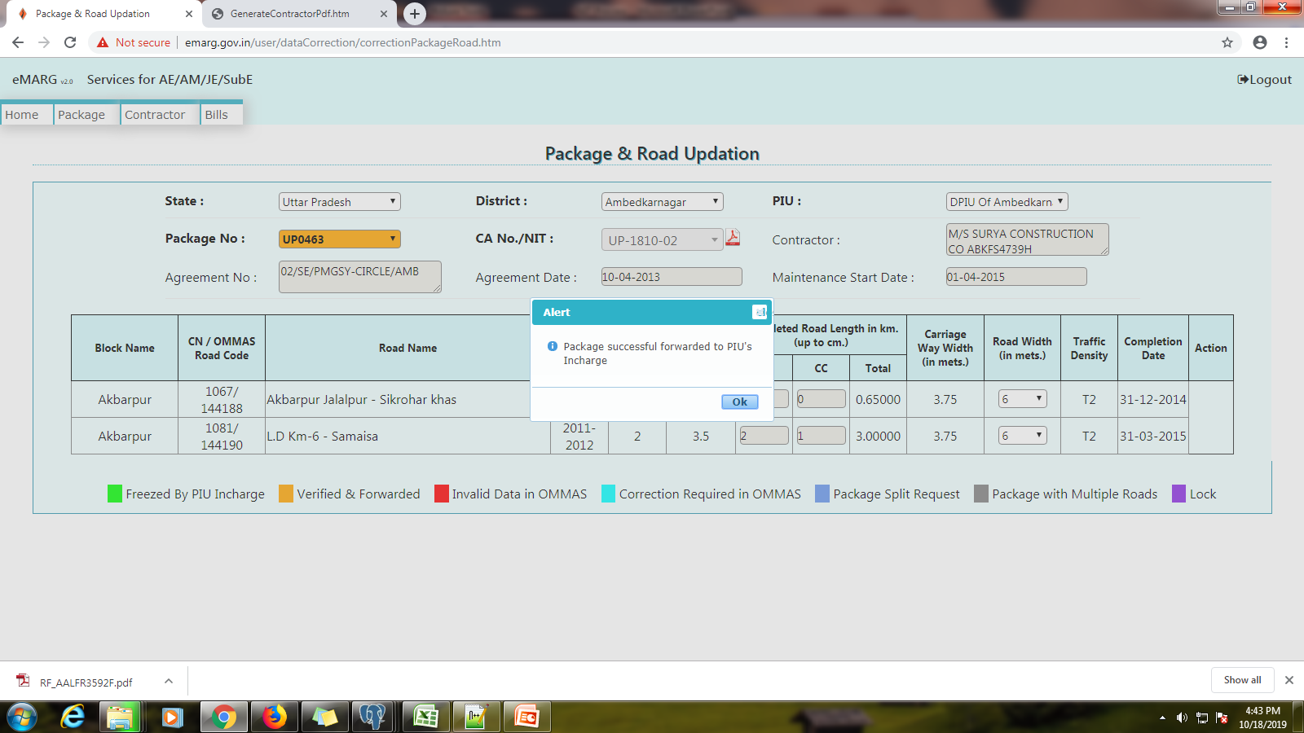
NIT CREATION
FREEZING OF PACKAGE BY PIU STAFF and PIU IN-CHARGE
PACKAGE FREEZING
CONTRACTOR REGISTRATION
LOCKING OF PACKAGE
ROAD REGISTRATION
MANUAL EXPENDITURE
ROUTINE INSPECTION (RI)
BILL SUBMISSION
PERFORMANCE EVALUATION (PE)
BILL VERIFICATION & FORWARD
BILL PROCESSING
VOUCHER GENERATION
SCROLL GENERATION
PACKAGE COMPLETION

Slide 29
NIT CREATION
FREEZING OF PACKAGE BY PIU STAFF and PIU IN-CHARGE
Process Finalization by PIU In-charge (EE/GM)
PACKAGE FREEZING
Step1: eMARG Login of PIU In-charge---------> Select “Services for PIU Incharge”
CONTRACTOR REGISTRATION
LOCKING OF PACKAGE
ROAD REGISTRATION
MANUAL EXPENDITURE
ROUTINE INSPECTION (RI)
BILL SUBMISSION
PERFORMANCE EVALUATION (PE)
BILL VERIFICATION & FORWARD
BILL PROCESSING
VOUCHER GENERATION
SCROLL GENERATION
PACKAGE COMPLETION

Slide 30
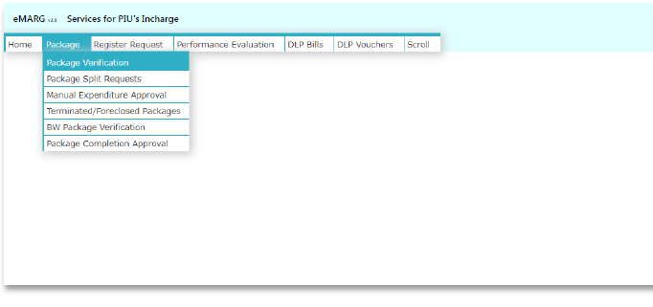
NIT CREATION
FREEZING OF PACKAGE BY PIU STAFF and PIU IN-CHARGE
PACKAGE FREEZING
Step2: Go to “Package” ---------> Select “Package Verification”
CONTRACTOR REGISTRATION
LOCKING OF PACKAGE
ROAD REGISTRATION
MANUAL EXPENDITURE
ROUTINE INSPECTION (RI)
BILL SUBMISSION
PERFORMANCE EVALUATION (PE)
BILL VERIFICATION & FORWARD
BILL PROCESSING
VOUCHER GENERATION
SCROLL GENERATION
PACKAGE COMPLETION

Slide 31
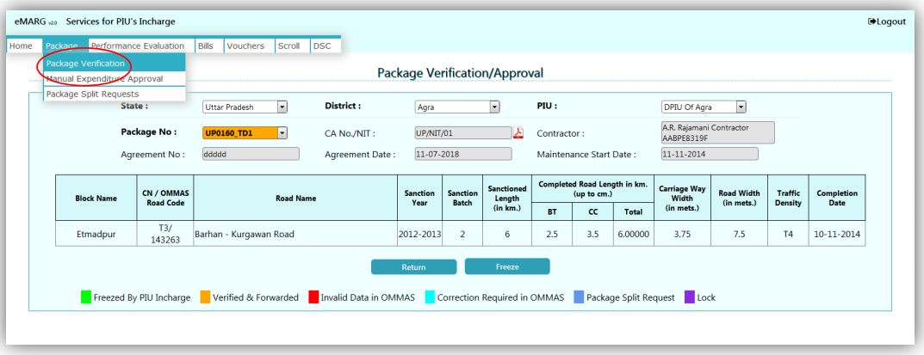
NIT CREATION
FREEZING OF PACKAGE BY PIU STAFF and PIU IN-CHARGE
Step3:
If all details are correct ---------> Select “Freeze”
or if any of the details is wrong------> Select “Return”
PACKAGE FREEZING
CONTRACTOR REGISTRATION
LOCKING OF PACKAGE
ROAD REGISTRATION
MANUAL EXPENDITURE
ROUTINE INSPECTION (RI)
BILL SUBMISSION
PERFORMANCE EVALUATION (PE)
BILL VERIFICATION & FORWARD
BILL PROCESSING
VOUCHER GENERATION
SCROLL GENERATION
PACKAGE COMPLETION

Slide 32
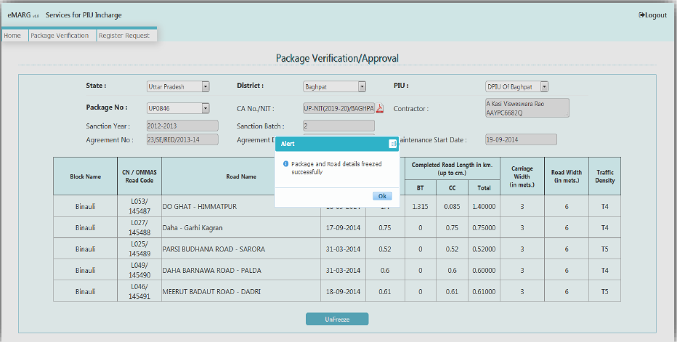
NIT CREATION
FREEZING OF PACKAGE BY PIU STAFF and PIU IN-CHARGE
PACKAGE FREEZING
CONTRACTOR REGISTRATION
LOCKING OF PACKAGE
ROAD REGISTRATION
MANUAL EXPENDITURE
ROUTINE INSPECTION (RI)
BILL SUBMISSION
PERFORMANCE EVALUATION (PE)
BILL VERIFICATION & FORWARD
BILL PROCESSING
VOUCHER GENERATION
SCROLL GENERATION
PACKAGE COMPLETION

Slide 33
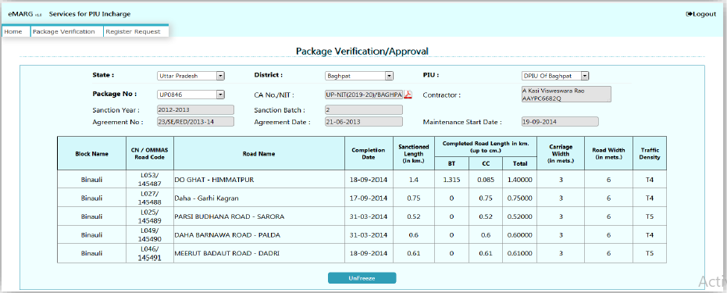
NIT CREATION
FREEZING OF PACKAGE BY PIU STAFF and PIU IN-CHARGE
If after freezing of package, PIU In-charge wants to un-freeze the package if he finds that he has wrongly freeze the package then he can do that
PACKAGE FREEZING
CONTRACTOR REGISTRATION
LOCKING OF PACKAGE
ROAD REGISTRATION
MANUAL EXPENDITURE
ROUTINE INSPECTION (RI)
BILL SUBMISSION
PERFORMANCE EVALUATION (PE)
BILL VERIFICATION & FORWARD
BILL PROCESSING
VOUCHER GENERATION
SCROLL GENERATION
PACKAGE COMPLETION

Slide 34
CONTRACTOR REGISTRATION

Slide 35
NIT CREATION
CONTRACTOR REGISTRATION
PACKAGE FREEZING
What is Contractor Registration?
Activities to be performed in Contractor Registration:
Entering the details of Bank like Bank Name, Branch Name, IFSC Code, Bank account No., etc of the contractor
Creating the login ID of the contractor
One Pre-requisite of contractor registration is that at least one of the packages of the contractor should be freezed
CONTRACTOR REGISTRATION
LOCKING OF PACKAGE
ROAD REGISTRATION
MANUAL EXPENDITURE
ROUTINE INSPECTION (RI)
Who will do the Contractor Registration?
BILL SUBMISSION
The contractor has to go to any of the PIUs where his maintenance work is being carried out
The PIU staff(AE/AM/JE) will do the registration of the contractor
The ITNO will approve the Login ID and Password of the contractor
PERFORMANCE EVALUATION (PE)
BILL VERIFICATION & FORWARD
Note:
If a contractor is working in multiple districts in a state, then he needs to register himself only once by going to any of the PIUs
If a contractor is working in multiple states, then he has register in all the states separately in which he is working
BILL PROCESSING
VOUCHER GENERATION
SCROLL GENERATION
PACKAGE COMPLETION

Slide 36
NIT CREATION
CONTRACTOR REGISTRATION
How to Register the Contractor?
PACKAGE FREEZING
Step1: eMARG Login of AE/AM/JE----------> Select “Services for Engineering Staff”
CONTRACTOR REGISTRATION
LOCKING OF PACKAGE
ROAD REGISTRATION
MANUAL EXPENDITURE
ROUTINE INSPECTION (RI)
BILL SUBMISSION
PERFORMANCE EVALUATION (PE)
BILL VERIFICATION & FORWARD
BILL PROCESSING
VOUCHER GENERATION
SCROLL GENERATION
PACKAGE COMPLETION

Slide 37
NIT CREATION
CONTRACTOR REGISTRATION
Step2: Go to “Contractor”----------> Select “Registration”
PACKAGE FREEZING
CONTRACTOR REGISTRATION
LOCKING OF PACKAGE
ROAD REGISTRATION
MANUAL EXPENDITURE
ROUTINE INSPECTION (RI)
BILL SUBMISSION
PERFORMANCE EVALUATION (PE)
BILL VERIFICATION & FORWARD
Step3: Enter PAN No. of the contractor and click on “Submit”
BILL PROCESSING
VOUCHER GENERATION
SCROLL GENERATION
PACKAGE COMPLETION

Slide 38
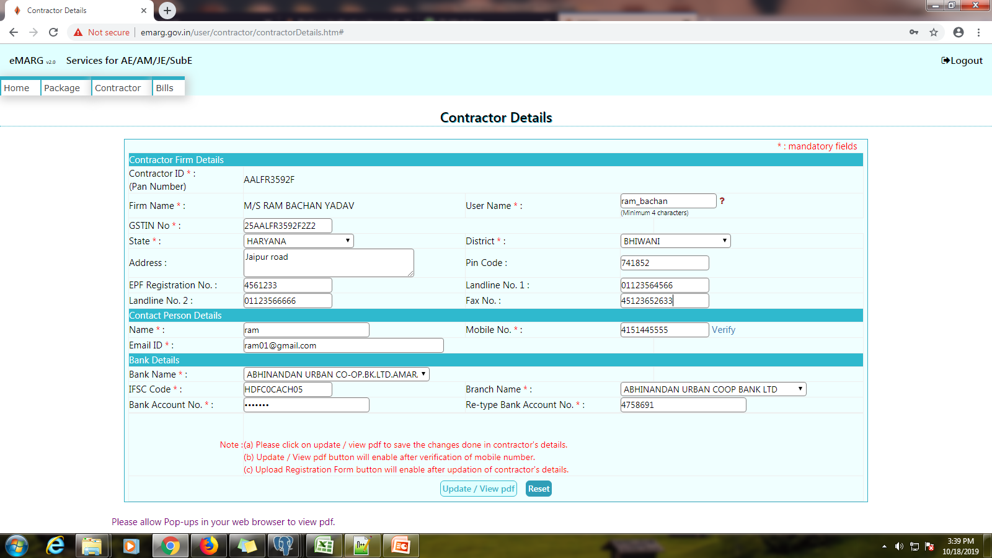
NIT CREATION
CONTRACTOR REGISTRATION
PACKAGE FREEZING
Step4: Enter Required Details and click on “Update/View PDF”
CONTRACTOR REGISTRATION
LOCKING OF PACKAGE
ROAD REGISTRATION
MANUAL EXPENDITURE
ROUTINE INSPECTION (RI)
BILL SUBMISSION
PERFORMANCE EVALUATION (PE)
BILL VERIFICATION & FORWARD
BILL PROCESSING
Create user ID
VOUCHER GENERATION
SCROLL GENERATION
PACKAGE COMPLETION

Slide 39
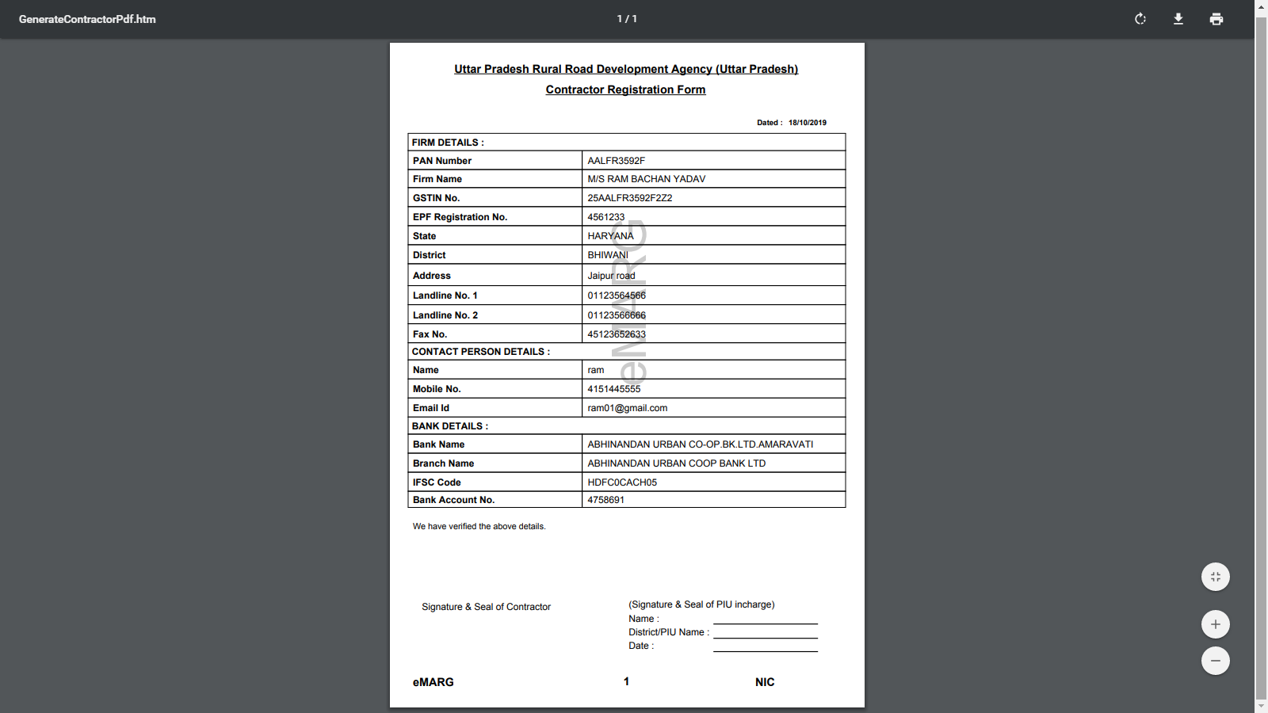
NIT CREATION
CONTRACTOR REGISTRATION
Step5: Save the PDF file and get it signed from contractor and PIU
PACKAGE FREEZING
CONTRACTOR REGISTRATION
LOCKING OF PACKAGE
ROAD REGISTRATION
MANUAL EXPENDITURE
ROUTINE INSPECTION (RI)
BILL SUBMISSION
PERFORMANCE EVALUATION (PE)
BILL VERIFICATION & FORWARD
BILL PROCESSING
VOUCHER GENERATION
SCROLL GENERATION
PACKAGE COMPLETION

Slide 40
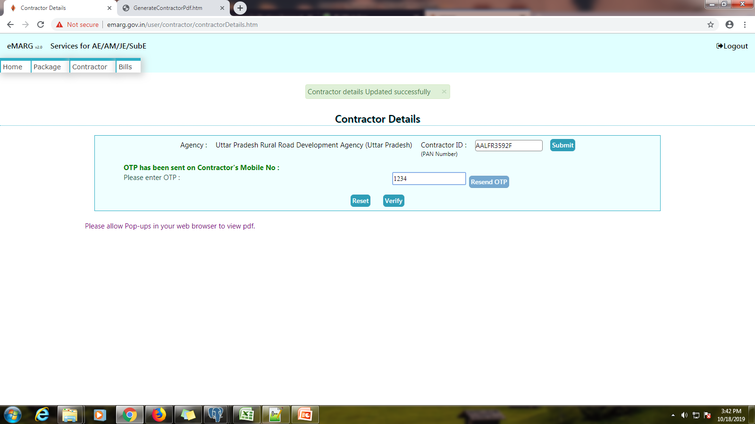
NIT CREATION
CONTRACTOR REGISTRATION
Step6:
The same PIU staff which has started the process has to again login and enter the PAN No. of the contractor
The contractor will be sent an OTP on his registered No. which needs to be entered
PACKAGE FREEZING
CONTRACTOR REGISTRATION
LOCKING OF PACKAGE
ROAD REGISTRATION
MANUAL EXPENDITURE
ROUTINE INSPECTION (RI)
BILL SUBMISSION
PERFORMANCE EVALUATION (PE)
BILL VERIFICATION & FORWARD
BILL PROCESSING
VOUCHER GENERATION
SCROLL GENERATION
PACKAGE COMPLETION

Slide 41
NIT CREATION
CONTRACTOR REGISTRATION
Step7: Click on “Create User ID”
PACKAGE FREEZING
CONTRACTOR REGISTRATION
LOCKING OF PACKAGE
ROAD REGISTRATION
MANUAL EXPENDITURE
ROUTINE INSPECTION (RI)
BILL SUBMISSION
PERFORMANCE EVALUATION (PE)
BILL VERIFICATION & FORWARD
Create user ID
BILL PROCESSING
VOUCHER GENERATION
SCROLL GENERATION
PACKAGE COMPLETION

Slide 42
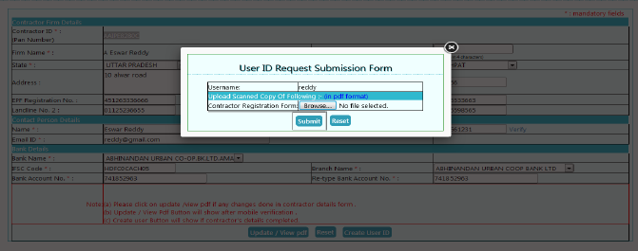
NIT CREATION
CONTRACTOR REGISTRATION
Step8: Enter the user name for contractor and upload the PDF signed by contractor and PIU In-charge and click on “Submit”
PACKAGE FREEZING
CONTRACTOR REGISTRATION
LOCKING OF PACKAGE
ROAD REGISTRATION
MANUAL EXPENDITURE
ROUTINE INSPECTION (RI)
BILL SUBMISSION
PERFORMANCE EVALUATION (PE)
BILL VERIFICATION & FORWARD
BILL PROCESSING
VOUCHER GENERATION
SCROLL GENERATION
PACKAGE COMPLETION

Slide 43
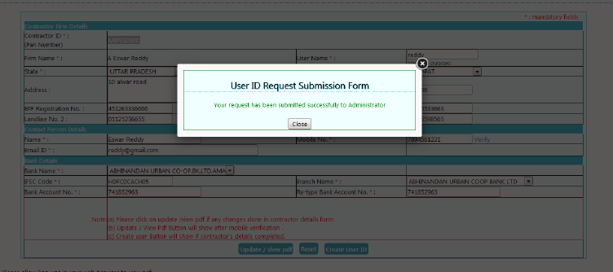
NIT CREATION
CONTRACTOR REGISTRATION
Step9: The user creation request will be sent to ITNO login and he has to approve the same
PACKAGE FREEZING
CONTRACTOR REGISTRATION
LOCKING OF PACKAGE
ROAD REGISTRATION
MANUAL EXPENDITURE
ROUTINE INSPECTION (RI)
BILL SUBMISSION
PERFORMANCE EVALUATION (PE)
BILL VERIFICATION & FORWARD
BILL PROCESSING
VOUCHER GENERATION
SCROLL GENERATION
PACKAGE COMPLETION

Slide 44
NIT CREATION
CONTRACTOR REGISTRATION
Option of updating the bank details like Name, Account No., etc after the registration of contractor is done
PACKAGE FREEZING
CONTRACTOR REGISTRATION
Step1: eMARG Login of AE/AM/JE----------> Select “Services for Engineering Staff”
LOCKING OF PACKAGE
ROAD REGISTRATION
MANUAL EXPENDITURE
ROUTINE INSPECTION (RI)
BILL SUBMISSION
PERFORMANCE EVALUATION (PE)
BILL VERIFICATION & FORWARD
BILL PROCESSING
VOUCHER GENERATION
SCROLL GENERATION
PACKAGE COMPLETION

Slide 45
NIT CREATION
CONTRACTOR REGISTRATION
Option of updating the bank details like Name, Account No., etc after the registration of contractor is done
PACKAGE FREEZING
CONTRACTOR REGISTRATION
Step1: eMARG Login of AE/AM/JE----------> Select “Services for Engineering Staff”
LOCKING OF PACKAGE
ROAD REGISTRATION
MANUAL EXPENDITURE
ROUTINE INSPECTION (RI)
BILL SUBMISSION
PERFORMANCE EVALUATION (PE)
BILL VERIFICATION & FORWARD
BILL PROCESSING
VOUCHER GENERATION
SCROLL GENERATION
PACKAGE COMPLETION

Slide 46
NIT CREATION
CONTRACTOR REGISTRATION
Step2: Go to “Contractor”----------> Select “Update Details”
PACKAGE FREEZING
CONTRACTOR REGISTRATION
LOCKING OF PACKAGE
ROAD REGISTRATION
MANUAL EXPENDITURE
ROUTINE INSPECTION (RI)
BILL SUBMISSION
PERFORMANCE EVALUATION (PE)
BILL VERIFICATION & FORWARD
Step3: Enter PAN No. of the contractor and click on “Submit”
BILL PROCESSING
VOUCHER GENERATION
SCROLL GENERATION
PACKAGE COMPLETION

Slide 47
NIT CREATION
CONTRACTOR REGISTRATION
PACKAGE FREEZING
Rest All process is same
CONTRACTOR REGISTRATION
LOCKING OF PACKAGE
ROAD REGISTRATION
MANUAL EXPENDITURE
ROUTINE INSPECTION (RI)
BILL SUBMISSION
PERFORMANCE EVALUATION (PE)
BILL VERIFICATION & FORWARD
BILL PROCESSING
Create user ID
VOUCHER GENERATION
SCROLL GENERATION
PACKAGE COMPLETION

Slide 48
LOCKING OF PACKAGE

Slide 49
NIT CREATION
LOCKING OF PACKAGE
PACKAGE FREEZING
What is Locking of Package?
The final verification of the package that all the data of package is correct and the package can now proceed further towards making payment
Unless the contractor of the package is not registered, the package can not be locked
CONTRACTOR REGISTRATION
LOCKING OF PACKAGE
Who will do the Locking of Package?
ROAD REGISTRATION
The PIU In-charge has to lock the package
MANUAL EXPENDITURE
How to do the Locking of Package?
ROUTINE INSPECTION (RI)
BILL SUBMISSION
Step1: eMARG Login of PIU In-charge---------> Select “Services for PIU Incharge”
PERFORMANCE EVALUATION (PE)
BILL VERIFICATION & FORWARD
BILL PROCESSING
VOUCHER GENERATION
SCROLL GENERATION
PACKAGE COMPLETION

Slide 50
NIT CREATION
LOCKING OF PACKAGE
PACKAGE FREEZING
Step2: Go to “Package” ---------> Select “Package Verification”
CONTRACTOR REGISTRATION
LOCKING OF PACKAGE
ROAD REGISTRATION
MANUAL EXPENDITURE
ROUTINE INSPECTION (RI)
BILL SUBMISSION
PERFORMANCE EVALUATION (PE)
BILL VERIFICATION & FORWARD
BILL PROCESSING
VOUCHER GENERATION
SCROLL GENERATION
PACKAGE COMPLETION

Slide 51
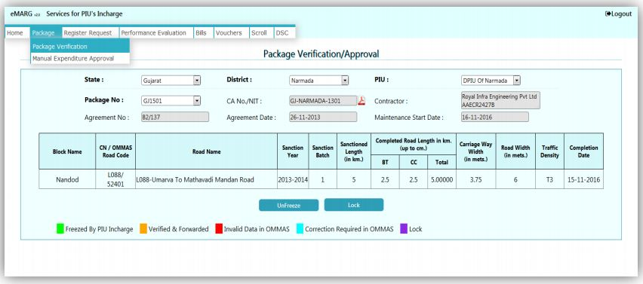
NIT CREATION
LOCKING OF PACKAGE
PACKAGE FREEZING
Step3: Select the Package No and click on “Lock”
CONTRACTOR REGISTRATION
LOCKING OF PACKAGE
ROAD REGISTRATION
MANUAL EXPENDITURE
ROUTINE INSPECTION (RI)
BILL SUBMISSION
PERFORMANCE EVALUATION (PE)
BILL VERIFICATION & FORWARD
BILL PROCESSING
VOUCHER GENERATION
SCROLL GENERATION
PACKAGE COMPLETION

Slide 52
NIT CREATION
UNLOCKING OF PACKAGE
PACKAGE FREEZING
Option of Unlocking the Package in case any data needs to be corrected even after locking of package is done
Unlocking of Package can be done only if the scroll has not been generated for the package
CONTRACTOR REGISTRATION
LOCKING OF PACKAGE
Step1: eMARG Login of PIU In-charge---------> Select “Services for PIU Incharge”
ROAD REGISTRATION
MANUAL EXPENDITURE
ROUTINE INSPECTION (RI)
BILL SUBMISSION
PERFORMANCE EVALUATION (PE)
BILL VERIFICATION & FORWARD
BILL PROCESSING
VOUCHER GENERATION
SCROLL GENERATION
PACKAGE COMPLETION

Slide 53
NIT CREATION
UNLOCKING OF PACKAGE
PACKAGE FREEZING
Step2: Select “Package Reversal/Unlock Request”
CONTRACTOR REGISTRATION
LOCKING OF PACKAGE
ROAD REGISTRATION
MANUAL EXPENDITURE
ROUTINE INSPECTION (RI)
BILL SUBMISSION
PERFORMANCE EVALUATION (PE)
BILL VERIFICATION & FORWARD
BILL PROCESSING
VOUCHER GENERATION
SCROLL GENERATION
PACKAGE COMPLETION

Slide 54
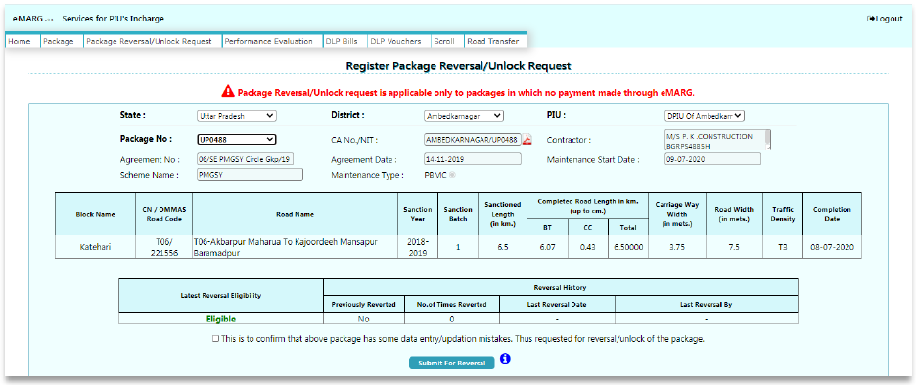
NIT CREATION
UNLOCKING OF PACKAGE
PACKAGE FREEZING
Step3: Select State/District/PIU/Package No. and Click on “Submit for Reversal”
CONTRACTOR REGISTRATION
LOCKING OF PACKAGE
ROAD REGISTRATION
MANUAL EXPENDITURE
ROUTINE INSPECTION (RI)
BILL SUBMISSION
PERFORMANCE EVALUATION (PE)
BILL VERIFICATION & FORWARD
BILL PROCESSING
VOUCHER GENERATION
SCROLL GENERATION
PACKAGE COMPLETION

Slide 55
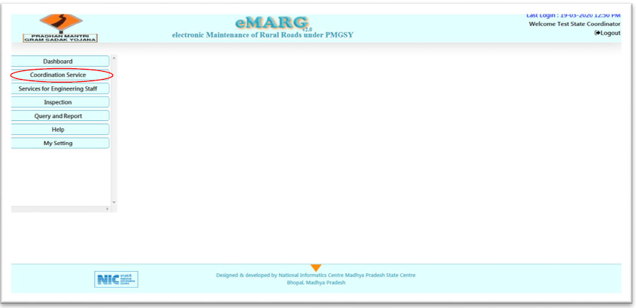
NIT CREATION
UNLOCKING OF PACKAGE
PACKAGE FREEZING
Step4: The package is sent to NMO Login for approval.
In NMO Login, go to “Coordination service”
CONTRACTOR REGISTRATION
LOCKING OF PACKAGE
ROAD REGISTRATION
MANUAL EXPENDITURE
ROUTINE INSPECTION (RI)
BILL SUBMISSION
PERFORMANCE EVALUATION (PE)
BILL VERIFICATION & FORWARD
BILL PROCESSING
VOUCHER GENERATION
SCROLL GENERATION
PACKAGE COMPLETION

Slide 56
NIT CREATION
UNLOCKING OF PACKAGE
PACKAGE FREEZING
Step6: Go to “Package Reversal/Unlock”
CONTRACTOR REGISTRATION
LOCKING OF PACKAGE
ROAD REGISTRATION
MANUAL EXPENDITURE
ROUTINE INSPECTION (RI)
BILL SUBMISSION
PERFORMANCE EVALUATION (PE)
BILL VERIFICATION & FORWARD
BILL PROCESSING
VOUCHER GENERATION
SCROLL GENERATION
PACKAGE COMPLETION

Slide 57
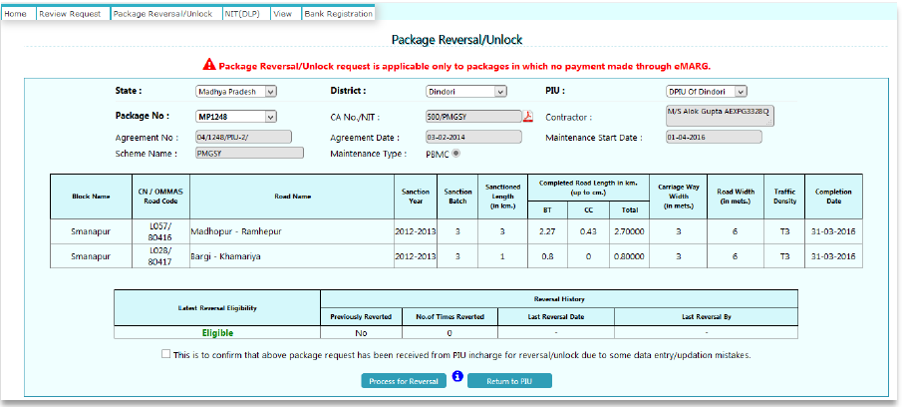
NIT CREATION
UNLOCKING OF PACKAGE
PACKAGE FREEZING
Step7: Tick the dialogue button and then click on “Proceed for reversal”
CONTRACTOR REGISTRATION
LOCKING OF PACKAGE
ROAD REGISTRATION
MANUAL EXPENDITURE
ROUTINE INSPECTION (RI)
BILL SUBMISSION
PERFORMANCE EVALUATION (PE)
BILL VERIFICATION & FORWARD
BILL PROCESSING
VOUCHER GENERATION
SCROLL GENERATION
PACKAGE COMPLETION

Slide 58
NIT CREATION
De-linking of the Bill Submission process and Inspections
PACKAGE FREEZING
Once a package is locked then following two processes can start simultaneously:
Bills related activities :Manual Expenditure, Bill Submission and Forward
Inspections related activities: Road Registration and Routine Inspections
CONTRACTOR REGISTRATION
LOCKING OF PACKAGE
Bills related activities are to be done on the computer
For inspection related activities, the PIU has to go to the road physically and carry out the activities
Bills related activities are independent from Inspection activities
Before eMARG the practice was that the contractor submits the bill and then the Engineer carries out Inspections. But in eMARG both these activities are carried out separately, i.e. the Engineer has to carry out bi monthly inspections irrespective of the status of bill being submitted by the contractor
ROAD REGISTRATION
MANUAL EXPENDITURE
ROUTINE INSPECTION (RI)
BILL SUBMISSION
PERFORMANCE EVALUATION (PE)
BILL VERIFICATION & FORWARD
BILL PROCESSING
VOUCHER GENERATION
SCROLL GENERATION
PACKAGE COMPLETION

Slide 59
ROAD REGISTRATION

Slide 60
NIT CREATION
ROAD REGISTRATION
PACKAGE FREEZING
What is Road Registration?
The process in which actual road for which routine maintenance will be carried out is registered physically on eMARG for getting the photographs of road during the routine inspections
Every km of the road is registered one by one
CONTRACTOR REGISTRATION
LOCKING OF PACKAGE
Who will do the Road Registration?
ROAD REGISTRATION
MANUAL EXPENDITURE
The PIU staff (AE/AM/JE) has to do the road registration
How to do the Road Registration?
ROUTINE INSPECTION (RI)
BILL SUBMISSION
The road registration is to be done through eMARG Mobile App
The App is supported only on Android Mobile Phone and is available on Google Play Store
PERFORMANCE EVALUATION (PE)
BILL VERIFICATION & FORWARD
BILL PROCESSING
VOUCHER GENERATION
SCROLL GENERATION
PACKAGE COMPLETION

Slide 61
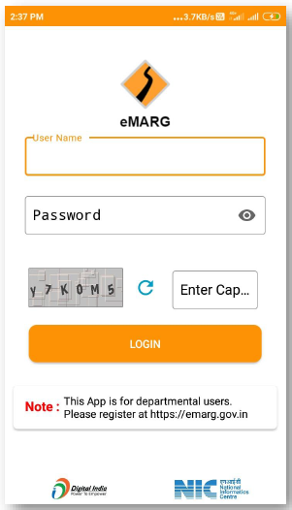
NIT CREATION
ROAD REGISTRATION
PACKAGE FREEZING
Step1: Enter User Name and Password and click on “LOG IN”
CONTRACTOR REGISTRATION
LOCKING OF PACKAGE
ROAD REGISTRATION
MANUAL EXPENDITURE
ROUTINE INSPECTION (RI)
BILL SUBMISSION
PERFORMANCE EVALUATION (PE)
BILL VERIFICATION & FORWARD
BILL PROCESSING
VOUCHER GENERATION
SCROLL GENERATION
PACKAGE COMPLETION

Slide 62
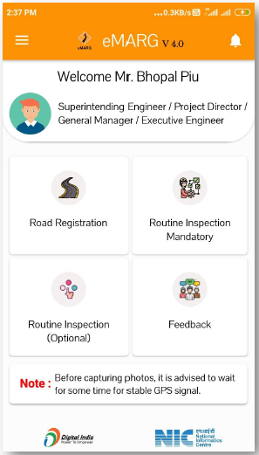
NIT CREATION
ROAD REGISTRATION
PACKAGE FREEZING
Step2: Select the option of “Road Registration”
CONTRACTOR REGISTRATION
LOCKING OF PACKAGE
ROAD REGISTRATION
MANUAL EXPENDITURE
ROUTINE INSPECTION (RI)
BILL SUBMISSION
PERFORMANCE EVALUATION (PE)
BILL VERIFICATION & FORWARD
BILL PROCESSING
VOUCHER GENERATION
SCROLL GENERATION
PACKAGE COMPLETION

Slide 63
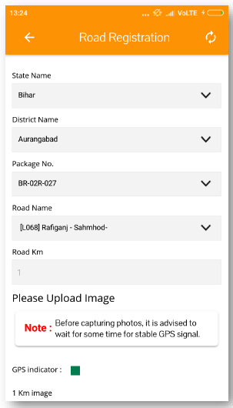
NIT CREATION
ROAD REGISTRATION
PACKAGE FREEZING
Step3: Select State Name/District Name/Package No./Road Name and then select “Road km”
CONTRACTOR REGISTRATION
LOCKING OF PACKAGE
ROAD REGISTRATION
MANUAL EXPENDITURE
ROUTINE INSPECTION (RI)
BILL SUBMISSION
PERFORMANCE EVALUATION (PE)
BILL VERIFICATION & FORWARD
BILL PROCESSING
VOUCHER GENERATION
SCROLL GENERATION
PACKAGE COMPLETION

Slide 64
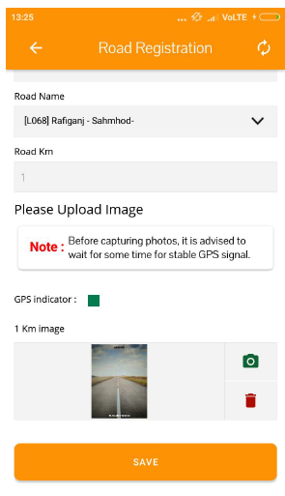
NIT CREATION
ROAD REGISTRATION
PACKAGE FREEZING
Step4: Take one photograph of the road for the selected km and click on save
CONTRACTOR REGISTRATION
LOCKING OF PACKAGE
ROAD REGISTRATION
MANUAL EXPENDITURE
ROUTINE INSPECTION (RI)
BILL SUBMISSION
PERFORMANCE EVALUATION (PE)
BILL VERIFICATION & FORWARD
BILL PROCESSING
VOUCHER GENERATION
SCROLL GENERATION
PACKAGE COMPLETION

Slide 65
NIT CREATION
ROAD REGISTRATION
PACKAGE FREEZING
CONTRACTOR REGISTRATION
Every km of the road needs to be selected one by one and one photograph for every km needs to be taken
For example if the road is of 5 km then first select Road km “0” from dropdown, take a photograph, then select “1” from dropdown, take a photograph, and so on till last km
Unless every km of the road is not registered, the road registration process will not be completed
LOCKING OF PACKAGE
ROAD REGISTRATION
MANUAL EXPENDITURE
ROUTINE INSPECTION (RI)
BILL SUBMISSION
PERFORMANCE EVALUATION (PE)
BILL VERIFICATION & FORWARD
BILL PROCESSING
VOUCHER GENERATION
SCROLL GENERATION
PACKAGE COMPLETION

Slide 66
ROUTINE INSPECTIONS (RI)

Slide 67
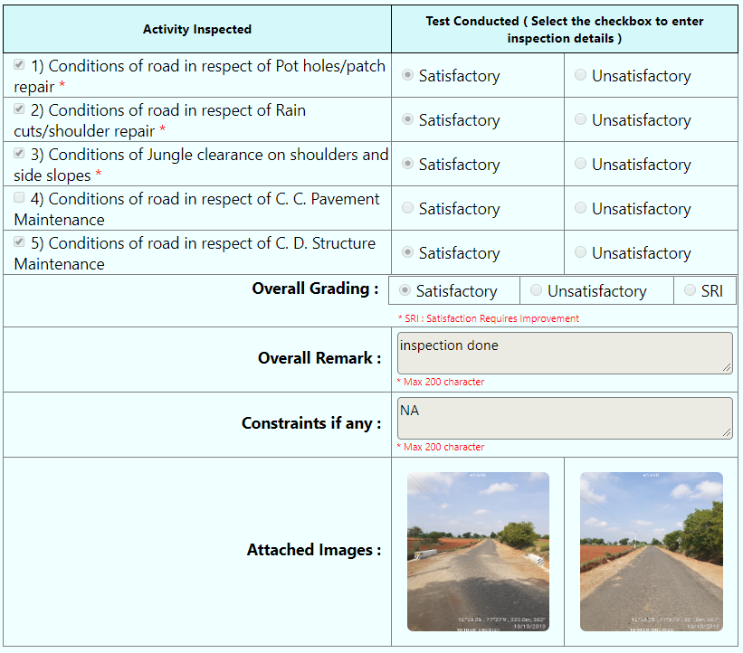
NIT CREATION
ROUTINE INSPECTION (RI)
PACKAGE FREEZING
What is Road Routine Inspection (RI)?
The inspections that are carried out to know the condition of road at various time intervals during the Defect Liability Period
The activities inspected during Routine Inspections (RI) are:
CONTRACTOR REGISTRATION
LOCKING OF PACKAGE
ROAD REGISTRATION
MANUAL EXPENDITURE
ROUTINE INSPECTION (RI)
BILL SUBMISSION
PERFORMANCE EVALUATION (PE)
BILL VERIFICATION & FORWARD
BILL PROCESSING
VOUCHER GENERATION
SCROLL GENERATION
PACKAGE COMPLETION

Slide 68
NIT CREATION
ROUTINE INSPECTION (RI)
PACKAGE FREEZING
Types of Routine Inspections?
# | Routine Inspections (Optional): RI(O) | Routine Inspections (Mandatory): RI(M)
Purpose of Inspection | The inspection carried out by the Engineer to check if there is any defect in the road and then notify the contractor to correct the same or, Recording the condition of any particular stretch of the road that is not covered in the RI(M) | The inspection carried out by the Engineer to asses the overall condition of the road before making the payment of the bills raised by the contractor
Frequency of Inspection | As and when required | Since the records captured during this inspection will be used for making the payments to the contractor, so RI(M) should mandatorily be carried out once in every two months
Unit of Inspection | Any stretch of the road in which defect has to be notified to the contractor or any particular stretch missed in RI(M) and the Engineer wants to record it | Every km of the road has to be mandatorily inspected Inspections have to be carried out mandatorily on the random chainage generated by the system for every km
Who will conduct Inspection | Can be carried out by either PIU staff(AE/AM/JE) or PIU In-charge (EE) | Can be carried out by either PIU staff(AE/AM/JE) or PIU In-charge (EE)
How to conduct Inspection | Will be carried out through eMARG App | Will be carried out through eMARG App
CONTRACTOR REGISTRATION
LOCKING OF PACKAGE
ROAD REGISTRATION
MANUAL EXPENDITURE
ROUTINE INSPECTION (RI)
BILL SUBMISSION
PERFORMANCE EVALUATION (PE)
BILL VERIFICATION & FORWARD
BILL PROCESSING
VOUCHER GENERATION
SCROLL GENERATION
PACKAGE COMPLETION

Slide 69
NIT CREATION
ROUTINE INSPECTION (RI)
Meaning of Bi-monthly frequency of RI(M)
PACKAGE FREEZING
Ideal Case:
Example – Maintenance Start Date of Road : 1 Jan 2021
CONTRACTOR REGISTRATION
1 Jan 21
LOCKING OF PACKAGE
ROAD REGISTRATION
MANUAL EXPENDITURE
JAN
Monthly Bill
ROUTINE INSPECTION (RI)
BILL SUBMISSION
31 Jan 21
Time Given to contractor to submit the bill
PERFORMANCE EVALUATION (PE)
BILL VERIFICATION & FORWARD
10 Feb 21
BILL PROCESSING
Time period in which Routine Inspection should be carried out for making payments for the bill of January
VOUCHER GENERATION
SCROLL GENERATION
28 Feb 21
PACKAGE COMPLETION

Slide 70
ROUTINE INSPECTION (RI)
Meaning of Bi-monthly frequency of RI(M):
Case in eMARG:
Example – Maintenance Start Date of Road : 1 Jan 2021
1 Jan 21
JAN
Monthly Bill
31 Jan 21
FEB
Monthly Bill
28 Feb 21
Time period in which Routine Inspection should be carried out for making payments for the bill of January and February
Monthly Bill
MAR
31 Mar 21
Monthly Bill
APR
30 Apr 21
Time period in which Routine Inspection should be carried out for making payments for the bill of March and April
31 May 21

Slide 71
NIT CREATION
ROUTINE INSPECTION (RI)
When to Conduct RI(M)?
PACKAGE FREEZING
CONTRACTOR REGISTRATION
OPTION-1
Knowing the complete schedule of RI(M) for a single package
LOCKING OF PACKAGE
ROAD REGISTRATION
MANUAL EXPENDITURE
ROUTINE INSPECTION (RI)
BILL SUBMISSION
PERFORMANCE EVALUATION (PE)
BILL VERIFICATION & FORWARD
BILL PROCESSING
VOUCHER GENERATION
SCROLL GENERATION
PACKAGE COMPLETION

Slide 72
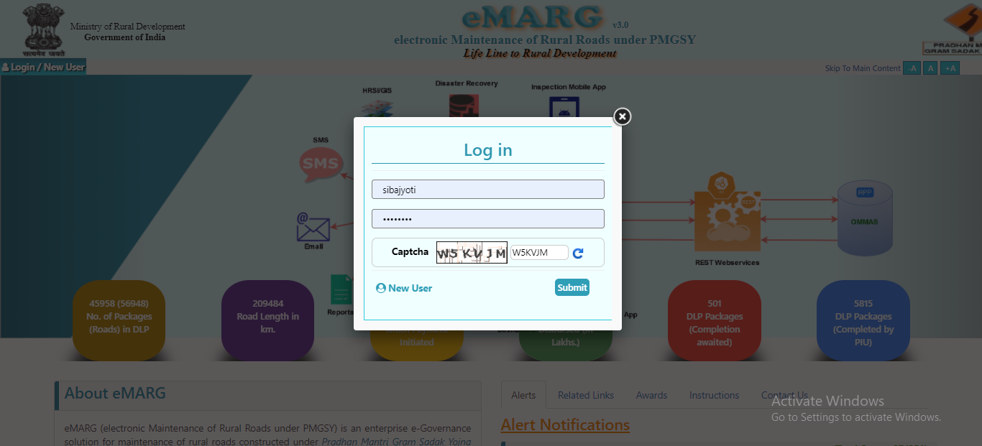
NIT CREATION
ROUTINE INSPECTION (RI)
When to Conduct RI(M)?
PACKAGE FREEZING
Option-1: Knowing the complete schedule of RI(M) for a single package
CONTRACTOR REGISTRATION
Step-1: Log in to eMARG with PIU Staff/PIU In-charge Login
LOCKING OF PACKAGE
ROAD REGISTRATION
MANUAL EXPENDITURE
ROUTINE INSPECTION (RI)
BILL SUBMISSION
PERFORMANCE EVALUATION (PE)
BILL VERIFICATION & FORWARD
BILL PROCESSING
VOUCHER GENERATION
SCROLL GENERATION
PACKAGE COMPLETION

Slide 73
NIT CREATION
ROUTINE INSPECTION (RI)
When to Conduct RI(M)?
PACKAGE FREEZING
Step-2: Go to “Query and Report”
CONTRACTOR REGISTRATION
LOCKING OF PACKAGE
ROAD REGISTRATION
MANUAL EXPENDITURE
ROUTINE INSPECTION (RI)
BILL SUBMISSION
PERFORMANCE EVALUATION (PE)
BILL VERIFICATION & FORWARD
BILL PROCESSING
VOUCHER GENERATION
SCROLL GENERATION
PACKAGE COMPLETION

Slide 74
NIT CREATION
ROUTINE INSPECTION (RI)
When to Conduct RI(M)?
PACKAGE FREEZING
Step-3: Go to “Inspection”----->”DLP”------->”Routine Inspection Schedule”
CONTRACTOR REGISTRATION
LOCKING OF PACKAGE
ROAD REGISTRATION
MANUAL EXPENDITURE
ROUTINE INSPECTION (RI)
BILL SUBMISSION
PERFORMANCE EVALUATION (PE)
BILL VERIFICATION & FORWARD
BILL PROCESSING
VOUCHER GENERATION
SCROLL GENERATION
PACKAGE COMPLETION

Slide 75
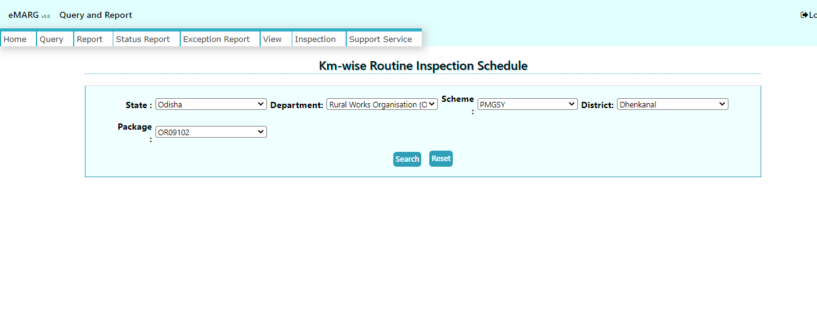
NIT CREATION
ROUTINE INSPECTION (RI)
When to Conduct RI(M)?
PACKAGE FREEZING
Step-4: Enter the details of Package and click on “Search”
CONTRACTOR REGISTRATION
LOCKING OF PACKAGE
ROAD REGISTRATION
MANUAL EXPENDITURE
ROUTINE INSPECTION (RI)
BILL SUBMISSION
PERFORMANCE EVALUATION (PE)
BILL VERIFICATION & FORWARD
BILL PROCESSING
VOUCHER GENERATION
SCROLL GENERATION
PACKAGE COMPLETION

Slide 76
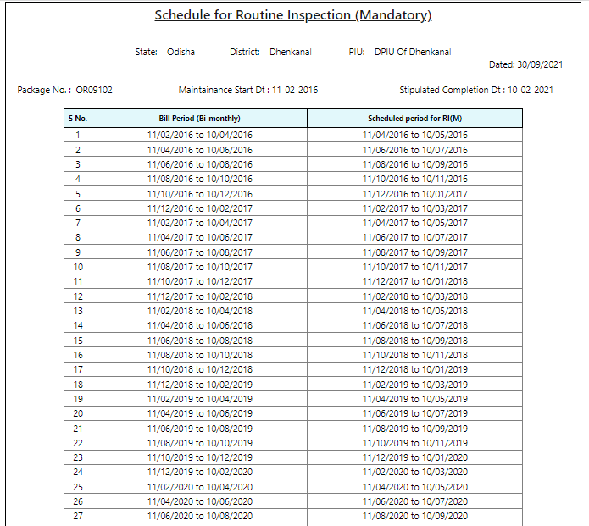
NIT CREATION
ROUTINE INSPECTION (RI)
When to Conduct RI(M)?
PACKAGE FREEZING
The Scheduled RI(M) period is displayed and within the scheduled periods only the RI(M) has to be conducted
CONTRACTOR REGISTRATION
LOCKING OF PACKAGE
ROAD REGISTRATION
MANUAL EXPENDITURE
ROUTINE INSPECTION (RI)
BILL SUBMISSION
PERFORMANCE EVALUATION (PE)
BILL VERIFICATION & FORWARD
BILL PROCESSING
VOUCHER GENERATION
SCROLL GENERATION
PACKAGE COMPLETION

Slide 77
NIT CREATION
ROUTINE INSPECTION (RI)
When to Conduct RI(M)?
PACKAGE FREEZING
CONTRACTOR REGISTRATION
OPTION-2
Knowing the roads due for RI(M) on a particular date
LOCKING OF PACKAGE
ROAD REGISTRATION
MANUAL EXPENDITURE
ROUTINE INSPECTION (RI)
BILL SUBMISSION
PERFORMANCE EVALUATION (PE)
BILL VERIFICATION & FORWARD
BILL PROCESSING
VOUCHER GENERATION
SCROLL GENERATION
PACKAGE COMPLETION

Slide 78
NIT CREATION
ROUTINE INSPECTION (RI)
When to Conduct RI(M)?
PACKAGE FREEZING
Option-2: Knowing the roads due for RI(M) on a particular date
CONTRACTOR REGISTRATION
Step-1: Go to “Query and Report”
LOCKING OF PACKAGE
ROAD REGISTRATION
MANUAL EXPENDITURE
ROUTINE INSPECTION (RI)
BILL SUBMISSION
PERFORMANCE EVALUATION (PE)
BILL VERIFICATION & FORWARD
BILL PROCESSING
VOUCHER GENERATION
SCROLL GENERATION
PACKAGE COMPLETION

Slide 79
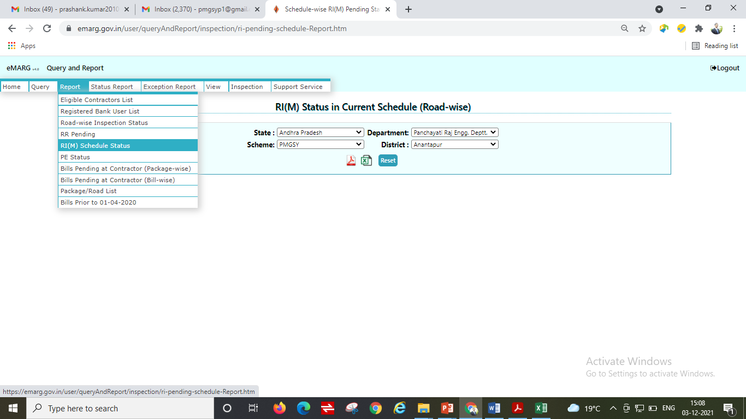
NIT CREATION
ROUTINE INSPECTION (RI)
When to Conduct RI(M)?
PACKAGE FREEZING
Option-2: Knowing the roads due for RI(M) on a particular date
CONTRACTOR REGISTRATION
Step-2: Go to “Report----->RI(M) Schedule Status”
LOCKING OF PACKAGE
ROAD REGISTRATION
MANUAL EXPENDITURE
ROUTINE INSPECTION (RI)
BILL SUBMISSION
PERFORMANCE EVALUATION (PE)
BILL VERIFICATION & FORWARD
BILL PROCESSING
VOUCHER GENERATION
SCROLL GENERATION
PACKAGE COMPLETION

Slide 80
NIT CREATION
ROUTINE INSPECTION (RI)
When to Conduct RI(M)?
PACKAGE FREEZING
Option-2: Knowing the roads due for RI(M) on a particular date
CONTRACTOR REGISTRATION
Step-3: Select State/Department/Scheme/District
LOCKING OF PACKAGE
ROAD REGISTRATION
MANUAL EXPENDITURE
ROUTINE INSPECTION (RI)
BILL SUBMISSION
PERFORMANCE EVALUATION (PE)
BILL VERIFICATION & FORWARD
BILL PROCESSING
VOUCHER GENERATION
SCROLL GENERATION
PACKAGE COMPLETION

Slide 81
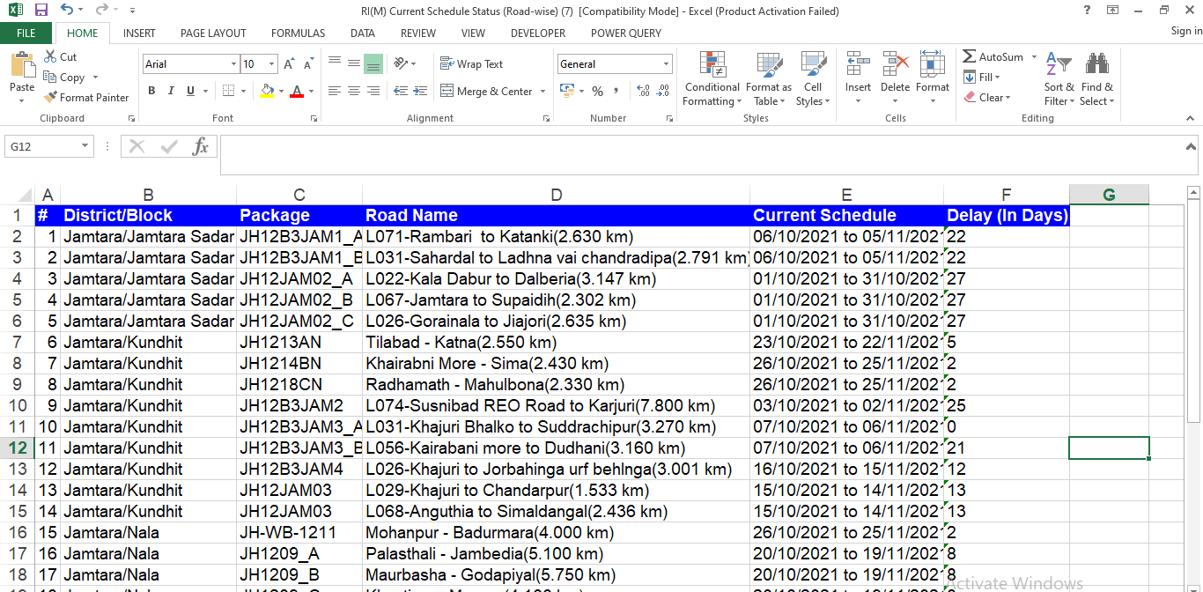
NIT CREATION
ROUTINE INSPECTION (RI)
When to Conduct RI(M)?
PACKAGE FREEZING
Option-2: Knowing the roads due for RI(M) on a particular date
CONTRACTOR REGISTRATION
Step-4: Remove the “0” roads from “Days left in current schedule”
LOCKING OF PACKAGE
Days left in current schedule
ROAD REGISTRATION
MANUAL EXPENDITURE
ROUTINE INSPECTION (RI)
BILL SUBMISSION
PERFORMANCE EVALUATION (PE)
BILL VERIFICATION & FORWARD
BILL PROCESSING
VOUCHER GENERATION
SCROLL GENERATION
PACKAGE COMPLETION

Slide 82
NIT CREATION
ROUTINE INSPECTION (RI)
How to Conduct RI(M)?
PACKAGE FREEZING
Notification Received by Engineer to Conduct Inspection
CONTRACTOR REGISTRATION
LOCKING OF PACKAGE
ROAD REGISTRATION
MANUAL EXPENDITURE
Routine Inspection is due for Package No. AS24140. Please conduct it at the earliest.
ROUTINE INSPECTION (RI)
BILL SUBMISSION
PERFORMANCE EVALUATION (PE)
BILL VERIFICATION & FORWARD
BILL PROCESSING
VOUCHER GENERATION
SCROLL GENERATION
PACKAGE COMPLETION

Slide 83
NIT CREATION
ROUTINE INSPECTION (RI)
PACKAGE FREEZING
Step-1: Enter User Name and Password and click on “LOG IN”
CONTRACTOR REGISTRATION
LOCKING OF PACKAGE
ROAD REGISTRATION
MANUAL EXPENDITURE
ROUTINE INSPECTION (RI)
BILL SUBMISSION
PERFORMANCE EVALUATION (PE)
BILL VERIFICATION & FORWARD
BILL PROCESSING
VOUCHER GENERATION
SCROLL GENERATION
PACKAGE COMPLETION

Slide 84
NIT CREATION
ROUTINE INSPECTION (RI)
Step-2: Select “Routine Inspection (Mandatory)”
PACKAGE FREEZING
CONTRACTOR REGISTRATION
LOCKING OF PACKAGE
ROAD REGISTRATION
MANUAL EXPENDITURE
ROUTINE INSPECTION (RI)
BILL SUBMISSION
PERFORMANCE EVALUATION (PE)
BILL VERIFICATION & FORWARD
BILL PROCESSING
VOUCHER GENERATION
SCROLL GENERATION
PACKAGE COMPLETION

Slide 85
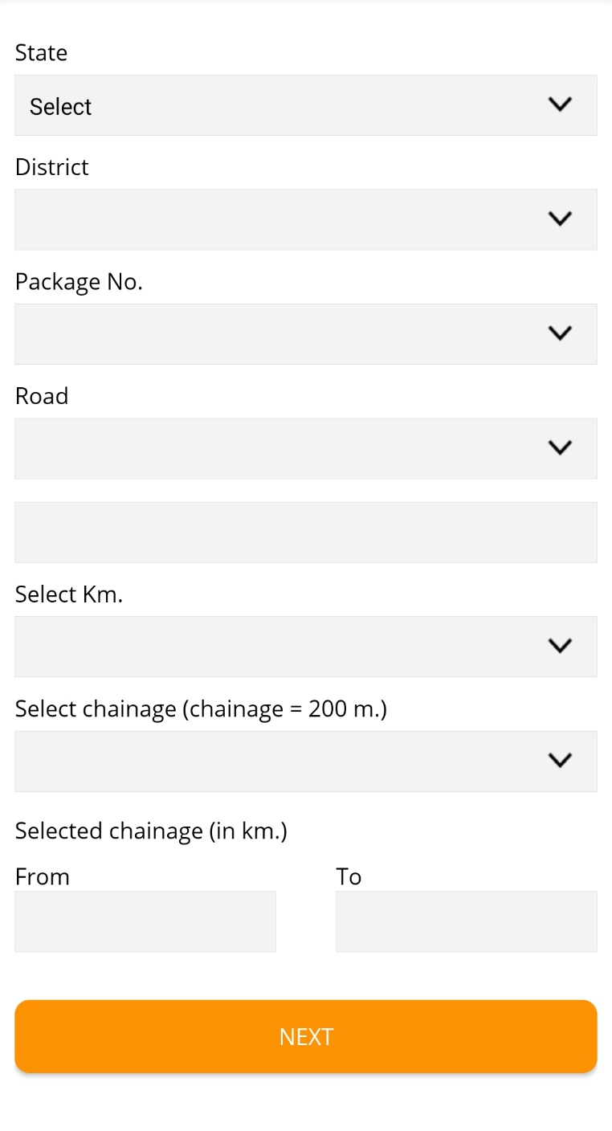
NIT CREATION
ROUTINE INSPECTION (RI)
Step-3: Click on “State”
PACKAGE FREEZING
CONTRACTOR REGISTRATION
LOCKING OF PACKAGE
ROAD REGISTRATION
MANUAL EXPENDITURE
ROUTINE INSPECTION (RI)
BILL SUBMISSION
PERFORMANCE EVALUATION (PE)
BILL VERIFICATION & FORWARD
BILL PROCESSING
VOUCHER GENERATION
SCROLL GENERATION
PACKAGE COMPLETION

Slide 86
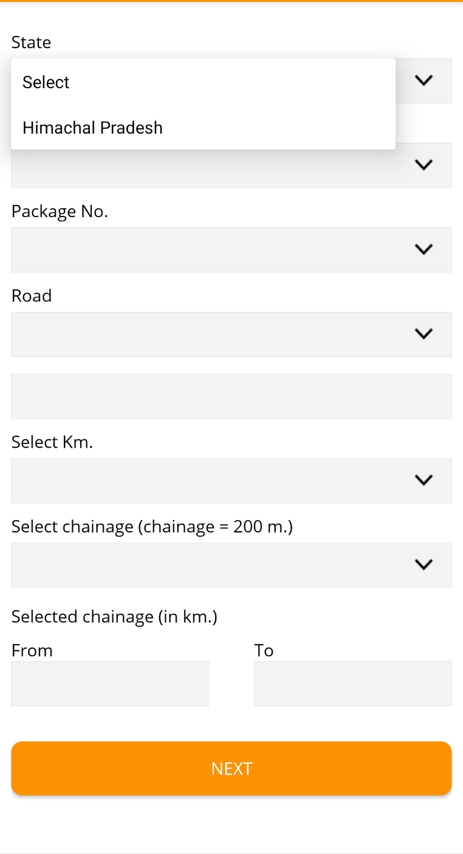
NIT CREATION
ROUTINE INSPECTION (RI)
Step-4: Select “State”
PACKAGE FREEZING
CONTRACTOR REGISTRATION
LOCKING OF PACKAGE
ROAD REGISTRATION
MANUAL EXPENDITURE
ROUTINE INSPECTION (RI)
BILL SUBMISSION
PERFORMANCE EVALUATION (PE)
BILL VERIFICATION & FORWARD
BILL PROCESSING
VOUCHER GENERATION
SCROLL GENERATION
PACKAGE COMPLETION

Slide 87
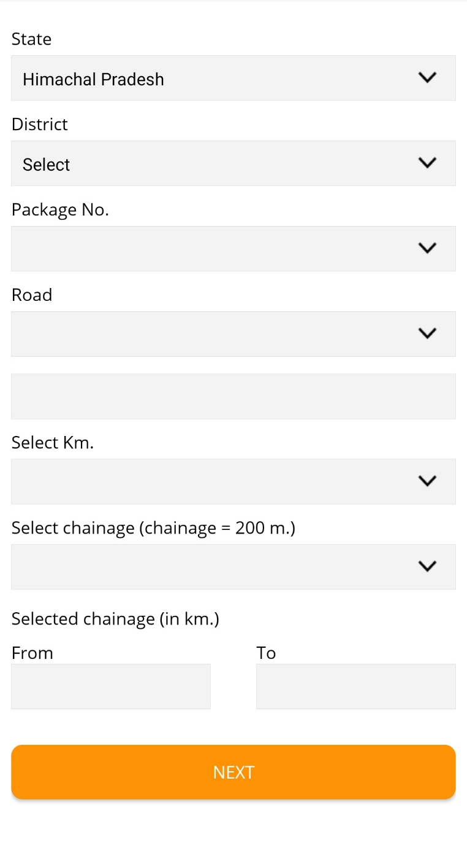
NIT CREATION
ROUTINE INSPECTION (RI)
Step-5: Click on “District”
PACKAGE FREEZING
CONTRACTOR REGISTRATION
LOCKING OF PACKAGE
ROAD REGISTRATION
MANUAL EXPENDITURE
ROUTINE INSPECTION (RI)
BILL SUBMISSION
PERFORMANCE EVALUATION (PE)
BILL VERIFICATION & FORWARD
BILL PROCESSING
VOUCHER GENERATION
SCROLL GENERATION
PACKAGE COMPLETION

Slide 88
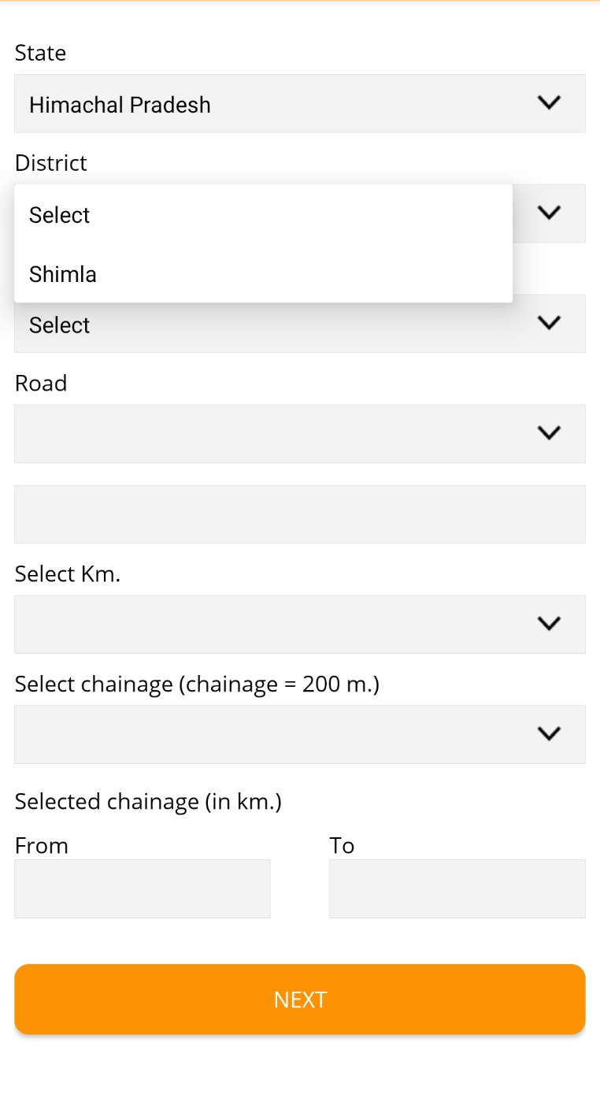
NIT CREATION
ROUTINE INSPECTION (RI)
Step-6: Select “District”
PACKAGE FREEZING
CONTRACTOR REGISTRATION
LOCKING OF PACKAGE
ROAD REGISTRATION
MANUAL EXPENDITURE
ROUTINE INSPECTION (RI)
BILL SUBMISSION
PERFORMANCE EVALUATION (PE)
BILL VERIFICATION & FORWARD
BILL PROCESSING
VOUCHER GENERATION
SCROLL GENERATION
PACKAGE COMPLETION

Slide 89
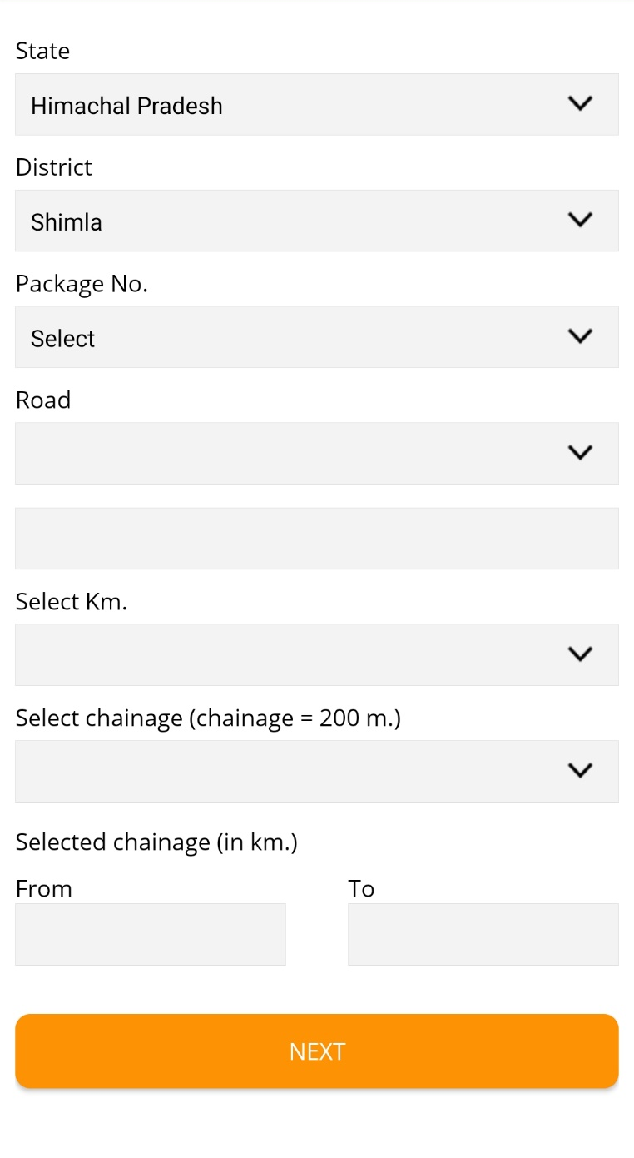
NIT CREATION
ROUTINE INSPECTION (RI)
Step-7: Click on “Package No.”
PACKAGE FREEZING
CONTRACTOR REGISTRATION
LOCKING OF PACKAGE
ROAD REGISTRATION
MANUAL EXPENDITURE
ROUTINE INSPECTION (RI)
BILL SUBMISSION
PERFORMANCE EVALUATION (PE)
BILL VERIFICATION & FORWARD
BILL PROCESSING
VOUCHER GENERATION
SCROLL GENERATION
PACKAGE COMPLETION

Slide 90
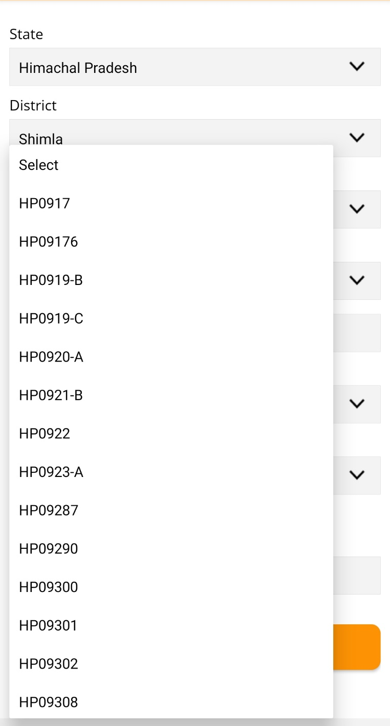
NIT CREATION
ROUTINE INSPECTION (RI)
Step-8: Select “Package No.”
PACKAGE FREEZING
CONTRACTOR REGISTRATION
LOCKING OF PACKAGE
ROAD REGISTRATION
MANUAL EXPENDITURE
ROUTINE INSPECTION (RI)
BILL SUBMISSION
PERFORMANCE EVALUATION (PE)
BILL VERIFICATION & FORWARD
BILL PROCESSING
VOUCHER GENERATION
SCROLL GENERATION
PACKAGE COMPLETION

Slide 91
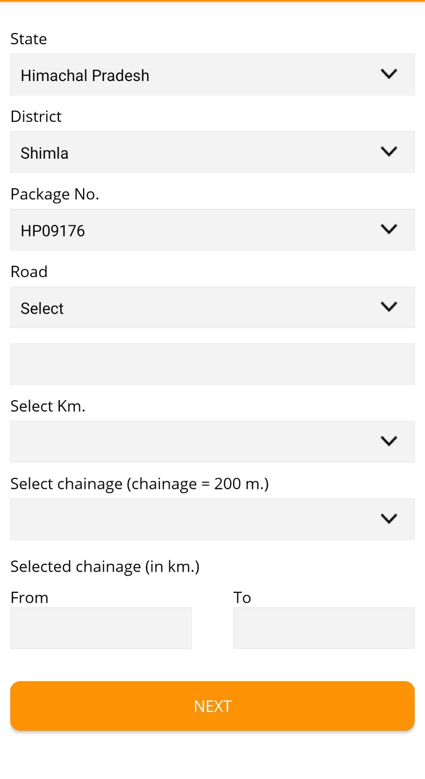
NIT CREATION
ROUTINE INSPECTION (RI)
Step-9: Click on “Road”
PACKAGE FREEZING
CONTRACTOR REGISTRATION
LOCKING OF PACKAGE
ROAD REGISTRATION
MANUAL EXPENDITURE
ROUTINE INSPECTION (RI)
BILL SUBMISSION
PERFORMANCE EVALUATION (PE)
BILL VERIFICATION & FORWARD
BILL PROCESSING
VOUCHER GENERATION
SCROLL GENERATION
PACKAGE COMPLETION

Slide 92
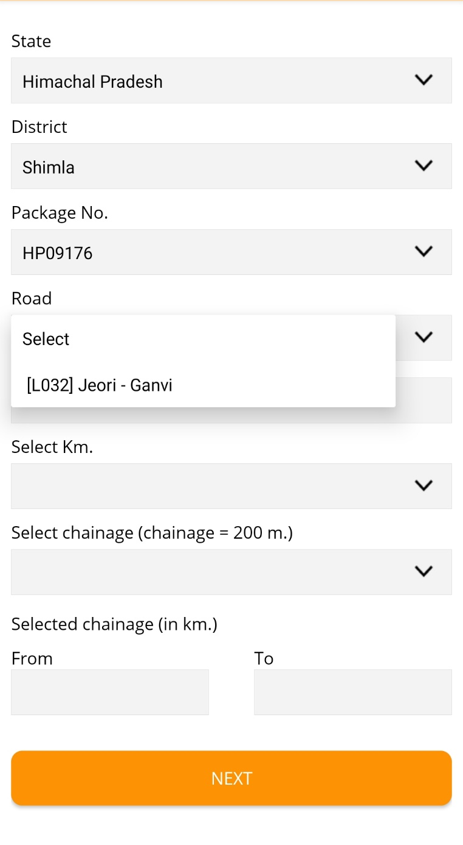
NIT CREATION
ROUTINE INSPECTION (RI)
Step-10: Select “Road”
PACKAGE FREEZING
CONTRACTOR REGISTRATION
LOCKING OF PACKAGE
ROAD REGISTRATION
MANUAL EXPENDITURE
ROUTINE INSPECTION (RI)
BILL SUBMISSION
PERFORMANCE EVALUATION (PE)
BILL VERIFICATION & FORWARD
BILL PROCESSING
VOUCHER GENERATION
SCROLL GENERATION
PACKAGE COMPLETION

Slide 93
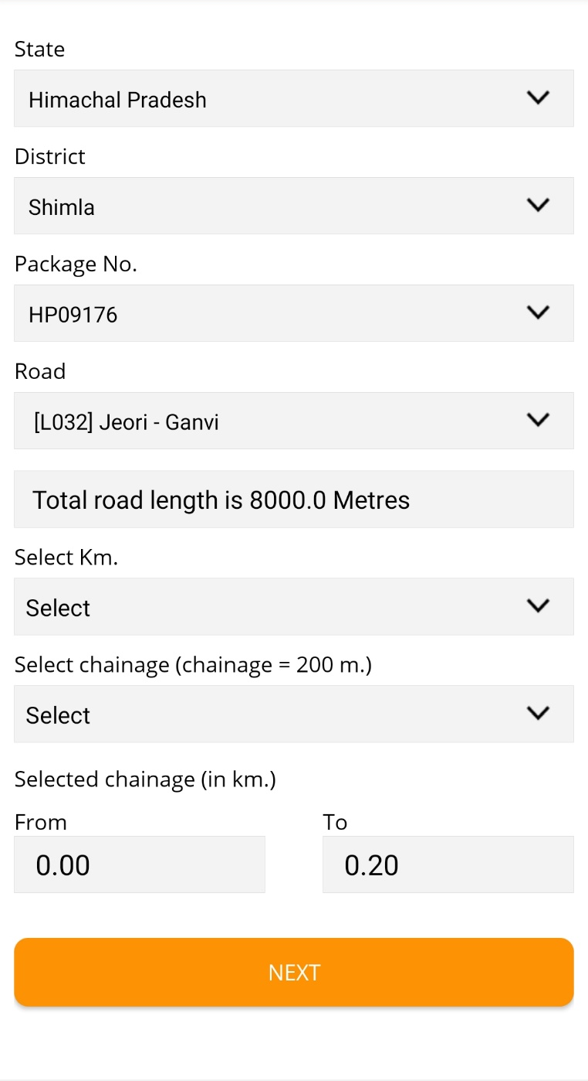
NIT CREATION
ROUTINE INSPECTION (RI)
Step-11: Click on “Select km”
PACKAGE FREEZING
CONTRACTOR REGISTRATION
LOCKING OF PACKAGE
ROAD REGISTRATION
MANUAL EXPENDITURE
ROUTINE INSPECTION (RI)
BILL SUBMISSION
PERFORMANCE EVALUATION (PE)
BILL VERIFICATION & FORWARD
BILL PROCESSING
VOUCHER GENERATION
SCROLL GENERATION
PACKAGE COMPLETION

Slide 94
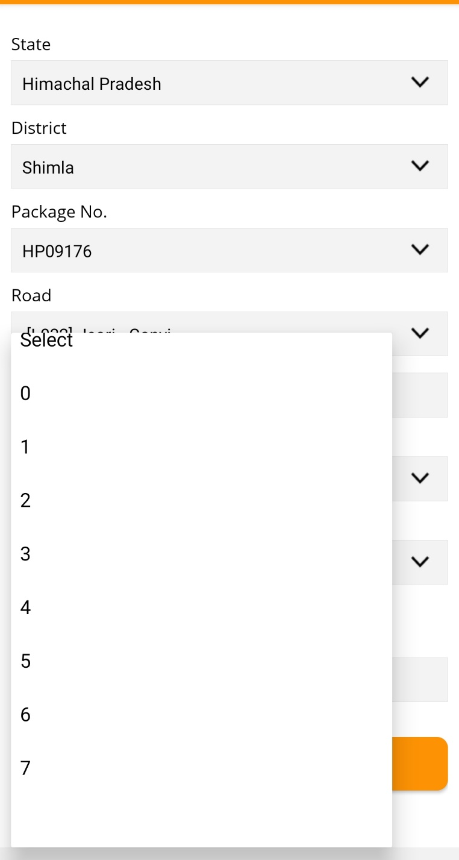
NIT CREATION
ROUTINE INSPECTION (RI)
Step-12: Select “km”
PACKAGE FREEZING
CONTRACTOR REGISTRATION
LOCKING OF PACKAGE
ROAD REGISTRATION
MANUAL EXPENDITURE
ROUTINE INSPECTION (RI)
BILL SUBMISSION
PERFORMANCE EVALUATION (PE)
BILL VERIFICATION & FORWARD
BILL PROCESSING
VOUCHER GENERATION
SCROLL GENERATION
PACKAGE COMPLETION

Slide 95
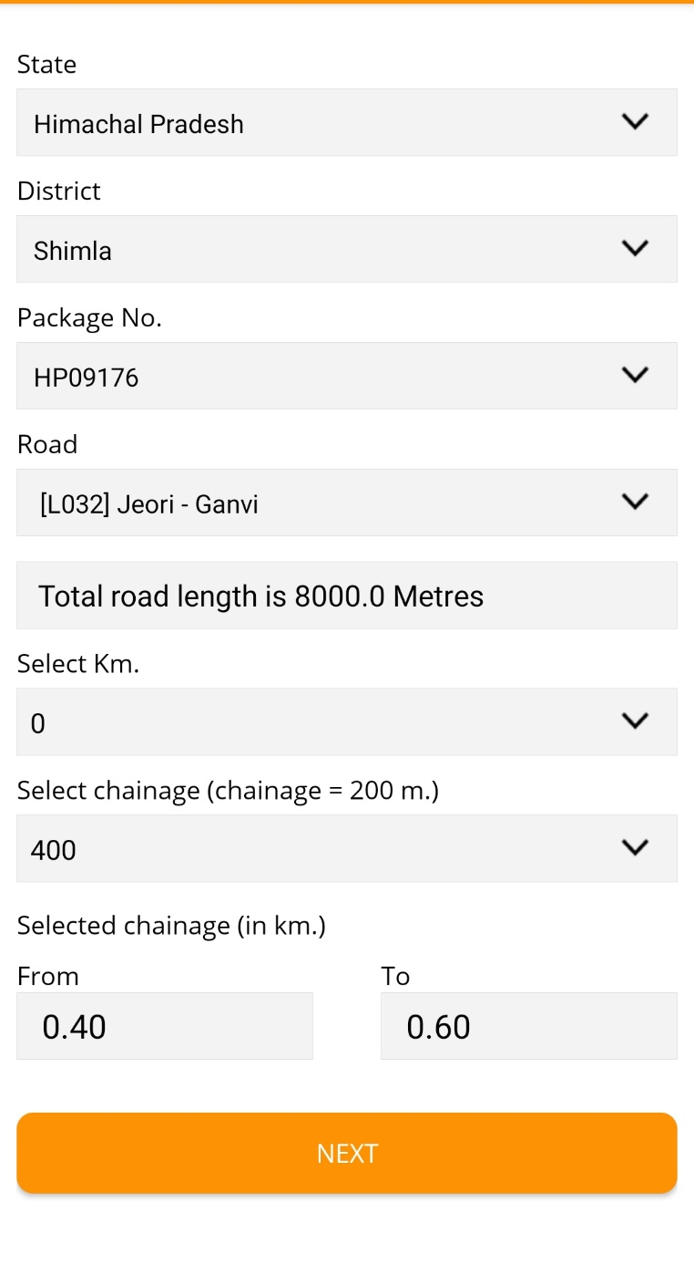
NIT CREATION
ROUTINE INSPECTION (RI)
Step-13: Go to the assigned chainage and click on “Next”
PACKAGE FREEZING
CONTRACTOR REGISTRATION
LOCKING OF PACKAGE
ROAD REGISTRATION
MANUAL EXPENDITURE
ROUTINE INSPECTION (RI)
BILL SUBMISSION
PERFORMANCE EVALUATION (PE)
BILL VERIFICATION & FORWARD
Automatic allocation of chainage by system in case of RI(M)
For RI(O) the chainage can be selected by the user from dropdown
BILL PROCESSING
400
VOUCHER GENERATION
SCROLL GENERATION
PACKAGE COMPLETION

Slide 96
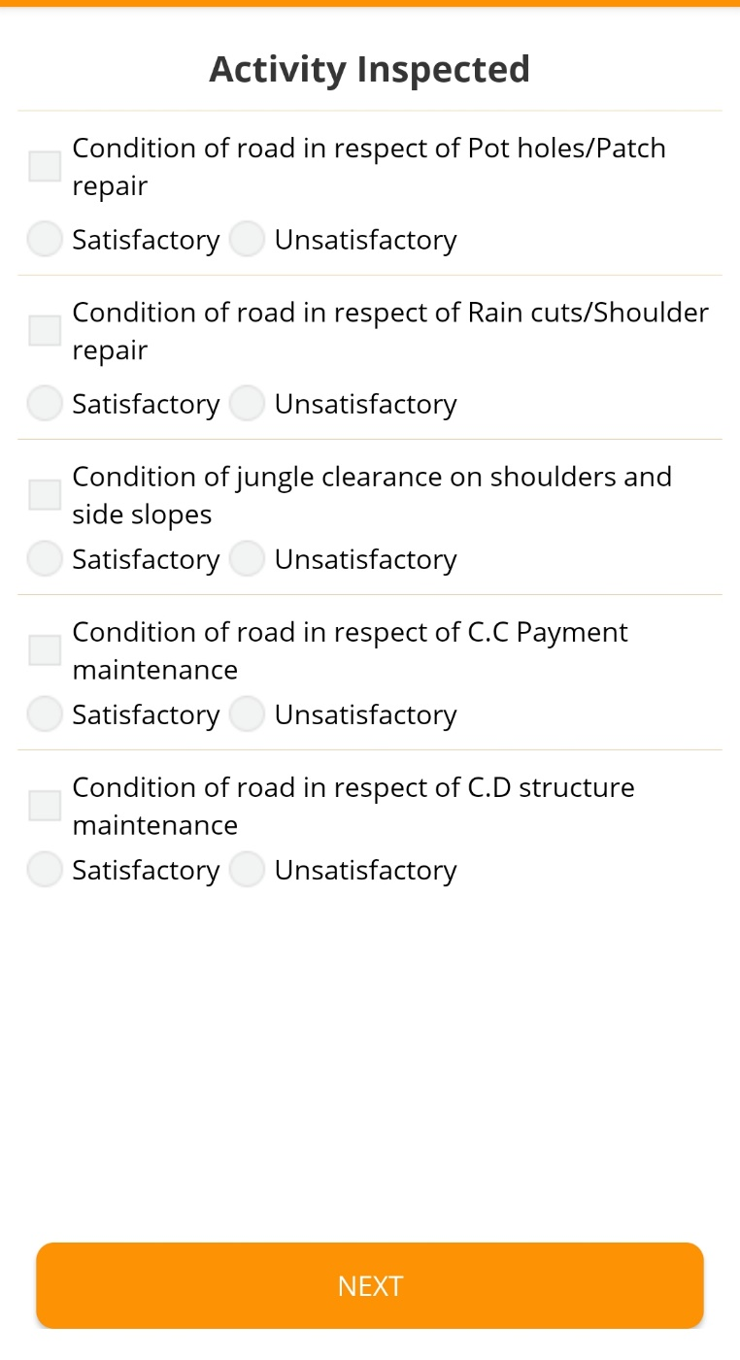
NIT CREATION
ROUTINE INSPECTION (RI)
Step-14: Select the grading as applicable for the selected km
PACKAGE FREEZING
CONTRACTOR REGISTRATION
LOCKING OF PACKAGE
ROAD REGISTRATION
MANUAL EXPENDITURE
ROUTINE INSPECTION (RI)
BILL SUBMISSION
PERFORMANCE EVALUATION (PE)
BILL VERIFICATION & FORWARD
BILL PROCESSING
VOUCHER GENERATION
SCROLL GENERATION
PACKAGE COMPLETION

Slide 97
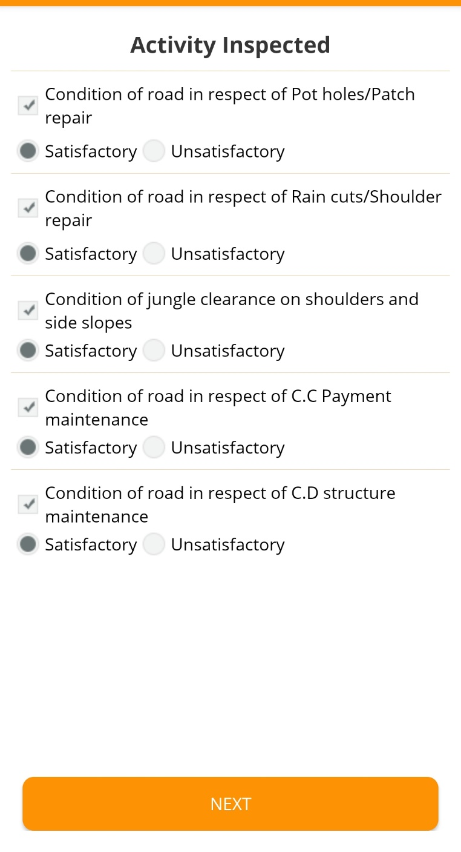
NIT CREATION
ROUTINE INSPECTION (RI)
Step-15: Click on “Next”
PACKAGE FREEZING
CONTRACTOR REGISTRATION
LOCKING OF PACKAGE
ROAD REGISTRATION
MANUAL EXPENDITURE
ROUTINE INSPECTION (RI)
BILL SUBMISSION
PERFORMANCE EVALUATION (PE)
BILL VERIFICATION & FORWARD
BILL PROCESSING
VOUCHER GENERATION
SCROLL GENERATION
PACKAGE COMPLETION

Slide 98
NIT CREATION
ROUTINE INSPECTION (RI)
Step-16: Give Overall grading, write overall remarks (Optional) and constraints if any and click two photographs
PACKAGE FREEZING
CONTRACTOR REGISTRATION
LOCKING OF PACKAGE
ROAD REGISTRATION
MANUAL EXPENDITURE
ROUTINE INSPECTION (RI)
BILL SUBMISSION
PERFORMANCE EVALUATION (PE)
BILL VERIFICATION & FORWARD
BILL PROCESSING
VOUCHER GENERATION
SCROLL GENERATION
PACKAGE COMPLETION

Slide 99
NIT CREATION
ROUTINE INSPECTION (RI)
PACKAGE FREEZING
CONTRACTOR REGISTRATION
CONDUCTING ROUTINE INSPECTION IN OFFLINE MODE (WITHOUT INTERNET CONNECTION)
LOCKING OF PACKAGE
ROAD REGISTRATION
MANUAL EXPENDITURE
ROUTINE INSPECTION (RI)
BILL SUBMISSION
PERFORMANCE EVALUATION (PE)
BILL VERIFICATION & FORWARD
BILL PROCESSING
VOUCHER GENERATION
SCROLL GENERATION
PACKAGE COMPLETION

Slide 100
NIT CREATION
ROUTINE INSPECTION (RI)
PACKAGE FREEZING
IMPORTANT INSTRUCTIONS TO CARRY OUT ROUTINE INSPECTION or ROAD REGISTRATION FROM eMARG APP in Offline mode
CONTRACTOR REGISTRATION
The App operates in offline mode also, so internet connectivity is not required for conducting RI or RR
It is advisable to conduct RI or RR in offline mode only and then upload the photographs by enabling the internet connection of phone
When Internet connection of phone is not enabled and if RI or RR is conducted then following message will come:
LOCKING OF PACKAGE
ROAD REGISTRATION
MANUAL EXPENDITURE
ROUTINE INSPECTION (RI)
BILL SUBMISSION
PERFORMANCE EVALUATION (PE)
BILL VERIFICATION & FORWARD
BILL PROCESSING
VOUCHER GENERATION
SCROLL GENERATION
PACKAGE COMPLETION

Slide 101
NIT CREATION
ROUTINE INSPECTION (RI)
Click on “OK” and the data will be saved locally
PACKAGE FREEZING
CONTRACTOR REGISTRATION
LOCKING OF PACKAGE
ROAD REGISTRATION
MANUAL EXPENDITURE
ROUTINE INSPECTION (RI)
BILL SUBMISSION
PERFORMANCE EVALUATION (PE)
BILL VERIFICATION & FORWARD
BILL PROCESSING
VOUCHER GENERATION
SCROLL GENERATION
PACKAGE COMPLETION

Slide 102
NIT CREATION
ROUTINE INSPECTION (RI)
Switch on the Internet connection of phone and click the sideline bar on left side
PACKAGE FREEZING
CONTRACTOR REGISTRATION
LOCKING OF PACKAGE
ROAD REGISTRATION
MANUAL EXPENDITURE
ROUTINE INSPECTION (RI)
BILL SUBMISSION
PERFORMANCE EVALUATION (PE)
BILL VERIFICATION & FORWARD
BILL PROCESSING
VOUCHER GENERATION
SCROLL GENERATION
PACKAGE COMPLETION

Slide 103
NIT CREATION
ROUTINE INSPECTION (RI)
Select the option of Offline Road Registration or Routine Inspection whichever is being conducted
PACKAGE FREEZING
CONTRACTOR REGISTRATION
LOCKING OF PACKAGE
ROAD REGISTRATION
MANUAL EXPENDITURE
ROUTINE INSPECTION (RI)
BILL SUBMISSION
PERFORMANCE EVALUATION (PE)
BILL VERIFICATION & FORWARD
BILL PROCESSING
VOUCHER GENERATION
SCROLL GENERATION
PACKAGE COMPLETION

Slide 104
NIT CREATION
ROUTINE INSPECTION (RI)
Click on “upload” to upload save photos
PACKAGE FREEZING
CONTRACTOR REGISTRATION
LOCKING OF PACKAGE
ROAD REGISTRATION
MANUAL EXPENDITURE
ROUTINE INSPECTION (RI)
BILL SUBMISSION
PERFORMANCE EVALUATION (PE)
BILL VERIFICATION & FORWARD
BILL PROCESSING
VOUCHER GENERATION
SCROLL GENERATION
PACKAGE COMPLETION

Slide 105
PERFORMANCE EVALUATION (PE)

Slide 106
NIT CREATION
PERFORMANCE EVALUATION (PE)
PACKAGE FREEZING
What is Performance Evaluation (PE)?
Evaluating the performance of the road by giving marks out of 100 based on the grading and photographs captured during the Routine Inspection
Parameters for which marks will be given are:
CONTRACTOR REGISTRATION
LOCKING OF PACKAGE
S.No | Parameters | Marks
1 | Maintenance of surface of Road including filling potholes and patch repairs etc. | 50
2 | Making up of berms/shoulders | 20
3 | Restoration of rain cuts and dressing of side slopes/berms | 10
4 | Maintenance of drains | 3
5 | Maintenance of culverts and cause ways | 4
6 | Maintenance of guard rails and parapet rails | 1
S.No | Parameters | Marks
7 | Maintenance of Road signs, speed breakers, standing trees adjacent to Road wherever required | 2
8 | Maintenance of 200 m and Kilo Meter stones | 2
9 | Cutting of branches of trees, shrubs and trimming of grass and weeds etc | 3
10 | White washing parapets of Works including CD | 2
11 | Painting of guard stones | 2
12 | Re-fixing displaced guard stones | 1
 | Total | 100
ROAD REGISTRATION
MANUAL EXPENDITURE
ROUTINE INSPECTION (RI)
BILL SUBMISSION
PERFORMANCE EVALUATION (PE)
BILL VERIFICATION & FORWARD
Performance Evaluation is Desk Based and has to be done on computer
At least one RI(M) should be conducted for doing Performance Evaluation. PE can not be done for only the RI(O)
Since the RI(M) has been conducted for every km, so PE will also be conducted for every km and marks will be given to every km of the road
Since RI(M) is conducted bi-monthly, so PE should also be done bi-monthly as soon as the RI(M) is conducted
BILL PROCESSING
VOUCHER GENERATION
SCROLL GENERATION
PACKAGE COMPLETION

Slide 107
NIT CREATION
PERFORMANCE EVALUATION (PE)
Who will do the Performance Evaluation (PE)?
PACKAGE FREEZING
PIU staff (AE/AM/JE) will initiate the process and will give marks out of 100
The marks given by PIU staff will be forwarded to PIU In-charge for finalizing it, he has the option to change the marks given PIU staff
The final marks approved by the PIU In-charge will be used for bill processing
CONTRACTOR REGISTRATION
LOCKING OF PACKAGE
ROAD REGISTRATION
MANUAL EXPENDITURE
ROUTINE INSPECTION (RI)
BILL SUBMISSION
PERFORMANCE EVALUATION (PE)
BILL VERIFICATION & FORWARD
BILL PROCESSING
VOUCHER GENERATION
SCROLL GENERATION
PACKAGE COMPLETION

Slide 108
NIT CREATION
PERFORMANCE EVALUATION (PE)
PACKAGE FREEZING
How to Conduct Performance Evaluation?
Step-1: Log in to eMARG with PIU Staff/PIU In-charge Login
CONTRACTOR REGISTRATION
LOCKING OF PACKAGE
ROAD REGISTRATION
MANUAL EXPENDITURE
ROUTINE INSPECTION (RI)
BILL SUBMISSION
PERFORMANCE EVALUATION (PE)
BILL VERIFICATION & FORWARD
BILL PROCESSING
VOUCHER GENERATION
SCROLL GENERATION
PACKAGE COMPLETION

Slide 109
NIT CREATION
PERFORMANCE EVALUATION (PE)
PACKAGE FREEZING
How to Conduct Performance Evaluation?
CONTRACTOR REGISTRATION
Step-2: Go to “Inspection”
LOCKING OF PACKAGE
ROAD REGISTRATION
MANUAL EXPENDITURE
ROUTINE INSPECTION (RI)
BILL SUBMISSION
PERFORMANCE EVALUATION (PE)
BILL VERIFICATION & FORWARD
BILL PROCESSING
VOUCHER GENERATION
SCROLL GENERATION
PACKAGE COMPLETION

Slide 110
NIT CREATION
PERFORMANCE EVALUATION (PE)
PACKAGE FREEZING
How to Conduct Performance Evaluation?
CONTRACTOR REGISTRATION
Step-3: Go to “performance Evaluation------>DLP Maintenance”
LOCKING OF PACKAGE
ROAD REGISTRATION
MANUAL EXPENDITURE
ROUTINE INSPECTION (RI)
BILL SUBMISSION
PERFORMANCE EVALUATION (PE)
BILL VERIFICATION & FORWARD
BILL PROCESSING
VOUCHER GENERATION
SCROLL GENERATION
PACKAGE COMPLETION

Slide 111
NIT CREATION
PERFORMANCE EVALUATION (PE)
PACKAGE FREEZING
How to Conduct Performance Evaluation?
CONTRACTOR REGISTRATION
Step-4: Select “State”
LOCKING OF PACKAGE
ROAD REGISTRATION
MANUAL EXPENDITURE
ROUTINE INSPECTION (RI)
BILL SUBMISSION
PERFORMANCE EVALUATION (PE)
BILL VERIFICATION & FORWARD
BILL PROCESSING
VOUCHER GENERATION
SCROLL GENERATION
PACKAGE COMPLETION

Slide 112
NIT CREATION
PERFORMANCE EVALUATION (PE)
PACKAGE FREEZING
How to Conduct Performance Evaluation?
CONTRACTOR REGISTRATION
LOCKING OF PACKAGE
ROAD REGISTRATION
MANUAL EXPENDITURE
ROUTINE INSPECTION (RI)
BILL SUBMISSION
PERFORMANCE EVALUATION (PE)
BILL VERIFICATION & FORWARD
BILL PROCESSING
VOUCHER GENERATION
SCROLL GENERATION
PACKAGE COMPLETION

Slide 113
NIT CREATION
PERFORMANCE EVALUATION (PE)
PACKAGE FREEZING
How to Conduct Performance Evaluation?
CONTRACTOR REGISTRATION
Step-5: Select “District”
LOCKING OF PACKAGE
ROAD REGISTRATION
MANUAL EXPENDITURE
ROUTINE INSPECTION (RI)
BILL SUBMISSION
PERFORMANCE EVALUATION (PE)
BILL VERIFICATION & FORWARD
BILL PROCESSING
VOUCHER GENERATION
SCROLL GENERATION
PACKAGE COMPLETION

Slide 114
NIT CREATION
PERFORMANCE EVALUATION (PE)
PACKAGE FREEZING
How to Conduct Performance Evaluation?
CONTRACTOR REGISTRATION
LOCKING OF PACKAGE
ROAD REGISTRATION
MANUAL EXPENDITURE
ROUTINE INSPECTION (RI)
BILL SUBMISSION
PERFORMANCE EVALUATION (PE)
BILL VERIFICATION & FORWARD
BILL PROCESSING
VOUCHER GENERATION
SCROLL GENERATION
PACKAGE COMPLETION

Slide 115
NIT CREATION
PERFORMANCE EVALUATION (PE)
PACKAGE FREEZING
How to Conduct Performance Evaluation?
CONTRACTOR REGISTRATION
Step-6: Select “Package No.”
LOCKING OF PACKAGE
ROAD REGISTRATION
MANUAL EXPENDITURE
ROUTINE INSPECTION (RI)
BILL SUBMISSION
PERFORMANCE EVALUATION (PE)
BILL VERIFICATION & FORWARD
BILL PROCESSING
VOUCHER GENERATION
SCROLL GENERATION
PACKAGE COMPLETION

Slide 116
NIT CREATION
PERFORMANCE EVALUATION (PE)
PACKAGE FREEZING
How to Conduct Performance Evaluation?
CONTRACTOR REGISTRATION
LOCKING OF PACKAGE
ROAD REGISTRATION
MANUAL EXPENDITURE
ROUTINE INSPECTION (RI)
BILL SUBMISSION
PERFORMANCE EVALUATION (PE)
BILL VERIFICATION & FORWARD
BILL PROCESSING
VOUCHER GENERATION
SCROLL GENERATION
PACKAGE COMPLETION

Slide 117
NIT CREATION
PERFORMANCE EVALUATION (PE)
PACKAGE FREEZING
How to Conduct Performance Evaluation?
Step-7: Select “Road Name”
CONTRACTOR REGISTRATION
LOCKING OF PACKAGE
ROAD REGISTRATION
MANUAL EXPENDITURE
ROUTINE INSPECTION (RI)
BILL SUBMISSION
PERFORMANCE EVALUATION (PE)
BILL VERIFICATION & FORWARD
BILL PROCESSING
VOUCHER GENERATION
SCROLL GENERATION
PACKAGE COMPLETION

Slide 118
NIT CREATION
PERFORMANCE EVALUATION (PE)
PACKAGE FREEZING
How to Conduct Performance Evaluation?
CONTRACTOR REGISTRATION
LOCKING OF PACKAGE
ROAD REGISTRATION
MANUAL EXPENDITURE
ROUTINE INSPECTION (RI)
BILL SUBMISSION
PERFORMANCE EVALUATION (PE)
BILL VERIFICATION & FORWARD
BILL PROCESSING
VOUCHER GENERATION
SCROLL GENERATION
PACKAGE COMPLETION

Slide 119
NIT CREATION
PERFORMANCE EVALUATION (PE)
PACKAGE FREEZING
How to Conduct Performance Evaluation?
Step-8: Select “Bill Period”
CONTRACTOR REGISTRATION
LOCKING OF PACKAGE
ROAD REGISTRATION
MANUAL EXPENDITURE
ROUTINE INSPECTION (RI)
BILL SUBMISSION
PERFORMANCE EVALUATION (PE)
BILL VERIFICATION & FORWARD
BILL PROCESSING
VOUCHER GENERATION
SCROLL GENERATION
PACKAGE COMPLETION

Slide 120
NIT CREATION
PERFORMANCE EVALUATION (PE)
PACKAGE FREEZING
How to Conduct Performance Evaluation?
CONTRACTOR REGISTRATION
NOTE: By default Bi-monthly bill periods will have to be selected one by one in sequential order
LOCKING OF PACKAGE
ROAD REGISTRATION
MANUAL EXPENDITURE
ROUTINE INSPECTION (RI)
BILL SUBMISSION
PERFORMANCE EVALUATION (PE)
BILL VERIFICATION & FORWARD
BILL PROCESSING
VOUCHER GENERATION
SCROLL GENERATION
PACKAGE COMPLETION

Slide 121
NIT CREATION
PERFORMANCE EVALUATION (PE)
There will be two possibilities for the selected bill period:
PACKAGE FREEZING
CONTRACTOR REGISTRATION
LOCKING OF PACKAGE
ROAD REGISTRATION
MANUAL EXPENDITURE
ROUTINE INSPECTION (RI)
BILL SUBMISSION
PERFORMANCE EVALUATION (PE)
BILL VERIFICATION & FORWARD
1. RI(M) is conducted in the scheduled date
2. RI(M) is not conducted in the scheduled date
BILL PROCESSING
VOUCHER GENERATION
SCROLL GENERATION
PACKAGE COMPLETION

Slide 122
NIT CREATION
PERFORMANCE EVALUATION (PE)
PACKAGE FREEZING
CONTRACTOR REGISTRATION
LOCKING OF PACKAGE
ROAD REGISTRATION
MANUAL EXPENDITURE
ROUTINE INSPECTION (RI)
BILL SUBMISSION
Case-1
RI(M) is conducted in the scheduled date
PERFORMANCE EVALUATION (PE)
BILL VERIFICATION & FORWARD
BILL PROCESSING
VOUCHER GENERATION
SCROLL GENERATION
PACKAGE COMPLETION

Slide 123
NIT CREATION
PERFORMANCE EVALUATION (PE)
Case-1: RI(M) is conducted in the scheduled date
PACKAGE FREEZING
CONTRACTOR REGISTRATION
Step-9: Select “km”
LOCKING OF PACKAGE
ROAD REGISTRATION
MANUAL EXPENDITURE
ROUTINE INSPECTION (RI)
BILL SUBMISSION
PERFORMANCE EVALUATION (PE)
BILL VERIFICATION & FORWARD
BILL PROCESSING
VOUCHER GENERATION
SCROLL GENERATION
PACKAGE COMPLETION

Slide 124
NIT CREATION
PERFORMANCE EVALUATION (PE)
Case-1: RI(M) is conducted in the scheduled date
PACKAGE FREEZING
CONTRACTOR REGISTRATION
LOCKING OF PACKAGE
ROAD REGISTRATION
MANUAL EXPENDITURE
ROUTINE INSPECTION (RI)
BILL SUBMISSION
PERFORMANCE EVALUATION (PE)
BILL VERIFICATION & FORWARD
BILL PROCESSING
VOUCHER GENERATION
SCROLL GENERATION
PACKAGE COMPLETION

Slide 125
NIT CREATION
PERFORMANCE EVALUATION (PE)
Case-1: RI(M) is conducted in the scheduled date
PACKAGE FREEZING
CONTRACTOR REGISTRATION
Step-10: Select “Routine Inspection”
LOCKING OF PACKAGE
ROAD REGISTRATION
MANUAL EXPENDITURE
ROUTINE INSPECTION (RI)
BILL SUBMISSION
PERFORMANCE EVALUATION (PE)
BILL VERIFICATION & FORWARD
BILL PROCESSING
VOUCHER GENERATION
SCROLL GENERATION
PACKAGE COMPLETION

Slide 126
NIT CREATION
PERFORMANCE EVALUATION (PE)
Case-1: RI(M) is conducted in the scheduled date
PACKAGE FREEZING
CONTRACTOR REGISTRATION
LOCKING OF PACKAGE
ROAD REGISTRATION
MANUAL EXPENDITURE
ROUTINE INSPECTION (RI)
BILL SUBMISSION
PERFORMANCE EVALUATION (PE)
BILL VERIFICATION & FORWARD
BILL PROCESSING
VOUCHER GENERATION
SCROLL GENERATION
PACKAGE COMPLETION

Slide 127
NIT CREATION
PERFORMANCE EVALUATION (PE)
Case-1: RI(M) is conducted in the scheduled date
PACKAGE FREEZING
CONTRACTOR REGISTRATION
Step-11: Click on to view the RI (M) conducted
LOCKING OF PACKAGE
ROAD REGISTRATION
MANUAL EXPENDITURE
ROUTINE INSPECTION (RI)
BILL SUBMISSION
PERFORMANCE EVALUATION (PE)
BILL VERIFICATION & FORWARD
BILL PROCESSING
VOUCHER GENERATION
SCROLL GENERATION
PACKAGE COMPLETION

Slide 128
NIT CREATION
PERFORMANCE EVALUATION (PE)
Case-1: RI(M) is conducted in the scheduled date
PACKAGE FREEZING
CONTRACTOR REGISTRATION
LOCKING OF PACKAGE
ROAD REGISTRATION
MANUAL EXPENDITURE
ROUTINE INSPECTION (RI)
BILL SUBMISSION
PERFORMANCE EVALUATION (PE)
BILL VERIFICATION & FORWARD
BILL PROCESSING
VOUCHER GENERATION
SCROLL GENERATION
PACKAGE COMPLETION

Slide 129
NIT CREATION
PERFORMANCE EVALUATION (PE)
Case-1: RI(M) is conducted in the scheduled date
PACKAGE FREEZING
Step-12: Enter marks and forward to PIU Incharge
CONTRACTOR REGISTRATION
LOCKING OF PACKAGE
ROAD REGISTRATION
MANUAL EXPENDITURE
ROUTINE INSPECTION (RI)
BILL SUBMISSION
PERFORMANCE EVALUATION (PE)
BILL VERIFICATION & FORWARD
BILL PROCESSING
VOUCHER GENERATION
SCROLL GENERATION
PACKAGE COMPLETION

Slide 130
NIT CREATION
PERFORMANCE EVALUATION (PE)
PACKAGE FREEZING
CONTRACTOR REGISTRATION
LOCKING OF PACKAGE
Finalization of PE Marks by PIU In-charge
ROAD REGISTRATION
MANUAL EXPENDITURE
ROUTINE INSPECTION (RI)
BILL SUBMISSION
PERFORMANCE EVALUATION (PE)
BILL VERIFICATION & FORWARD
BILL PROCESSING
VOUCHER GENERATION
SCROLL GENERATION
PACKAGE COMPLETION

Slide 131
NIT CREATION
PERFORMANCE EVALUATION (PE)
PACKAGE FREEZING
Finalization of Marks by PIU In-charge
Step-1: Go to “Services for PIU In-charge” in the login of PIU In-charge
CONTRACTOR REGISTRATION
LOCKING OF PACKAGE
ROAD REGISTRATION
MANUAL EXPENDITURE
ROUTINE INSPECTION (RI)
BILL SUBMISSION
PERFORMANCE EVALUATION (PE)
BILL VERIFICATION & FORWARD
BILL PROCESSING
VOUCHER GENERATION
SCROLL GENERATION
PACKAGE COMPLETION

Slide 132
NIT CREATION
PERFORMANCE EVALUATION (PE)
PACKAGE FREEZING
Step-2: Go to “Performance Evaluation”------>”DLP Maintenance”
CONTRACTOR REGISTRATION
LOCKING OF PACKAGE
ROAD REGISTRATION
MANUAL EXPENDITURE
ROUTINE INSPECTION (RI)
BILL SUBMISSION
PERFORMANCE EVALUATION (PE)
BILL VERIFICATION & FORWARD
BILL PROCESSING
VOUCHER GENERATION
SCROLL GENERATION
PACKAGE COMPLETION

Slide 133
NIT CREATION
PERFORMANCE EVALUATION (PE)
PACKAGE FREEZING
Step-3: From the list of Pending PE approvals, click on “Process” one by one
CONTRACTOR REGISTRATION
LOCKING OF PACKAGE
ROAD REGISTRATION
MANUAL EXPENDITURE
ROUTINE INSPECTION (RI)
BILL SUBMISSION
PERFORMANCE EVALUATION (PE)
BILL VERIFICATION & FORWARD
BILL PROCESSING
VOUCHER GENERATION
SCROLL GENERATION
PACKAGE COMPLETION

Slide 134
NIT CREATION
PERFORMANCE EVALUATION (PE)
PACKAGE FREEZING
Step-4: Give the marks, Write the remarks in case the marks given by inspecting officer is changed and click on “Approve”
CONTRACTOR REGISTRATION
LOCKING OF PACKAGE
ROAD REGISTRATION
MANUAL EXPENDITURE
ROUTINE INSPECTION (RI)
BILL SUBMISSION
PERFORMANCE EVALUATION (PE)
BILL VERIFICATION & FORWARD
BILL PROCESSING
VOUCHER GENERATION
SCROLL GENERATION
PACKAGE COMPLETION

Slide 135
NIT CREATION
PERFORMANCE EVALUATION (PE)
PACKAGE FREEZING
CONTRACTOR REGISTRATION
LOCKING OF PACKAGE
ROAD REGISTRATION
MANUAL EXPENDITURE
ROUTINE INSPECTION (RI)
BILL SUBMISSION
Case-2
RI(M) is not conducted in the scheduled date
PERFORMANCE EVALUATION (PE)
BILL VERIFICATION & FORWARD
BILL PROCESSING
VOUCHER GENERATION
SCROLL GENERATION
PACKAGE COMPLETION

Slide 136
PERFORMANCE EVALUATION (PE)
If RI(M) is not conducted in the scheduled duration then PIU Staff will not be able to enter marks and he has to forward the PE to PIU Incharge by entering mandatory remarks that why the RI(M) was not conducted in the scheduled duration

Slide 137
PERFORMANCE EVALUATION (PE)
How to Conduct Performance Evaluation?
Step-1: Log in to PIU In-charge Login

Slide 138
PERFORMANCE EVALUATION (PE)
How to Conduct Performance Evaluation?
Step-2: Click on the PIU Name

Slide 139
PERFORMANCE EVALUATION (PE)
How to Conduct Performance Evaluation?
Step-3: Select “PE approval”

Slide 140
PERFORMANCE EVALUATION (PE)
How to Conduct Performance Evaluation?
Step-4: Click on Certificate

Slide 141
PERFORMANCE EVALUATION (PE)
How to Conduct Performance Evaluation?
Step-5: Write the Remarks that why was RI(M) not conducted in the scheduled duration and how marks are being given for this PE

Slide 142
PERFORMANCE EVALUATION (PE)
How to Conduct Performance Evaluation?
Step-6: Click on Generate

Slide 143
PERFORMANCE EVALUATION (PE)
Select the applicable option

Slide 144
PERFORMANCE EVALUATION (PE)
Step-7: Click on to sign the certificate

Slide 145
PERFORMANCE EVALUATION (PE)
Step-8: Insert DSC token and Click on “Sign”

Slide 146
PERFORMANCE EVALUATION (PE)
Step-9: Enter OTP and Click on Submit

Slide 147
PERFORMANCE EVALUATION (PE)
Step-10: Click on confirm Sign

Slide 148
PERFORMANCE EVALUATION (PE)
Step-11: Once certificate signed successfully then click on process button to give marks

Slide 149
PERFORMANCE EVALUATION (PE)
Step-12: PIU In-charge can now enter the marks

Slide 150
PERFORMANCE EVALUATION (PE)
Step-13: Enter Marks and click on approve

Slide 151
MANUAL EXPENDITURE ENTRY (MEE)

Slide 152
NIT CREATION
MANUAL EXPENDITURE ENTRY (MEE)
PACKAGE FREEZING
What is Manual Expenditure Entry (MEE)?
It is the process of letting know the eMARG software that till what period and amount the last payment was done for the package before coming to eMARG and from which bill period the bills will be generated in eMARG
Two entries are to be done for MEE:
Last Bill Period paid before the package’s payment is to be started through eMARG
Total gross amount paid till the last bill period
CONTRACTOR REGISTRATION
LOCKING OF PACKAGE
ROAD REGISTRATION
MANUAL EXPENDITURE
Who will do the Manual Expenditure Entry (MEE)?
ROUTINE INSPECTION (RI)
The Account Officer(AO) will enter the details of MEE
The PIU In-charge will approve the entries done by Account Officer (AO)
BILL SUBMISSION
How to do the Manual Expenditure Entry (MEE)?
PERFORMANCE EVALUATION (PE)
BILL VERIFICATION & FORWARD
Step-1: AO has to login to eMARG and select “Package Manual Expenditure”------>”DLP”
BILL PROCESSING
VOUCHER GENERATION
SCROLL GENERATION
PACKAGE COMPLETION

Slide 153
NIT CREATION
MANUAL EXPENDITURE ENTRY (MEE)
PACKAGE FREEZING
Step-2: Select State/Department/District/Package No. and Click on “Next”
CONTRACTOR REGISTRATION
LOCKING OF PACKAGE
ROAD REGISTRATION
MANUAL EXPENDITURE
ROUTINE INSPECTION (RI)
BILL SUBMISSION
PERFORMANCE EVALUATION (PE)
BILL VERIFICATION & FORWARD
BILL PROCESSING
VOUCHER GENERATION
SCROLL GENERATION
PACKAGE COMPLETION

Slide 154
NIT CREATION
MANUAL EXPENDITURE ENTRY (MEE)
PACKAGE FREEZING
Step-2: Select State/Department/District/Package No. and Click on “Next”
CONTRACTOR REGISTRATION
LOCKING OF PACKAGE
ROAD REGISTRATION
MANUAL EXPENDITURE
ROUTINE INSPECTION (RI)
BILL SUBMISSION
PERFORMANCE EVALUATION (PE)
BILL VERIFICATION & FORWARD
BILL PROCESSING
VOUCHER GENERATION
SCROLL GENERATION
PACKAGE COMPLETION

Slide 155
NIT CREATION
MANUAL EXPENDITURE ENTRY (MEE)
PACKAGE FREEZING
Step-3: Select the “Last Paid upto Bill year”, “Last Paid upto Bill Month” and Gross Amount paid road wise and click on “Forward to PIU In-charge”
CONTRACTOR REGISTRATION
LOCKING OF PACKAGE
ROAD REGISTRATION
MANUAL EXPENDITURE
ROUTINE INSPECTION (RI)
BILL SUBMISSION
PERFORMANCE EVALUATION (PE)
BILL VERIFICATION & FORWARD
BILL PROCESSING
VOUCHER GENERATION
NOTE: To understand what to enter for each field, kindly see the next slide.
SCROLL GENERATION
PACKAGE COMPLETION

Slide 156
Maintenance Start Date: | 01-Jan-18
Year of Maintenance | Bill Period From | Bill Period To | Gross Amount Paid | Net Amount Paid
I | 01-Jan-18 | 31-Jan-18 | 1000 | 900
 | 01-Feb-18 | 28-Feb-18 | 1000 | 900
 | 01-Mar-18 | 31-Mar-18 | 1000 | 900
 | 01-Apr-18 | 30-Apr-18 | 1000 | 900
 | 01-May-18 | 31-May-18 | 1000 | 900
 | 01-Jun-18 | 30-Jun-18 | 1000 | 900
 | 01-Jul-18 | 31-Jul-18 | 1000 | 900
 | 01-Aug-18 | 31-Aug-18 | 1000 | 900
 | 01-Sep-18 | 30-Sep-18 | 1000 | 900
 | 01-Oct-18 | 31-Oct-18 | 1000 | 900
 | 01-Nov-18 | 30-Nov-18 | 1000 | 900
 | 01-Dec-18 | 31-Dec-18 | 1000 | 900
II | 01-Jan-19 | 31-Jan-19 | 1000 | 900
 | 01-Feb-19 | 28-Feb-19 | 1000 | 900
 | 01-Mar-19 | 31-Mar-19 | 1000 | 900
 | 01-Apr-19 | 30-Apr-19 | 1000 | 900
 | 01-May-19 | 31-May-19 | 1000 | 900
 | 01-Jun-19 | 30-Jun-19 | 1000 | 900
 | 01-Jul-19 | 31-Jul-19 | 1000 | 900
 | 01-Aug-19 | 31-Aug-19 | 1000 | 900
 | 01-Sep-19 | 30-Sep-19 | 0 | 0
 | 01-Oct-19 | 31-Oct-19 | 0 | 0
 | 01-Nov-19 | 30-Nov-19 | 0 | 0
 | 01-Dec-19 | 31-Dec-19 | 0 | 0
III | 01-Jan-20 | 31-Jan-20 | 0 | 0
 | 01-Feb-20 | 29-Feb-20 | 0 | 0
 | 01-Mar-20 | 31-Mar-20 | 0 | 0
 | 01-Apr-20 | 30-Apr-20 | 0 | 0
 | 01-May-20 | 31-May-20 | 0 | 0
 | 01-Jun-20 | 30-Jun-20 | 0 | 0
 | 01-Jul-20 | 31-Jul-20 | 0 | 0
 | 01-Aug-20 | 31-Aug-20 | 0 | 0
TOTAL |  |  | 20000 | 18000
CASE-1: If the PIU wants to make Payment from 1st Sept 2019
Last Paid upto Bill Year=II Last Paid upto Bill Month=1-Aug-19 to 31-Aug-19 Gross Amount=20000 Net Amount=18000
CASE-2: If the PIU wants to make Payment from 1st July 2020
Last Paid upto Bill Year=III Last Paid upto Bill Month=1-June-20 to 30-June-20 Gross Amount=20000 Net Amount=18000
CASE-3: If No Payment has been made till date on package and PIU wants to make payment from first Bill Period
Last Paid upto Bill Year=No Payment Last Paid upto Bill Month=No Payment Gross Amount=0 Net Amount=0
CASE-4: If No Payment has been made till date on package and PIU wants to make payment from 1st Jan 2020
Last Paid upto Bill Year=II Last Paid upto Bill Month=1-Dec-19 to 31-Dec-19 Gross Amount=0 Net Amount=0

Slide 157
NIT CREATION
MANUAL EXPENDITURE ENTRY (MEE)
Approval by PIU In-Charge
PACKAGE FREEZING
Step-1: PIU In-charge to login to eMARG and select “Services for PIU In-charge”
CONTRACTOR REGISTRATION
LOCKING OF PACKAGE
ROAD REGISTRATION
MANUAL EXPENDITURE
ROUTINE INSPECTION (RI)
BILL SUBMISSION
PERFORMANCE EVALUATION (PE)
BILL VERIFICATION & FORWARD
BILL PROCESSING
VOUCHER GENERATION
SCROLL GENERATION
PACKAGE COMPLETION

Slide 158
NIT CREATION
MANUAL EXPENDITURE ENTRY (MEE)
Approval by PIU In-Charge
PACKAGE FREEZING
Step-2: Go to “Package”----->”Manual Expenditure Approval”------>”DLP”
CONTRACTOR REGISTRATION
LOCKING OF PACKAGE
ROAD REGISTRATION
MANUAL EXPENDITURE
ROUTINE INSPECTION (RI)
BILL SUBMISSION
PERFORMANCE EVALUATION (PE)
BILL VERIFICATION & FORWARD
BILL PROCESSING
VOUCHER GENERATION
SCROLL GENERATION
PACKAGE COMPLETION

Slide 159
NIT CREATION
MANUAL EXPENDITURE ENTRY (MEE)
Approval by PIU In-Charge
PACKAGE FREEZING
Step-3: Select State/Department/District/Package No. And click on “Next”
CONTRACTOR REGISTRATION
LOCKING OF PACKAGE
ROAD REGISTRATION
MANUAL EXPENDITURE
ROUTINE INSPECTION (RI)
BILL SUBMISSION
PERFORMANCE EVALUATION (PE)
BILL VERIFICATION & FORWARD
BILL PROCESSING
VOUCHER GENERATION
SCROLL GENERATION
PACKAGE COMPLETION

Slide 160
NIT CREATION
MANUAL EXPENDITURE ENTRY (MEE)
PACKAGE FREEZING
Step-4: Click on “Approve” if the entries are correct or click on “Return to AO” if entries are wrong
CONTRACTOR REGISTRATION
LOCKING OF PACKAGE
ROAD REGISTRATION
MANUAL EXPENDITURE
ROUTINE INSPECTION (RI)
BILL SUBMISSION
PERFORMANCE EVALUATION (PE)
BILL VERIFICATION & FORWARD
BILL PROCESSING
VOUCHER GENERATION
SCROLL GENERATION
PACKAGE COMPLETION

Slide 161
BILL SUBMISSION BY CONTRACTOR

Slide 162
NIT CREATION
BILL SUBMISSION BY CONTRACTOR
PACKAGE FREEZING
Notification Received by Contractor to submit bill
CONTRACTOR REGISTRATION
LOCKING OF PACKAGE
Bill is due for submission of Package No. AS24140 for the period 1-June-21 to 30-June-21. If bill is not submitted on or before the due date, the payment will be zero and no late bills can be accepted. Please submit it at the earliest.
ROAD REGISTRATION
MANUAL EXPENDITURE
ROUTINE INSPECTION (RI)
BILL SUBMISSION
PERFORMANCE EVALUATION (PE)
BILL VERIFICATION & FORWARD
BILL PROCESSING
VOUCHER GENERATION
SCROLL GENERATION
PACKAGE COMPLETION

Slide 163
NIT CREATION
BILL SUBMISSION BY CONTRACTOR
PACKAGE FREEZING
Step-1: The contractor has to login to eMARG
CONTRACTOR REGISTRATION
LOCKING OF PACKAGE
ROAD REGISTRATION
MANUAL EXPENDITURE
ROUTINE INSPECTION (RI)
BILL SUBMISSION
PERFORMANCE EVALUATION (PE)
BILL VERIFICATION & FORWARD
BILL PROCESSING
VOUCHER GENERATION
SCROLL GENERATION
PACKAGE COMPLETION

Slide 164
NIT CREATION
BILL SUBMISSION BY CONTRACTOR
PACKAGE FREEZING
Step-2: Select Bills
CONTRACTOR REGISTRATION
LOCKING OF PACKAGE
ROAD REGISTRATION
MANUAL EXPENDITURE
ROUTINE INSPECTION (RI)
BILL SUBMISSION
PERFORMANCE EVALUATION (PE)
BILL VERIFICATION & FORWARD
BILL PROCESSING
VOUCHER GENERATION
SCROLL GENERATION
PACKAGE COMPLETION

Slide 165
NIT CREATION
BILL SUBMISSION BY CONTRACTOR
PACKAGE FREEZING
Step-3: Select “Submit Bill”
CONTRACTOR REGISTRATION
LOCKING OF PACKAGE
ROAD REGISTRATION
MANUAL EXPENDITURE
ROUTINE INSPECTION (RI)
BILL SUBMISSION
PERFORMANCE EVALUATION (PE)
BILL VERIFICATION & FORWARD
BILL PROCESSING
VOUCHER GENERATION
SCROLL GENERATION
PACKAGE COMPLETION

Slide 166
NIT CREATION
BILL SUBMISSION BY CONTRACTOR
PACKAGE FREEZING
Step-4: See the bill amount and tick the dialogue box
CONTRACTOR REGISTRATION
LOCKING OF PACKAGE
ROAD REGISTRATION
MANUAL EXPENDITURE
ROUTINE INSPECTION (RI)
BILL SUBMISSION
PERFORMANCE EVALUATION (PE)
BILL VERIFICATION & FORWARD
BILL PROCESSING
VOUCHER GENERATION
SCROLL GENERATION
PACKAGE COMPLETION

Slide 167
NIT CREATION
BILL SUBMISSION BY CONTRACTOR
PACKAGE FREEZING
Step-5: Click on “Submit Bill”
CONTRACTOR REGISTRATION
LOCKING OF PACKAGE
ROAD REGISTRATION
MANUAL EXPENDITURE
ROUTINE INSPECTION (RI)
BILL SUBMISSION
PERFORMANCE EVALUATION (PE)
BILL VERIFICATION & FORWARD
BILL PROCESSING
VOUCHER GENERATION
SCROLL GENERATION
PACKAGE COMPLETION

Slide 168
NIT CREATION
BILL SUBMISSION BY CONTRACTOR
PACKAGE FREEZING
Step-6: Enter OTP and click on “Submit”
CONTRACTOR REGISTRATION
LOCKING OF PACKAGE
1234
ROAD REGISTRATION
MANUAL EXPENDITURE
ROUTINE INSPECTION (RI)
BILL SUBMISSION
PERFORMANCE EVALUATION (PE)
BILL VERIFICATION & FORWARD
BILL PROCESSING
VOUCHER GENERATION
SCROLL GENERATION
PACKAGE COMPLETION

Slide 169
NIT CREATION
BILL SUBMISSION BY CONTRACTOR
PACKAGE FREEZING
Step-7: The Bill is submitted successfully
CONTRACTOR REGISTRATION
LOCKING OF PACKAGE
ROAD REGISTRATION
MANUAL EXPENDITURE
ROUTINE INSPECTION (RI)
BILL SUBMISSION
PERFORMANCE EVALUATION (PE)
BILL VERIFICATION & FORWARD
BILL PROCESSING
VOUCHER GENERATION
SCROLL GENERATION
PACKAGE COMPLETION

Slide 170
BILL VERIFICATION AND FORWARD

Slide 171
NIT CREATION
BILL VERIFICATION AND FORWARD
PACKAGE FREEZING
What is Bill Verification and Forward?
Once the Bill is submitted by contractor, it is forwarded to PIU Staff (AE/AM/JE) login
The PIU Staff then verifies the bill amount is correct and as per the NIT mapped with the package and forwards it to PIU In-charge for further processing
CONTRACTOR REGISTRATION
LOCKING OF PACKAGE
Who will do the Bill Verification and Forward?
The PIU Staff will forward the Bill to PIU In-charge
ROAD REGISTRATION
MANUAL EXPENDITURE
How to do the Bill Verification and Forward?
ROUTINE INSPECTION (RI)
BILL SUBMISSION
Step-1: The PIU Staff has to login to eMARG and go to “Services for PIU Staff”
PERFORMANCE EVALUATION (PE)
BILL VERIFICATION & FORWARD
BILL PROCESSING
VOUCHER GENERATION
SCROLL GENERATION
PACKAGE COMPLETION

Slide 172
NIT CREATION
BILL VERIFICATION AND FORWARD
PACKAGE FREEZING
Step-2: Go to “DLP Bills”----->”Routine (Part-II)”------>”Pending Bills”
CONTRACTOR REGISTRATION
LOCKING OF PACKAGE
ROAD REGISTRATION
MANUAL EXPENDITURE
ROUTINE INSPECTION (RI)
BILL SUBMISSION
PERFORMANCE EVALUATION (PE)
BILL VERIFICATION & FORWARD
BILL PROCESSING
VOUCHER GENERATION
SCROLL GENERATION
PACKAGE COMPLETION

Slide 173
NIT CREATION
BILL VERIFICATION AND FORWARD
PACKAGE FREEZING
Step-3: Select State/District/PIU/Package
CONTRACTOR REGISTRATION
LOCKING OF PACKAGE
ROAD REGISTRATION
MANUAL EXPENDITURE
ROUTINE INSPECTION (RI)
BILL SUBMISSION
PERFORMANCE EVALUATION (PE)
BILL VERIFICATION & FORWARD
BILL PROCESSING
VOUCHER GENERATION
SCROLL GENERATION
PACKAGE COMPLETION

Slide 174
NIT CREATION
BILL VERIFICATION AND FORWARD
PACKAGE FREEZING
Step-4: Click on “Forward” if the bill amount is correct or Click on “Return” if the bill amount is wrong
CONTRACTOR REGISTRATION
LOCKING OF PACKAGE
ROAD REGISTRATION
MANUAL EXPENDITURE
ROUTINE INSPECTION (RI)
BILL SUBMISSION
PERFORMANCE EVALUATION (PE)
BILL VERIFICATION & FORWARD
BILL PROCESSING
VOUCHER GENERATION
SCROLL GENERATION
PACKAGE COMPLETION

Slide 175
BILL PROCESSING

Slide 176
NIT CREATION
BILL PROCESSING
PACKAGE FREEZING
What is Bill Processing?
Attaching the marks given in the Performance Evaluation to the Bill amount submitted by the contractor
Done automatically by the software
The Pre-requisite is that the bill must be submitted by the contractor and Performance Evaluation for that bill period must be done
CONTRACTOR REGISTRATION
LOCKING OF PACKAGE
ROAD REGISTRATION
MANUAL EXPENDITURE
Who will do Bill Processing?
ROUTINE INSPECTION (RI)
BILL SUBMISSION
PIU In-charge will do the Bill Processing
PERFORMANCE EVALUATION (PE)
BILL VERIFICATION & FORWARD
What are the criteria for payment based on marks in PE?
No payment to the entire road if any two successive stretches get <80 marks in the same PE
No Payment for the entire road, if weighted average marks of entire road<80 marks
Proportionate payment if the weighted average marks of entire road is between 80-100
No Payment if the same stretch gets <80 marks in two successive PE
BILL PROCESSING
VOUCHER GENERATION
SCROLL GENERATION
PACKAGE COMPLETION

Slide 177
CRITERIA FOR PAYMENT
Example: Suppose road is of 4.6km and marks in PE for each km is mentioned in the box
PE-1 (JAN)
No Payment for the entire road, as two stretches get <80 marks
75
82
78
86
85
0
1
2
3
4
4.6
PE-1 (JAN)
$\frac{70+82+81+83+82∗0.6}{4.6}$ =79.3
70
82
81
83
82
No Payment for the entire road, as avg marks of entire road<80
0
1
2
3
4
4.6
PE-1 (JAN)
$\frac{78+82+85+84+82∗0.6}{4.6}$ =82.2
78
82
85
84
82
82.2% of the Payment to be done against the bill amount raised
0
1
2
3
4
4.6
PE-2 (MAR)
No Payment as same stretch gets <80 marks in two successive PE
76
82
85
84
82
0
1
2
3
4
4.6

Slide 178
NIT CREATION
BILL PROCESSING
PACKAGE FREEZING
How to do Bill Processing?
CONTRACTOR REGISTRATION
Step-1: PIU In-charge has to login to eMARG and select “Service for PIU In-charge”
LOCKING OF PACKAGE
ROAD REGISTRATION
MANUAL EXPENDITURE
ROUTINE INSPECTION (RI)
BILL SUBMISSION
PERFORMANCE EVALUATION (PE)
BILL VERIFICATION & FORWARD
BILL PROCESSING
VOUCHER GENERATION
SCROLL GENERATION
PACKAGE COMPLETION

Slide 179
NIT CREATION
BILL PROCESSING
PACKAGE FREEZING
Step-2: Select “DLP Bills”
CONTRACTOR REGISTRATION
LOCKING OF PACKAGE
ROAD REGISTRATION
MANUAL EXPENDITURE
ROUTINE INSPECTION (RI)
BILL SUBMISSION
PERFORMANCE EVALUATION (PE)
BILL VERIFICATION & FORWARD
BILL PROCESSING
VOUCHER GENERATION
SCROLL GENERATION
PACKAGE COMPLETION

Slide 180
NIT CREATION
BILL PROCESSING
PACKAGE FREEZING
Step-3: Select “ Routine (Part-II)”
CONTRACTOR REGISTRATION
LOCKING OF PACKAGE
ROAD REGISTRATION
MANUAL EXPENDITURE
ROUTINE INSPECTION (RI)
BILL SUBMISSION
PERFORMANCE EVALUATION (PE)
BILL VERIFICATION & FORWARD
BILL PROCESSING
VOUCHER GENERATION
SCROLL GENERATION
PACKAGE COMPLETION

Slide 181
NIT CREATION
BILL PROCESSING
PACKAGE FREEZING
Step-4: Select “ Process”
CONTRACTOR REGISTRATION
LOCKING OF PACKAGE
ROAD REGISTRATION
MANUAL EXPENDITURE
ROUTINE INSPECTION (RI)
BILL SUBMISSION
PERFORMANCE EVALUATION (PE)
BILL VERIFICATION & FORWARD
BILL PROCESSING
VOUCHER GENERATION
SCROLL GENERATION
PACKAGE COMPLETION

Slide 182
NIT CREATION
BILL PROCESSING
PACKAGE FREEZING
Step-5: Click on “ Process”
CONTRACTOR REGISTRATION
LOCKING OF PACKAGE
ROAD REGISTRATION
MANUAL EXPENDITURE
ROUTINE INSPECTION (RI)
BILL SUBMISSION
PERFORMANCE EVALUATION (PE)
BILL VERIFICATION & FORWARD
BILL PROCESSING
VOUCHER GENERATION
SCROLL GENERATION
PACKAGE COMPLETION

Slide 183
NIT CREATION
BILL PROCESSING
Step-6: Click on “ Approve”
PACKAGE FREEZING
CONTRACTOR REGISTRATION
LOCKING OF PACKAGE
ROAD REGISTRATION
MANUAL EXPENDITURE
ROUTINE INSPECTION (RI)
BILL SUBMISSION
PERFORMANCE EVALUATION (PE)
BILL VERIFICATION & FORWARD
BILL PROCESSING
VOUCHER GENERATION
SCROLL GENERATION
PACKAGE COMPLETION

Slide 184
NIT CREATION
BILL PROCESSING
Forwarding the Processed Bills to Account Officer (AO) for Voucher Generation
PACKAGE FREEZING
Step-1: Select “DLP Bills”
CONTRACTOR REGISTRATION
LOCKING OF PACKAGE
ROAD REGISTRATION
MANUAL EXPENDITURE
ROUTINE INSPECTION (RI)
BILL SUBMISSION
PERFORMANCE EVALUATION (PE)
BILL VERIFICATION & FORWARD
BILL PROCESSING
VOUCHER GENERATION
SCROLL GENERATION
PACKAGE COMPLETION

Slide 185
NIT CREATION
BILL PROCESSING
PACKAGE FREEZING
Step-2: Select “ Routine (Part-II)”
CONTRACTOR REGISTRATION
LOCKING OF PACKAGE
ROAD REGISTRATION
MANUAL EXPENDITURE
ROUTINE INSPECTION (RI)
BILL SUBMISSION
PERFORMANCE EVALUATION (PE)
BILL VERIFICATION & FORWARD
BILL PROCESSING
VOUCHER GENERATION
SCROLL GENERATION
PACKAGE COMPLETION

Slide 186
NIT CREATION
BILL PROCESSING
PACKAGE FREEZING
Step-3: Select “ Forward”
CONTRACTOR REGISTRATION
LOCKING OF PACKAGE
ROAD REGISTRATION
MANUAL EXPENDITURE
ROUTINE INSPECTION (RI)
BILL SUBMISSION
PERFORMANCE EVALUATION (PE)
BILL VERIFICATION & FORWARD
BILL PROCESSING
VOUCHER GENERATION
SCROLL GENERATION
PACKAGE COMPLETION

Slide 187
NIT CREATION
BILL PROCESSING
There are following three cases:
Bill is submitted on time (shown in colour)
Bill is submitted late by contractor (shown in colour)
Bill is prior to 1.04.2020 (shown in colour)
PACKAGE FREEZING
CONTRACTOR REGISTRATION
LOCKING OF PACKAGE
ROAD REGISTRATION
MANUAL EXPENDITURE
ROUTINE INSPECTION (RI)
BILL SUBMISSION
PERFORMANCE EVALUATION (PE)
BILL VERIFICATION & FORWARD
BILL PROCESSING
VOUCHER GENERATION
SCROLL GENERATION
PACKAGE COMPLETION

Slide 188
NIT CREATION
BILL PROCESSING
Case-1: Bill is submitted on time (shown in colour)
PACKAGE FREEZING
CONTRACTOR REGISTRATION
Click on “ Forward to AO”
LOCKING OF PACKAGE
ROAD REGISTRATION
MANUAL EXPENDITURE
ROUTINE INSPECTION (RI)
BILL SUBMISSION
PERFORMANCE EVALUATION (PE)
BILL VERIFICATION & FORWARD
BILL PROCESSING
VOUCHER GENERATION
SCROLL GENERATION
PACKAGE COMPLETION

Slide 189
NIT CREATION
BILL PROCESSING
Case-2: Bill is submitted late by the contractor (shown in colour)
PACKAGE FREEZING
Definition of delayed bill:
If contractor submits bill within 10 days after bill period or within 15 days of MEE approval Date, then bill is submitted on time or else it is delayed
CONTRACTOR REGISTRATION
LOCKING OF PACKAGE
Example:
Maintenance Start Date: 1/1/2021
Date of Manual Entry of Expenditure: 20/3/2021
Cut-off Date for considering bill as not late: 4/4/2021 (MEE Date + 15 days)
ROAD REGISTRATION
MANUAL EXPENDITURE
ROUTINE INSPECTION (RI)
BILL SUBMISSION
Bill Period | Date of Bill Submission | Bill Status: Late/ Not late at the time of bill processing | Reason
1/1/21 to 31/1/21 | 2/4/21 | Not Late | Last Date of Bill Submission is before Cut off Date
 | 6/4/21 | Late | Last Date of Bill Submission is after Cut off Date
1/4/21 to 30/4/21 | 15/5/21 | Late | Bill submitted after 10 days of bill period
PERFORMANCE EVALUATION (PE)
BILL VERIFICATION & FORWARD
BILL PROCESSING
VOUCHER GENERATION
SCROLL GENERATION
PACKAGE COMPLETION

Slide 190
PROCESSING OF DELAYED BILLS BY PIU IN-CHARGE
VERY IMPORTANT
The Approved amount for all the delayed bills are made “0” automatically by the system, so if you click on “Forward to AO” button then zero amount bill will be sent to AO for voucher preparation

Slide 191
PROCESSING OF DELAYED BILLS BY PIU IN-CHARGE
VERY IMPORTANT
To make the approved amount as non zero, click on the check box

Slide 192
PROCESSING OF DELAYED BILLS BY PIU IN-CHARGE
Click on “OK” if the payment is to be made for the delayed bill

Slide 193
PROCESSING OF DELAYED BILLS BY PIU IN-CHARGE
Click on to upload certificate for justifying the payment

Slide 194
PROCESSING OF DELAYED BILLS BY PIU IN-CHARGE
Write the reason for making payment to contractor even if the bill was submitted late by the contractor and click on generate

Slide 195
PROCESSING OF DELAYED BILLS BY PIU IN-CHARGE
“Forward to AO” button will be enabled once certificate is uploaded successfully

Slide 196
NIT CREATION
BILL PROCESSING
Case-3: Bills prior to 1.04.2020 (shown in colour)
PACKAGE FREEZING
All those bills prior to 1.04.2020 and that were submitted late by the contractor as per the new definition of delayed bills are now available in the PIU In-charge login
The approved amount of these bills has already been made zero by the system
If the PIU In-charge does not want to make payment on these bills then he can directly send the bills to AO with approved bill amount as zero
If the PIU In-charge has to make payment on these bills then first he has to upload a certificate and then forward the bills to EinC login for approval
CONTRACTOR REGISTRATION
LOCKING OF PACKAGE
ROAD REGISTRATION
MANUAL EXPENDITURE
ROUTINE INSPECTION (RI)
BILL SUBMISSION
PERFORMANCE EVALUATION (PE)
BILL VERIFICATION & FORWARD
BILL PROCESSING
VOUCHER GENERATION
SCROLL GENERATION
PACKAGE COMPLETION

Slide 197
Bills Prior to 1.04.2020
Bills Prior to 1.04.2020 are shown in colour
PIU In-charge can directly Forward it to AO if no payment is to be made on these bills

Slide 198
Bills Prior to 1.04.2020
If payment is to be made on these bills then click on tickbox

Slide 199
Bills Prior to 1.04.2020
Click on “OK” to upload certificate

Slide 200
Bills Prior to 1.04.2020
The button will change to “Forward to EinC”

Slide 201
Bills Prior to 1.04.2020
Upload the certificate and click on “Forward to EinC”

Slide 202
VOUCHER GENERATION

Slide 203
NIT CREATION
VOUCHER GENERATION
PACKAGE FREEZING
What is Voucher?
In eMARG even though the bills are generated and submitted monthly by the contractor but the payment to the contractor is made six monthly
Voucher is a document generated by system in which the approved bill amounts of six months are clubbed together and further additions and deductions are carried out to get the gross amount and net amount to be paid to the contractor
Unless Bills of six consecutive months are not forwarded to Account Officer (AO), the voucher can not be generated
CONTRACTOR REGISTRATION
LOCKING OF PACKAGE
ROAD REGISTRATION
MANUAL EXPENDITURE
ROUTINE INSPECTION (RI)
BILL SUBMISSION
PERFORMANCE EVALUATION (PE)
BILL VERIFICATION & FORWARD
Who will Generate Voucher?
At first the Account Officer (AO) will do the Miscellaneous Addition/Deduction if any on the system approved bill amount of six month for manually settling the difference in amount that is actually to be paid and amount approved by system. This step is completely optional and has to be done only if it is required
Account Officer (AO) then forwards the final system generated voucher to the PIU In-Charge for approval
PIU In-Charge finally approves the Voucher
BILL PROCESSING
VOUCHER GENERATION
SCROLL GENERATION
PACKAGE COMPLETION

Slide 204
NIT CREATION
VOUCHER GENERATION
PACKAGE FREEZING
How to generate Voucher?
Adding any Miscellaneous Addition/Deduction
CONTRACTOR REGISTRATION
Step-1: In the AO login go to “DLP Vouchers”----->”Routine Part-II”----->”Miscellaneous Ded/Add”
LOCKING OF PACKAGE
ROAD REGISTRATION
MANUAL EXPENDITURE
ROUTINE INSPECTION (RI)
BILL SUBMISSION
PERFORMANCE EVALUATION (PE)
BILL VERIFICATION & FORWARD
BILL PROCESSING
VOUCHER GENERATION
SCROLL GENERATION
PACKAGE COMPLETION

Slide 205
NIT CREATION
VOUCHER GENERATION
PACKAGE FREEZING
Step-2: Select Package/Maintenance Year/ Year Part and click on “Process”
CONTRACTOR REGISTRATION
LOCKING OF PACKAGE
ROAD REGISTRATION
MANUAL EXPENDITURE
ROUTINE INSPECTION (RI)
BILL SUBMISSION
PERFORMANCE EVALUATION (PE)
BILL VERIFICATION & FORWARD
BILL PROCESSING
VOUCHER GENERATION
SCROLL GENERATION
PACKAGE COMPLETION

Slide 206
NIT CREATION
VOUCHER GENERATION
PACKAGE FREEZING
Step-3: Enter the Misc Deduction/Addition amount (if any) by adding remarks and click on “Save”
CONTRACTOR REGISTRATION
LOCKING OF PACKAGE
ROAD REGISTRATION
MANUAL EXPENDITURE
ROUTINE INSPECTION (RI)
BILL SUBMISSION
NOTE:
Misc Deduction is of two types- Refundable and Non Refundable
Amount entered in Misc Deduction (Refundable) will not be a part of gross amount of voucher and will have to be booked under suitable account head as the amount has to be refunded to the contractor later
Amount entered in Misc Deduction (Non-Refundable) will be a part of gross amount of voucher and will not be paid later to the contractor
Amount entered in Misc Addition will be also a part of gross amount of voucher
PERFORMANCE EVALUATION (PE)
BILL VERIFICATION & FORWARD
BILL PROCESSING
VOUCHER GENERATION
SCROLL GENERATION
PACKAGE COMPLETION

Slide 207
NIT CREATION
VOUCHER GENERATION
PACKAGE FREEZING
Voucher Preparation
Step-1:In the AO login go to “DLP Vouchers”----->”Routine Part-II”----->”Prepare Voucher”
CONTRACTOR REGISTRATION
LOCKING OF PACKAGE
ROAD REGISTRATION
MANUAL EXPENDITURE
ROUTINE INSPECTION (RI)
BILL SUBMISSION
PERFORMANCE EVALUATION (PE)
BILL VERIFICATION & FORWARD
BILL PROCESSING
VOUCHER GENERATION
SCROLL GENERATION
PACKAGE COMPLETION

Slide 208
NIT CREATION
VOUCHER GENERATION
PACKAGE FREEZING
Voucher Preparation
Step-2: Select package and voucher and Click on “Save & Forward to PIU Incharge”
CONTRACTOR REGISTRATION
LOCKING OF PACKAGE
ROAD REGISTRATION
MANUAL EXPENDITURE
ROUTINE INSPECTION (RI)
BILL SUBMISSION
PERFORMANCE EVALUATION (PE)
BILL VERIFICATION & FORWARD
BILL PROCESSING
VOUCHER GENERATION
SCROLL GENERATION
PACKAGE COMPLETION

Slide 209
NIT CREATION
VOUCHER GENERATION
PACKAGE FREEZING
Voucher Approval By PIU In-charge
Step-1: PIU In-charge has to login to eMARG and select “Service for PIU In-charge”
CONTRACTOR REGISTRATION
LOCKING OF PACKAGE
ROAD REGISTRATION
MANUAL EXPENDITURE
ROUTINE INSPECTION (RI)
BILL SUBMISSION
PERFORMANCE EVALUATION (PE)
BILL VERIFICATION & FORWARD
BILL PROCESSING
VOUCHER GENERATION
SCROLL GENERATION
PACKAGE COMPLETION

Slide 210
NIT CREATION
VOUCHER GENERATION
PACKAGE FREEZING
Voucher Approval By PIU In-charge
Step-2: Go to “DLP Vouchers”----->”Routine (Part-II)”------>”Approval”
CONTRACTOR REGISTRATION
LOCKING OF PACKAGE
ROAD REGISTRATION
MANUAL EXPENDITURE
ROUTINE INSPECTION (RI)
BILL SUBMISSION
PERFORMANCE EVALUATION (PE)
BILL VERIFICATION & FORWARD
BILL PROCESSING
VOUCHER GENERATION
SCROLL GENERATION
PACKAGE COMPLETION

Slide 211
NIT CREATION
VOUCHER GENERATION
PACKAGE FREEZING
Voucher Approval By PIU In-charge
Step-3: Select State/District/PIU/Package/Voucher Period
CONTRACTOR REGISTRATION
LOCKING OF PACKAGE
ROAD REGISTRATION
MANUAL EXPENDITURE
ROUTINE INSPECTION (RI)
BILL SUBMISSION
PERFORMANCE EVALUATION (PE)
BILL VERIFICATION & FORWARD
BILL PROCESSING
VOUCHER GENERATION
SCROLL GENERATION
PACKAGE COMPLETION

Slide 212
NIT CREATION
VOUCHER GENERATION
PACKAGE FREEZING
Voucher Approval By PIU In-charge
Step-4: Click on “Approve” if the amounts are correctly calculated or else click “Return to AO”
CONTRACTOR REGISTRATION
LOCKING OF PACKAGE
ROAD REGISTRATION
MANUAL EXPENDITURE
ROUTINE INSPECTION (RI)
BILL SUBMISSION
PERFORMANCE EVALUATION (PE)
BILL VERIFICATION & FORWARD
BILL PROCESSING
VOUCHER GENERATION
SCROLL GENERATION
PACKAGE COMPLETION

Slide 213
SCROLL GENERATION

Slide 214
NIT CREATION
SCROLL GENERATION
PACKAGE FREEZING
What is Scroll ?
CONTRACTOR REGISTRATION
When DSC is attached to the voucher, then it becomes scroll
As soon as DSC is attached and scroll is generated, it is automatically sent to bank for payment
LOCKING OF PACKAGE
Who will Generate Scroll?
ROAD REGISTRATION
MANUAL EXPENDITURE
PIU In-charge will generate the scroll
ROUTINE INSPECTION (RI)
BILL SUBMISSION
How to Generate Scroll?
Step-1: PIU In-charge has to login to eMARG and select “Service for PIU In-charge”
PERFORMANCE EVALUATION (PE)
BILL VERIFICATION & FORWARD
BILL PROCESSING
VOUCHER GENERATION
SCROLL GENERATION
PACKAGE COMPLETION

Slide 215
NIT CREATION
SCROLL GENERATION
PACKAGE FREEZING
Step-2: Go to “Scroll”----->”Generate Scroll”
CONTRACTOR REGISTRATION
LOCKING OF PACKAGE
ROAD REGISTRATION
MANUAL EXPENDITURE
ROUTINE INSPECTION (RI)
BILL SUBMISSION
PERFORMANCE EVALUATION (PE)
BILL VERIFICATION & FORWARD
BILL PROCESSING
VOUCHER GENERATION
SCROLL GENERATION
PACKAGE COMPLETION

Slide 216
NIT CREATION
SCROLL GENERATION
PACKAGE FREEZING
Step-3: Select State/District/PIU/Package/Voucher
CONTRACTOR REGISTRATION
LOCKING OF PACKAGE
ROAD REGISTRATION
MANUAL EXPENDITURE
ROUTINE INSPECTION (RI)
BILL SUBMISSION
PERFORMANCE EVALUATION (PE)
BILL VERIFICATION & FORWARD
BILL PROCESSING
VOUCHER GENERATION
SCROLL GENERATION
PACKAGE COMPLETION

Slide 217
NIT CREATION
SCROLL GENERATION
PACKAGE FREEZING
Step-4: Click on “Generate Scroll”
CONTRACTOR REGISTRATION
LOCKING OF PACKAGE
ROAD REGISTRATION
MANUAL EXPENDITURE
ROUTINE INSPECTION (RI)
BILL SUBMISSION
PERFORMANCE EVALUATION (PE)
BILL VERIFICATION & FORWARD
BILL PROCESSING
VOUCHER GENERATION
SCROLL GENERATION
PACKAGE COMPLETION

Slide 218
NIT CREATION
SCROLL GENERATION
PACKAGE FREEZING
The scroll generated by the system can then be saved
CONTRACTOR REGISTRATION
LOCKING OF PACKAGE
ROAD REGISTRATION
MANUAL EXPENDITURE
ROUTINE INSPECTION (RI)
BILL SUBMISSION
PERFORMANCE EVALUATION (PE)
BILL VERIFICATION & FORWARD
BILL PROCESSING
VOUCHER GENERATION
SCROLL GENERATION
PACKAGE COMPLETION

Slide 219
NIT CREATION
SCROLL GENERATION
PACKAGE FREEZING
CONTRACTOR REGISTRATION
LOCKING OF PACKAGE
ROAD REGISTRATION
MANUAL EXPENDITURE
ROUTINE INSPECTION (RI)
BILL SUBMISSION
PERFORMANCE EVALUATION (PE)
BILL VERIFICATION & FORWARD
BILL PROCESSING
VOUCHER GENERATION
SCROLL GENERATION
PACKAGE COMPLETION

Slide 220
NIT CREATION
SCROLL GENERATION
PACKAGE FREEZING
How to digitally sign a Scroll?
Step-1: PIU In-charge has to login to eMARG and select “Signing”
CONTRACTOR REGISTRATION
LOCKING OF PACKAGE
ROAD REGISTRATION
MANUAL EXPENDITURE
ROUTINE INSPECTION (RI)
BILL SUBMISSION
PERFORMANCE EVALUATION (PE)
BILL VERIFICATION & FORWARD
BILL PROCESSING
VOUCHER GENERATION
SCROLL GENERATION
PACKAGE COMPLETION

Slide 221
NIT CREATION
SCROLL GENERATION
PACKAGE FREEZING
Step-2: Go to “Scroll”----->”Routine”----->”Digital Sign Scroll”
CONTRACTOR REGISTRATION
LOCKING OF PACKAGE
ROAD REGISTRATION
MANUAL EXPENDITURE
ROUTINE INSPECTION (RI)
BILL SUBMISSION
PERFORMANCE EVALUATION (PE)
BILL VERIFICATION & FORWARD
BILL PROCESSING
VOUCHER GENERATION
SCROLL GENERATION
PACKAGE COMPLETION

Slide 222
NIT CREATION
SCROLL GENERATION
PACKAGE FREEZING
Step-3: Select scroll
CONTRACTOR REGISTRATION
LOCKING OF PACKAGE
ROAD REGISTRATION
MANUAL EXPENDITURE
ROUTINE INSPECTION (RI)
BILL SUBMISSION
PERFORMANCE EVALUATION (PE)
BILL VERIFICATION & FORWARD
Step-4: Click on “Digitally sign and forward to bank”
BILL PROCESSING
VOUCHER GENERATION
SCROLL GENERATION
PACKAGE COMPLETION

Slide 223
NIT CREATION
SCROLL GENERATION
PACKAGE FREEZING
Step-5: Enter OTP
CONTRACTOR REGISTRATION
LOCKING OF PACKAGE
ROAD REGISTRATION
MANUAL EXPENDITURE
ROUTINE INSPECTION (RI)
BILL SUBMISSION
Step-6: Enter DSC token password
PERFORMANCE EVALUATION (PE)
BILL VERIFICATION & FORWARD
BILL PROCESSING
VOUCHER GENERATION
SCROLL GENERATION
PACKAGE COMPLETION

Slide 224
NIT CREATION
SCROLL GENERATION
PACKAGE FREEZING
Step-7: Confirm signing
CONTRACTOR REGISTRATION
LOCKING OF PACKAGE
ROAD REGISTRATION
MANUAL EXPENDITURE
ROUTINE INSPECTION (RI)
BILL SUBMISSION
PERFORMANCE EVALUATION (PE)
BILL VERIFICATION & FORWARD
BILL PROCESSING
VOUCHER GENERATION
SCROLL GENERATION
PACKAGE COMPLETION

Slide 225
NIT CREATION
SCROLL GENERATION
PACKAGE FREEZING
Digitally Signed Scroll will downloaded
CONTRACTOR REGISTRATION
LOCKING OF PACKAGE
ROAD REGISTRATION
MANUAL EXPENDITURE
ROUTINE INSPECTION (RI)
BILL SUBMISSION
PERFORMANCE EVALUATION (PE)
BILL VERIFICATION & FORWARD
BILL PROCESSING
VOUCHER GENERATION
SCROLL GENERATION
PACKAGE COMPLETION

Slide 226
NIT CREATION
SCROLL GENERATION
PACKAGE FREEZING
The scroll is then sent to Bank automatically where it can be either accepted or rejected by the Bank
If the Bank declines the scroll then Financial Controller, Contractor and concerned PIU In-charge will get notification by SMS
CONTRACTOR REGISTRATION
LOCKING OF PACKAGE
ROAD REGISTRATION
MANUAL EXPENDITURE
ROUTINE INSPECTION (RI)
BILL SUBMISSION
PERFORMANCE EVALUATION (PE)
BILL VERIFICATION & FORWARD
BILL PROCESSING
VOUCHER GENERATION
SCROLL GENERATION
PACKAGE COMPLETION

Slide 227
NIT CREATION
SCROLL GENERATION
PACKAGE FREEZING
The scroll is then sent to Bank automatically where it can be either accepted or rejected by the Bank
If the Bank declines the scroll then Financial Controller, Contractor and concerned PIU In-charge will get notification by SMS
CONTRACTOR REGISTRATION
LOCKING OF PACKAGE
ROAD REGISTRATION
MANUAL EXPENDITURE
ROUTINE INSPECTION (RI)
BILL SUBMISSION
PERFORMANCE EVALUATION (PE)
BILL VERIFICATION & FORWARD
BILL PROCESSING
VOUCHER GENERATION
SCROLL GENERATION
PACKAGE COMPLETION

Slide 228
NIT CREATION
SCROLL GENERATION
PACKAGE FREEZING
Process of regeneration of scroll once it is declined by bank
CONTRACTOR REGISTRATION
Step-1: In the login of Financial Controller, Go to “Declined Scrolls”
LOCKING OF PACKAGE
ROAD REGISTRATION
MANUAL EXPENDITURE
ROUTINE INSPECTION (RI)
BILL SUBMISSION
PERFORMANCE EVALUATION (PE)
BILL VERIFICATION & FORWARD
BILL PROCESSING
VOUCHER GENERATION
SCROLL GENERATION
PACKAGE COMPLETION

Slide 229
NIT CREATION
SCROLL GENERATION
PACKAGE FREEZING
Process of regeneration of scroll once it is declined by bank
CONTRACTOR REGISTRATION
Step-2: Upload “Non Withdrawal Certificate” and click on “Approve”
LOCKING OF PACKAGE
ROAD REGISTRATION
MANUAL EXPENDITURE
ROUTINE INSPECTION (RI)
BILL SUBMISSION
PERFORMANCE EVALUATION (PE)
BILL VERIFICATION & FORWARD
BILL PROCESSING
VOUCHER GENERATION
SCROLL GENERATION
PACKAGE COMPLETION

Slide 230
NIT CREATION
SCROLL GENERATION
PACKAGE FREEZING
Process of regeneration of scroll once it is declined by bank
CONTRACTOR REGISTRATION
Step-3: Enter OTP and Click “Submit”
LOCKING OF PACKAGE
ROAD REGISTRATION
MANUAL EXPENDITURE
ROUTINE INSPECTION (RI)
BILL SUBMISSION
PERFORMANCE EVALUATION (PE)
BILL VERIFICATION & FORWARD
BILL PROCESSING
VOUCHER GENERATION
SCROLL GENERATION
PACKAGE COMPLETION

Slide 231
NIT CREATION
SCROLL GENERATION
PACKAGE FREEZING
Process of regeneration of scroll once it is declined by bank
CONTRACTOR REGISTRATION
Step-4: The status changes to “Approved”
LOCKING OF PACKAGE
ROAD REGISTRATION
MANUAL EXPENDITURE
ROUTINE INSPECTION (RI)
BILL SUBMISSION
PERFORMANCE EVALUATION (PE)
BILL VERIFICATION & FORWARD
BILL PROCESSING
VOUCHER GENERATION
SCROLL GENERATION
PACKAGE COMPLETION

Slide 232
NIT CREATION
SCROLL GENERATION
PACKAGE FREEZING
Process of regeneration of scroll once it is declined by bank
CONTRACTOR REGISTRATION
Step-5: The declined scroll is again available in PIU In-charge login for submission
LOCKING OF PACKAGE
ROAD REGISTRATION
MANUAL EXPENDITURE
ROUTINE INSPECTION (RI)
BILL SUBMISSION
PERFORMANCE EVALUATION (PE)
BILL VERIFICATION & FORWARD
BILL PROCESSING
VOUCHER GENERATION
SCROLL GENERATION
PACKAGE COMPLETION

Slide 233
PACKAGE COMPLETION

Slide 234
NIT CREATION
PACKAGE COMPLETION
PACKAGE FREEZING
What is Package Completion ?
Once the DLP period of a package is completed and all the bills of the package are paid then the package needs to be shown as completed in eMARG
CONTRACTOR REGISTRATION
LOCKING OF PACKAGE
Who will do the Package Completion?
PIU staff (AE/AM/JE) will initiate the process and PIU In-charge will approve and close the process
ROAD REGISTRATION
MANUAL EXPENDITURE
How to show Package completion?
ROUTINE INSPECTION (RI)
BILL SUBMISSION
Process Initiation by PIU Staff (AE/AM/JE)
Step1: eMARG Login of AE/AM/JE----------> Select “Services for Engineering Staff”
PERFORMANCE EVALUATION (PE)
BILL VERIFICATION & FORWARD
BILL PROCESSING
VOUCHER GENERATION
SCROLL GENERATION
PACKAGE COMPLETION

Slide 235
NIT CREATION
PACKAGE COMPLETION
PACKAGE FREEZING
Step2: Go to “Package” ---------->Select “Package Completion”
CONTRACTOR REGISTRATION
LOCKING OF PACKAGE
ROAD REGISTRATION
MANUAL EXPENDITURE
ROUTINE INSPECTION (RI)
BILL SUBMISSION
PERFORMANCE EVALUATION (PE)
BILL VERIFICATION & FORWARD
BILL PROCESSING
VOUCHER GENERATION
SCROLL GENERATION
PACKAGE COMPLETION

Slide 236
NIT CREATION
PACKAGE COMPLETION
PACKAGE FREEZING
Step3: Select state/Department/District/Package No. and Fill Actual Maintenance completion Date and Click on “Forward to PIU Incharge”
CONTRACTOR REGISTRATION
LOCKING OF PACKAGE
ROAD REGISTRATION
MANUAL EXPENDITURE
ROUTINE INSPECTION (RI)
BILL SUBMISSION
PERFORMANCE EVALUATION (PE)
BILL VERIFICATION & FORWARD
BILL PROCESSING
VOUCHER GENERATION
SCROLL GENERATION
PACKAGE COMPLETION

Slide 237
NIT CREATION
PACKAGE COMPLETION
PACKAGE FREEZING
Step3: Select state/Department/District/Package No. and Fill Actual Maintenance completion Date and Click on “Forward to PIU Incharge”
CONTRACTOR REGISTRATION
LOCKING OF PACKAGE
ROAD REGISTRATION
MANUAL EXPENDITURE
ROUTINE INSPECTION (RI)
BILL SUBMISSION
PERFORMANCE EVALUATION (PE)
BILL VERIFICATION & FORWARD
BILL PROCESSING
VOUCHER GENERATION
SCROLL GENERATION
PACKAGE COMPLETION

Slide 238
NIT CREATION
PACKAGE COMPLETION
Process Finalization by PIU In-charge (EE/GM)
PACKAGE FREEZING
Step1: eMARG Login of PIU In-charge---------> Select “Services for PIU Incharge”
CONTRACTOR REGISTRATION
LOCKING OF PACKAGE
ROAD REGISTRATION
MANUAL EXPENDITURE
ROUTINE INSPECTION (RI)
BILL SUBMISSION
PERFORMANCE EVALUATION (PE)
BILL VERIFICATION & FORWARD
BILL PROCESSING
VOUCHER GENERATION
SCROLL GENERATION
PACKAGE COMPLETION

Slide 239
NIT CREATION
PACKAGE COMPLETION
PACKAGE FREEZING
Step2: Go to “Package” ---------> Select “Package Completion Approval”
CONTRACTOR REGISTRATION
LOCKING OF PACKAGE
ROAD REGISTRATION
MANUAL EXPENDITURE
ROUTINE INSPECTION (RI)
BILL SUBMISSION
PERFORMANCE EVALUATION (PE)
BILL VERIFICATION & FORWARD
BILL PROCESSING
VOUCHER GENERATION
SCROLL GENERATION
PACKAGE COMPLETION

Slide 240
NIT CREATION
PACKAGE COMPLETION
PACKAGE FREEZING
Step3: Upload Completion certificate-----> Click on “Approve”
CONTRACTOR REGISTRATION
LOCKING OF PACKAGE
ROAD REGISTRATION
MANUAL EXPENDITURE
ROUTINE INSPECTION (RI)
BILL SUBMISSION
PERFORMANCE EVALUATION (PE)
BILL VERIFICATION & FORWARD
BILL PROCESSING
VOUCHER GENERATION
SCROLL GENERATION
PACKAGE COMPLETION

Slide 241
NIT CREATION
PACKAGE COMPLETION
What to do if no payment is to be made in the package and package just needs to be shown as completed but the contractor can not be registered as he is not approachable and is not in contact with PIU?
PACKAGE FREEZING
CONTRACTOR REGISTRATION
Do the Notional Registration of such contractors but make sure that no payment is to be made to the contractor because no payment can be done for notionally registered contractors
LOCKING OF PACKAGE
ROAD REGISTRATION
MANUAL EXPENDITURE
How to do Notional Registration of Contractor?
ROUTINE INSPECTION (RI)
Step1: eMARG Login of AE/AM/JE----------> Select “Services for Engineering Staff”
BILL SUBMISSION
PERFORMANCE EVALUATION (PE)
BILL VERIFICATION & FORWARD
BILL PROCESSING
VOUCHER GENERATION
SCROLL GENERATION
PACKAGE COMPLETION

Slide 242
NIT CREATION
PACKAGE COMPLETION
Step2: Go to “Contractor”----------> Select “ Notional Registration”
PACKAGE FREEZING
CONTRACTOR REGISTRATION
LOCKING OF PACKAGE
ROAD REGISTRATION
MANUAL EXPENDITURE
ROUTINE INSPECTION (RI)
BILL SUBMISSION
PERFORMANCE EVALUATION (PE)
BILL VERIFICATION & FORWARD
Step3: Enter PAN No. of the contractor and click on “Submit”
BILL PROCESSING
VOUCHER GENERATION
SCROLL GENERATION
PACKAGE COMPLETION

Slide 243
NIT CREATION
PACKAGE COMPLETION
Step4: Select “ Request for Notional Registration”
PACKAGE FREEZING
CONTRACTOR REGISTRATION
LOCKING OF PACKAGE
ROAD REGISTRATION
MANUAL EXPENDITURE
ROUTINE INSPECTION (RI)
BILL SUBMISSION
Contractor will be registered notionally
PERFORMANCE EVALUATION (PE)
BILL VERIFICATION & FORWARD
BILL PROCESSING
VOUCHER GENERATION
SCROLL GENERATION
PACKAGE COMPLETION

Slide 244
PIU TASK SHEET

Slide 245
PIU TASKSHEET
What is PIU Task Sheet?
Both PIU staff and PIU In-charge have some fixed set of tasks to perform on eMARG for making payments
Whenever a PIU staff or PIU In-charge logs in to eMARG, on his screen a detailed task list appears which are pending at their respective levels for completion
How to use the Task Sheet?
Step-1: Log in to eMARG with PIU Staff/PIU In-charge Login

Slide 246
PIU TASKSHEET
Step-1: Click on the “PIU Name”

Slide 247
PIU TASKSHEET
Step-2: No. of Pending tasks are displayed along with the details. Take a printout by Clicking on the “PDF” Icon

Slide 248
PIU TASKSHEET
Step-3: Click on the hyperlink of any of the Pending task and you will come directly to the page from where the task is to be performed

Slide 249
PIU TASKSHEET

Slide 250
USE OF PIU TASKSHEET FOR MONITORING
PIU In-Charge can see the No. of tasks pending at PIU Staff by Clicking on “Task sheet of Engineering Staff”

Slide 251
USE OF PIU TASKSHEET FOR MONITORING
PIU In-Charge can see the No. of tasks pending at PIU Staff by Clicking on “Task sheet of Engineering Staff”

Slide 252
USE OF PIU TASKSHEET FOR MONITORING
NMO can see the tasks pending at PIU Staff and PIU In-charge of the entire state

Slide 253
USE OF PIU TASKSHEET FOR MONITORING
Click on “Task sheet of Engineering staff” to see the tasks pending on PIU Staff

Slide 254
USE OF PIU TASKSHEET FOR MONITORING
NMO can see the tasks pending at PIU Staff and PIU In-charge of the entire state

