Slide 1
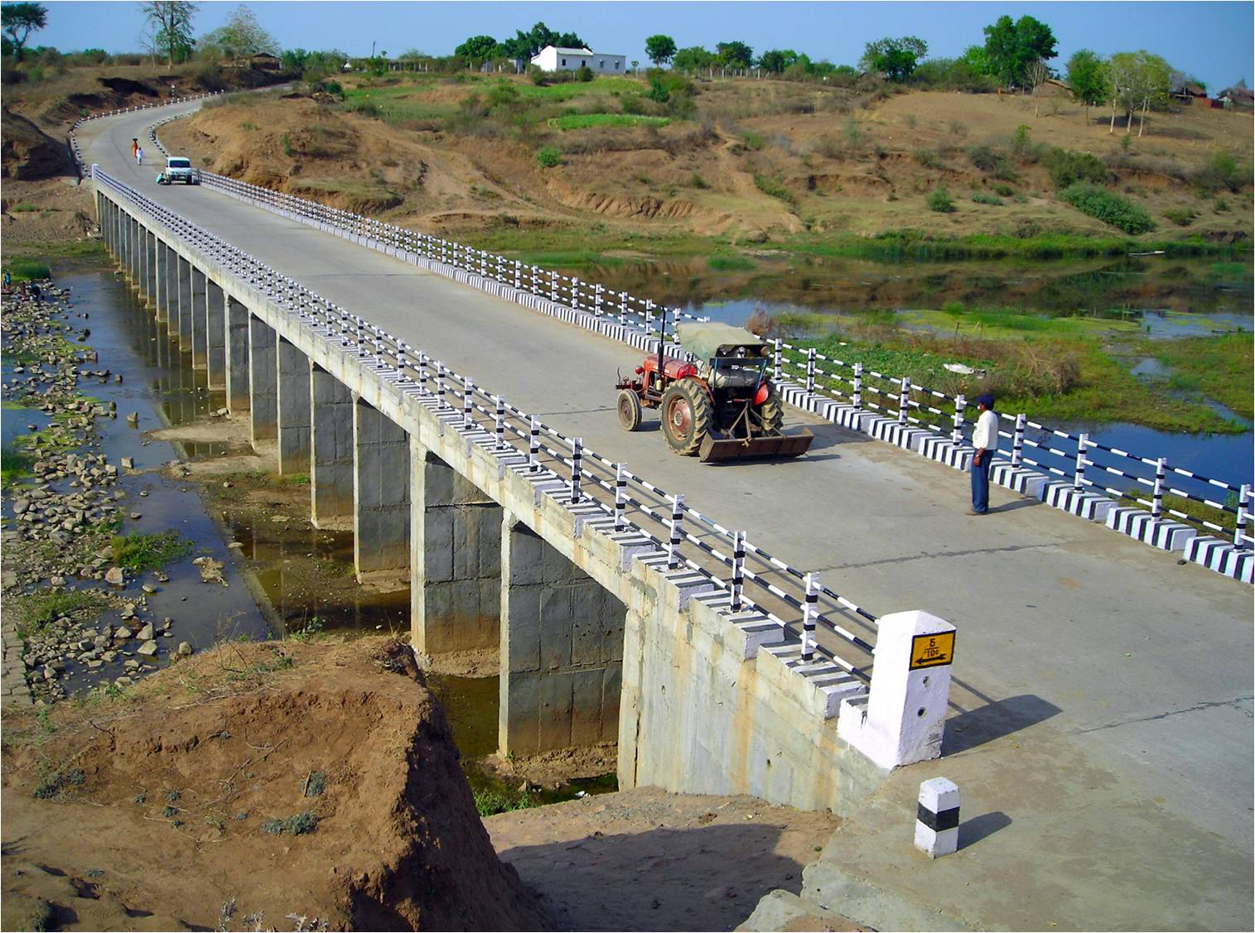
Pradhan Mantri Gram Sadak Yojana
eMARG
(electronic Maintenance of Rural Roads under PMGSY)
DATA PUSH FROM OMMAS TO eMARG
THE ROAD TO DIGITAL TRANSFORMATION

Slide 2
Data Push from OMMAS
to eMARG

Slide 3
FIRST STEP (MOST IMPORTANT): Check that each road is mapped to correct PIU on OMMAS

Slide 4
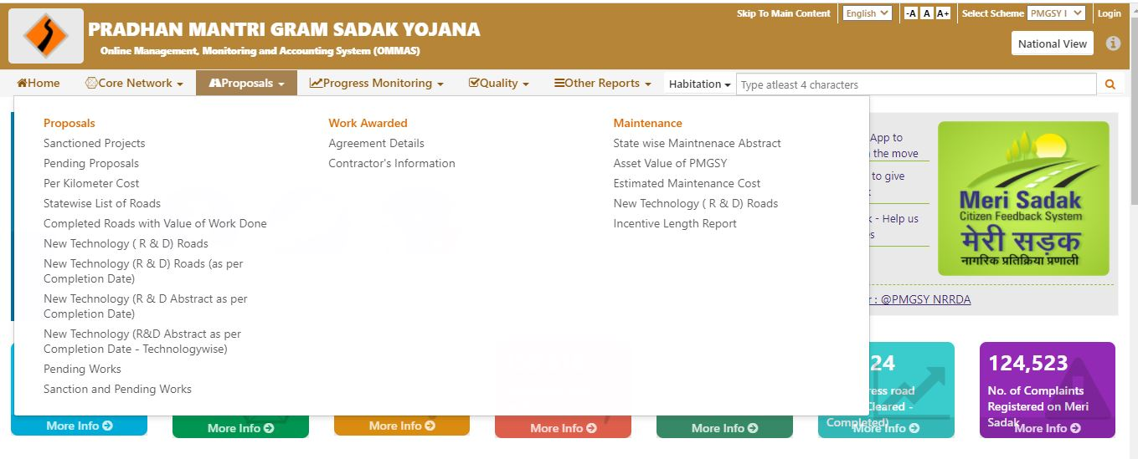
Step-1: Go to OMMAS Citizen Section “Proposals------>Statewise List of Roads”

Slide 5
Step-2: Select the suitable fields and click on view

Slide 6
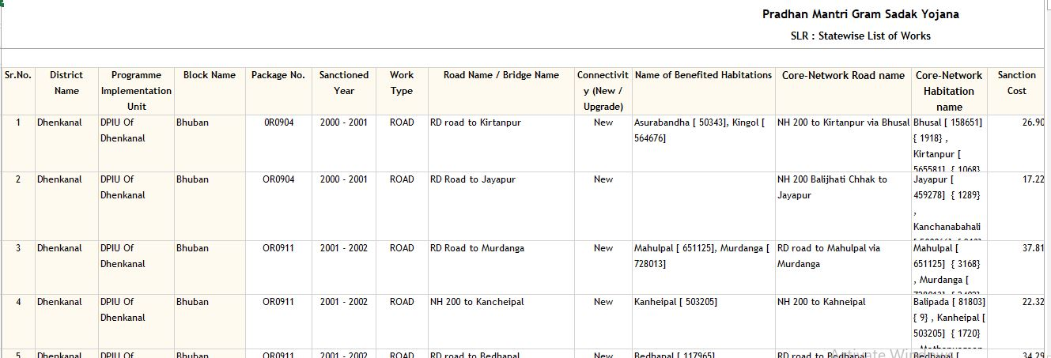
Step-3: Match the PIU Name against each road. If there is a mismatch in the name of PIU Displayed and actual PIU on ground then note the details and inform to NRIDA.
Don’t Proceed further in case the PIU is not correctly linked

Slide 7
Correcting the PIU Name against a particular road

Slide 8
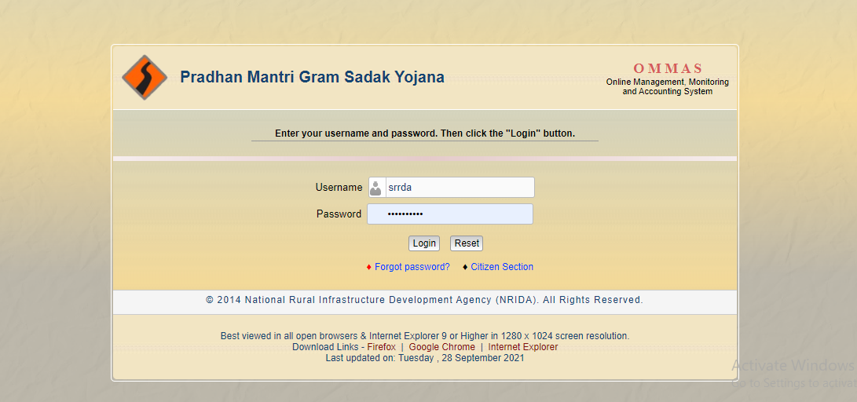
Step-1: Login to OMMAS with SRRDA Login

Slide 9
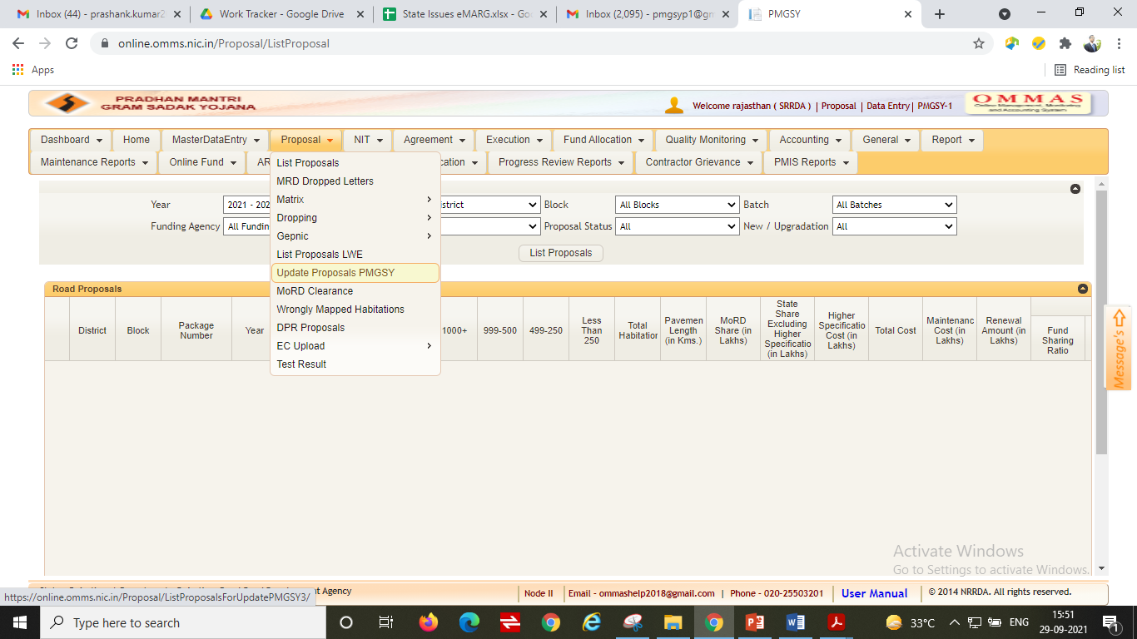
Step-2: Go to “Proposal------>Update Proposals PMGSY”

Slide 10
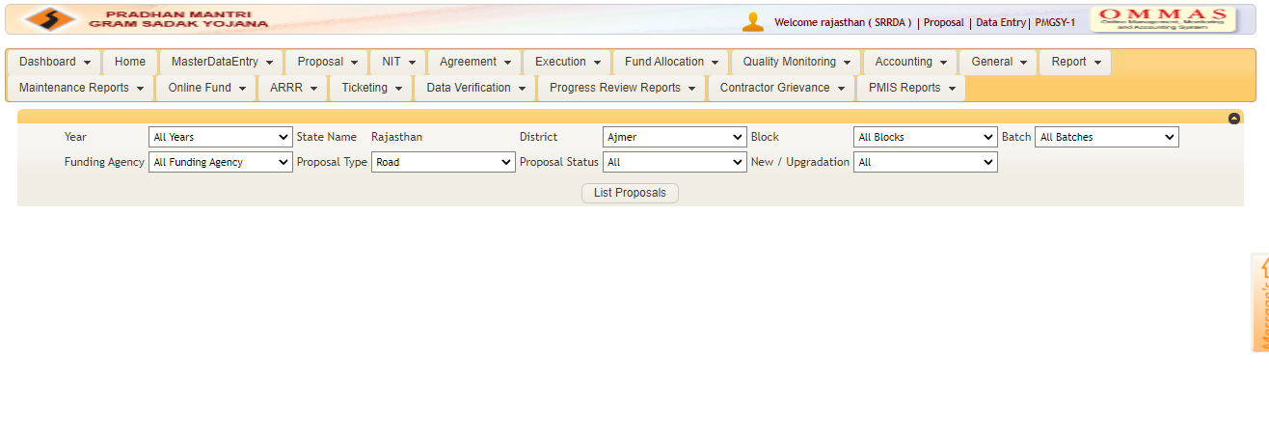
Step-3: Enter Details of the concerned road and click List proposals

Slide 11
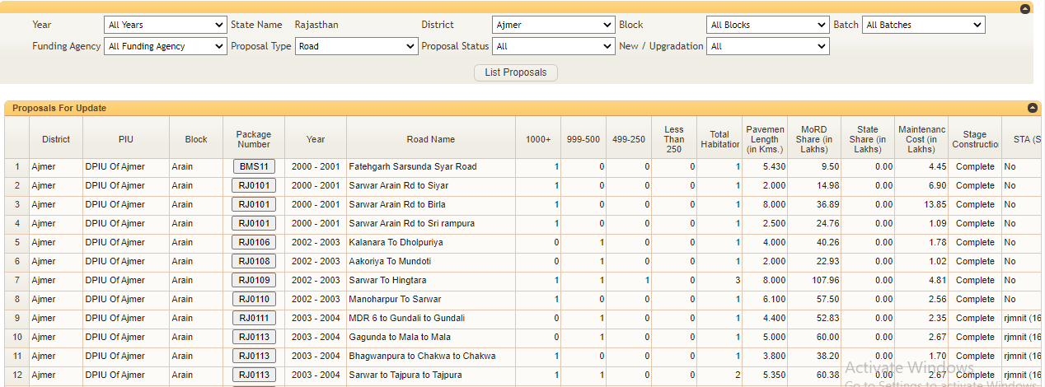
Step-4: Click on Package No. for

Slide 12
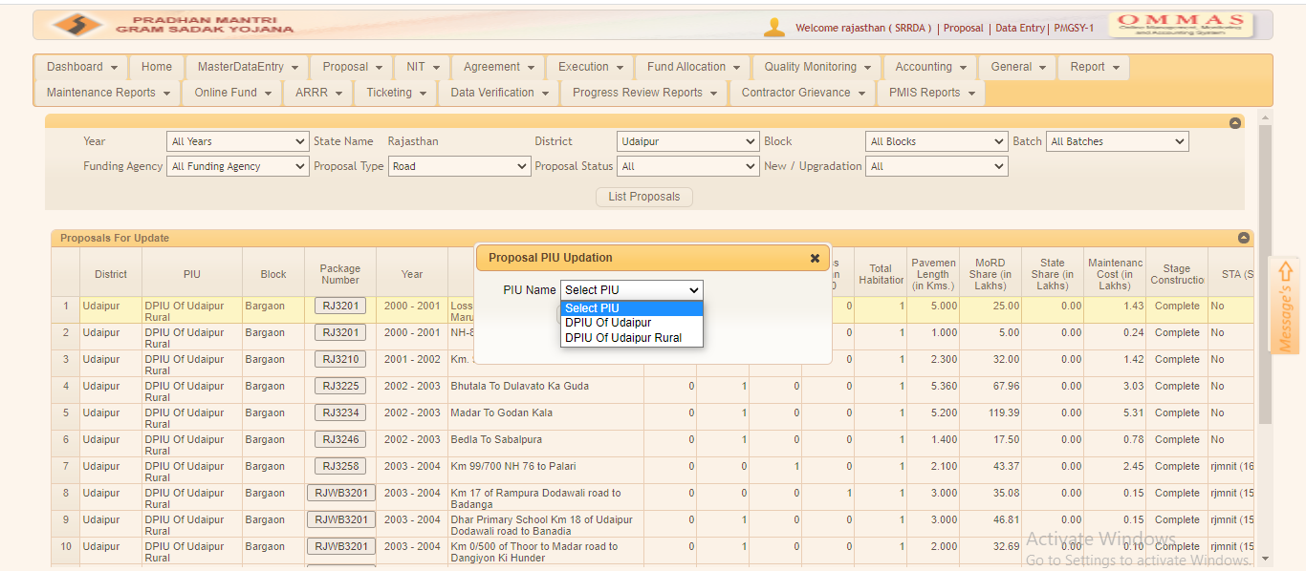
Step-5: Select correct PIU from the dropdown

Slide 13
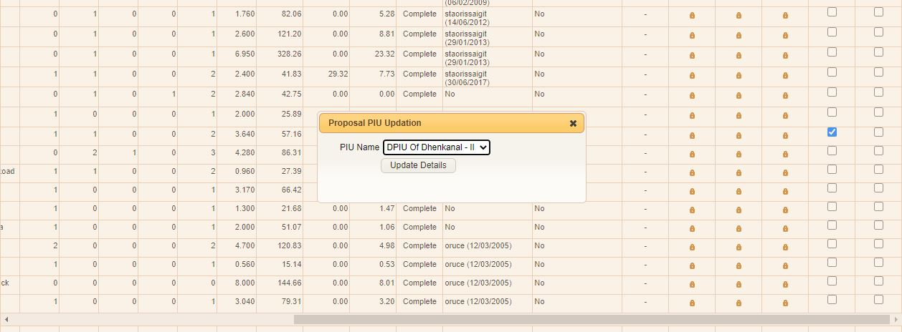
Step-7: Click on Update Details

Slide 14
SECOND STEP: Check the status of Maintenance Agreement Details of the Package

Slide 15
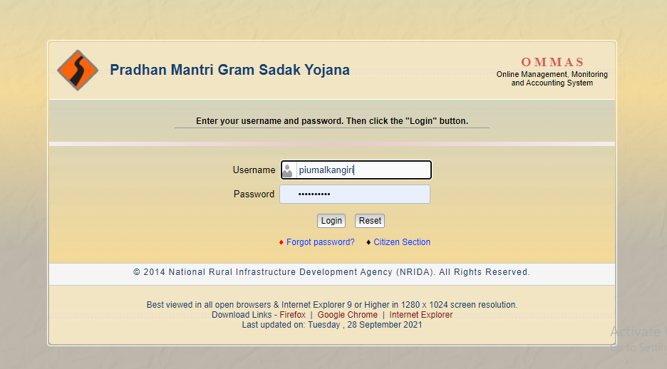
How to Check the status of Maintenance Agreement Details:
Step 1: PIU should login at OMMAS with his credentials (https://online.omms.nic.in/Login/Login/)

Slide 16
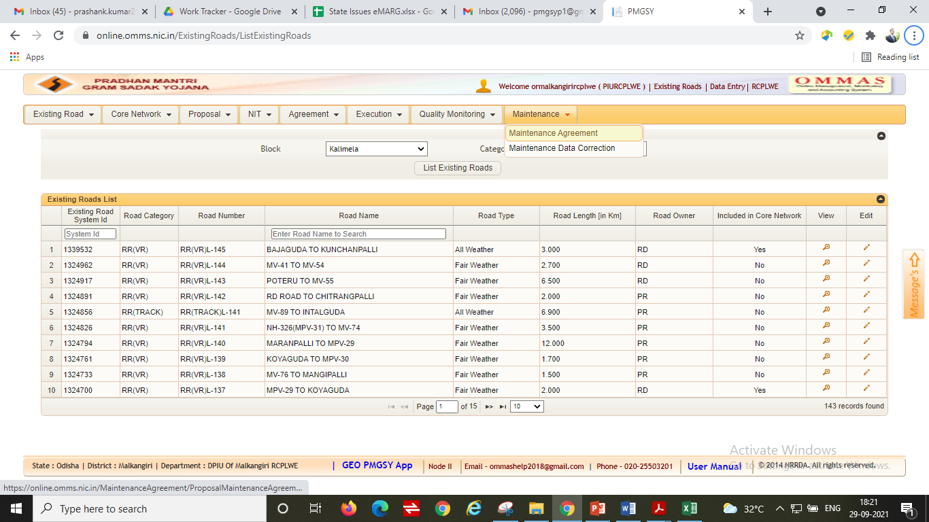
How to Check the status of Maintenance Agreement Details:
Step 2: Go to “Maintenance------->Maintenance Agreement”

Slide 17
How to Check the status of Maintenance Agreement Details:
Step 3: Enter the details of package and click on “View”

Slide 18
How to Check the status of Maintenance Agreement Details:
Step 4: Click on the “View” button available on the right of the screen

Slide 19
Step-5: Check how the Screen looks like on clicking “view”:
CASE-1: If the screen looks like below then it means that Maintenance Agreement Details have not been entered
CASE-2: If the screen looks like below then it means that Maintenance Agreement Details have been entered

Slide 20
How to Check the status of Maintenance Agreement Details:
Case-1 (Maintenance Agreement Details are not entered)
Step-1: Click on “Add Maintenance Details”

Slide 21
How to Check the status of Maintenance Agreement Details:
Case-1 (Maintenance Agreement Details are not entered)
Step-2: For “Do you want to continue with same contractor” click on “Yes” (if the contractor for construction and DLP maintenance are same)

Slide 22
How to Check the status of Maintenance Agreement Details:
Case-1 (Maintenance Agreement Details are not entered)
Step-3: Enter the mandatory fields and click on “save"
NOTE: If the contractor for construction and DLP maintenance are not same then click on “No” and enter all the details manually

Slide 23
How to Check the status of Maintenance Agreement Details:
Case-1 (Maintenance Agreement Details are not entered)
Step-4: Click on Lock button under “Finalize” to finalize the Maintenance Agreement

Slide 24
How to Check the status of Maintenance Agreement Details:
Case-2 (Maintenance Agreement Details are entered)
Step-1: Check the status of Maintenance Agreement Details
The Agreement Status should be always “In Progress”

Slide 25
How to Check the status of Maintenance Agreement Details:
Case-2 (Maintenance Agreement Details are entered)
Step-2: If the status is showing “complete” then Click on “Terminate”

Slide 26
How to Check the status of Maintenance Agreement Details:
Case-2 (Maintenance Agreement Details are entered)
Step-3: Click on “Add Maintenance Agreement Details” and enter the Maintenance Agreement Details again

Slide 27
How to Check the status of Maintenance Agreement Details:
Case-2 (Maintenance Agreement Details are entered)
Step-4: If the Agreement Status is “Terminate” then click on “Add Maintenance Agreement Details” to add agreement details again

Slide 28
How to Check the status of Maintenance Agreement Details:
Case-2 (Maintenance Agreement Details are entered)
Step-5: Check if the agreement detail is finalized (Lock button under “Finalize” option should be locked and not opened

Slide 29
How to Check the status of Maintenance Agreement Details:
Case-2 (Maintenance Agreement Details are entered)
Check if there are more than one roads in a package then the maintenance agreement details like “Maintenance Agreement Number”, “Contractor Name” and “ Agreement Date” should be same for all roads
Step 1: Click on ‘View’ one by one for all the roads and match their ‘Agreement Number’ and ‘Agreement Date’. Both of them should be same for all the roads in a single package.
Step 2: Check details for All roads one by one and make sure that Agreement No., Contractor Name and Agreement Date is same for all Roads

Slide 30
Please note the agreement numbers are different for the 2 roads in this package: 649F2 of 2007-08 and 648F2 of 2007-08
Step 3: Terminate the wrong Agreement by clicking on ‘Terminate’

Slide 31
Step 4: add a new Maintenance Agreement by clicking on ‘Add Maintenance Agreement Details’.
Step 5: After entering the corrected Maintenance agreement details and save them

Slide 32
Step 6: Finalize the saved new Maintenance Agreement

Slide 33
Checks on Maintenance Agreement Details:
Check the status of Maintenance Agreement Details
Check if maintenance agreement is present
No
Add the Maintenance Agreement Details
Yes
If the status is showing “Complete” then terminate the existing agreement and add new agreement
Check if the status of agreement details is “In Progress”
No
Yes
If the status is showing “Terminate” then simply add new agreement
No
Check if agreement is “Finalized”
Click on Lock button to finalize the agreement
NOTE: Check if there are more than one roads in a package then the maintenance agreement details like “Maintenance Agreement Number”, “Contractor Name” and “ Agreement Date” should be same for all roads

Slide 34
THIRD STEP:
Pushing Package From OMMAS to eMARG

Slide 35
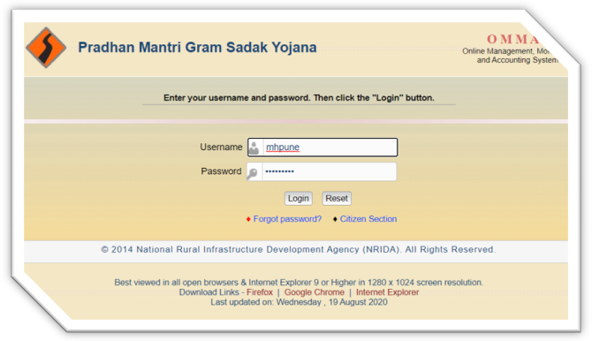
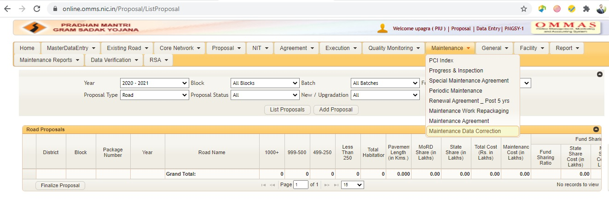
How to Push Package from OMMAS to eMARG:
Step 1: PIU should login at OMMAS with his credentials (https://online.omms.nic.in/Login/Login/)
Step 2: Go to “Maintenance” Menu and select “Maintenance Data Correction”

Slide 36
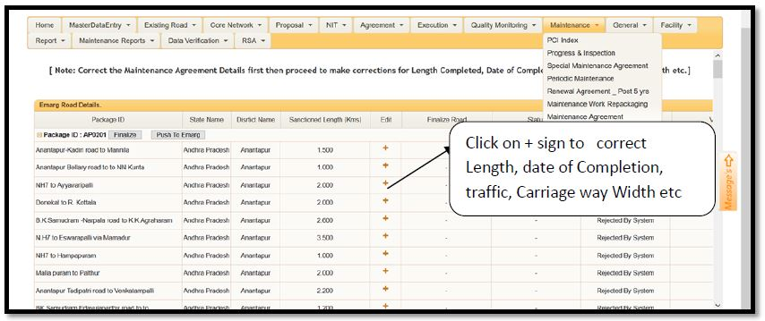
How to Push Package from OMMAS to eMARG:
Step 3: Look for your package on this screen and Click on ‘+’ (Edit) sign against all the roads one by one.
Packages Visible in this data correction Screen
The package which has completion date after 31st March 2014
The package which were earlier pushed to eMARG but had invalid data or some corrections required in them

Slide 37
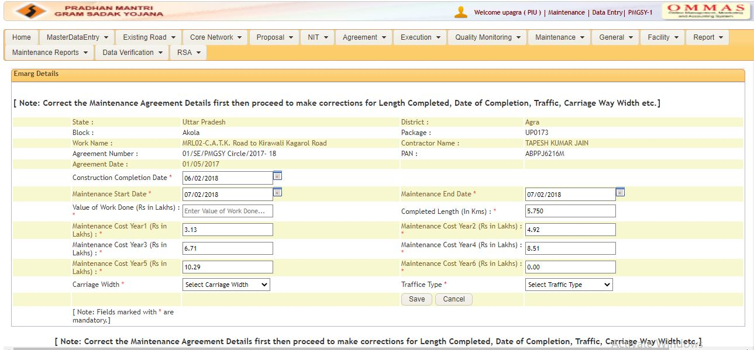
How to Push Package from OMMAS to eMARG:
Step 4: Details get displayed at the top of the page for this road. Fill the relevant field and click on save

Slide 38
How to Push Package from OMMAS to eMARG:
Step 5: Once the road details are edited and saved, you need to Finalize the road. To finalize the road, Click on ‘lock’ icon under ‘Finalize Road’

Slide 39
How to Push Package from OMMAS to eMARG:
Make sure that all the details of road are correct before finalizing the road. If after finalizing the road you feel that some entries are still to be corrected then you can de finalize the road and make the corrections again.

Slide 40
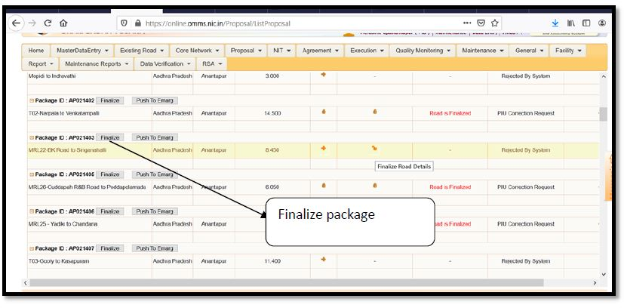
How to Push Package from OMMAS to eMARG:
Step 6: Once all the roads of a package are finalized, Click on ‘Finalize’ to finalize the complete package.

Slide 41
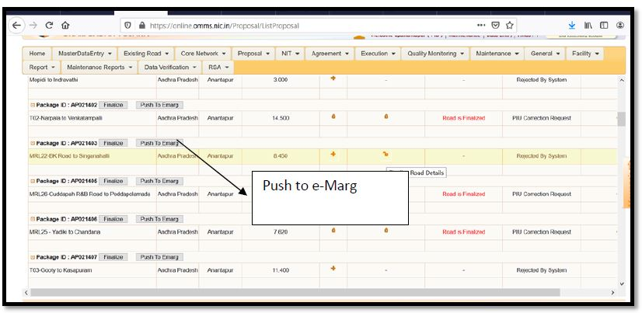
How to Push Package from OMMAS to eMARG:
Step 7: Click on ‘Push to eMARG’
The Status for the package changes to ‘Package pushed to eMARG’ in green.

Slide 42
How to Push Package from OMMAS to eMARG:
Step 8: The Status for the package changes to ‘Package pushed to eMARG’ in green.

Slide 43
Known Issues and Resolutions

Slide 44
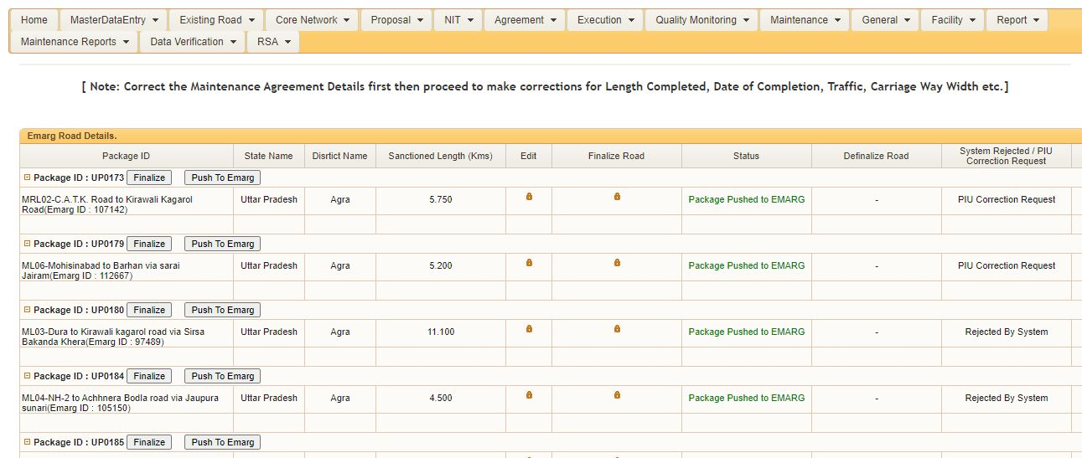
Issue-1: My package is not visible in the data correction screen for pushing to eMARG

Slide 45
Eligibility Criteria for Pushing of Package from OMMAS to eMARG:
Condition 1: A package is eligible for pushing to eMARG only when all the roads of a particular package are completed
Package | Roads | Completion Dates
ABC | Road 1 | 20 March 2018
 | Road 2 | 10 December 2017
 | Road 3 | -
This package will not be pushed to eMARG because Road 3 is still in progress
Condition 2: A package is eligible for pushing to eMARG only when the package completion date is after 31st March 2014
Package Completion Date: The date of completion of the last completed road of a package is the package completion date
The package completion date here is 15 February 2016 as Road 3 is getting completed last and since the package completion date is after 31st March 2014, the package can be pushed to eMARG
Package | Roads | Completion Dates
XYZ | Road 1 | 20 January 2016
 | Road 2 | 10 December 2013
 | Road 3 | 15 February 2016

Slide 46
Packages not Eligible for Pushing from OMMAS to eMARG:
Condition 1: All the roads of the package are of stage-1/stage-A type
Package | Roads | Completion Dates | Proposal Type
XYZ | Road 1 | 20 March 2018 | S1
 | Road 2 | 10 December 2017 | S1
 | Road 3 | 17 April 2018 | S1
All the roads of the package have been entered as a Stage-1 Road in ‘Proposal Type’, hence this package is not eligible to be pushed to eMARG
Condition 2: The package consists of only LSB works
Package | Work Name | Work Type | Completion Dates
XYZ | ABCD | LSB | 20 March 2018
 | EFGH | LSB | 10 December 2017
All the works of the package are LSBs. Hence, this package is not eligible for pushing to eMARG
Condition 3: The single road has more than one contractor maintaining it
Package | Road | Completion Date | Contractor Name
XYZ | Road 1 | 20 March 2018 | ABC
 |  |  | DEF
The road is maintained by more than one contractor. Hence, this package is not eligible for pushing to eMARG

Slide 47
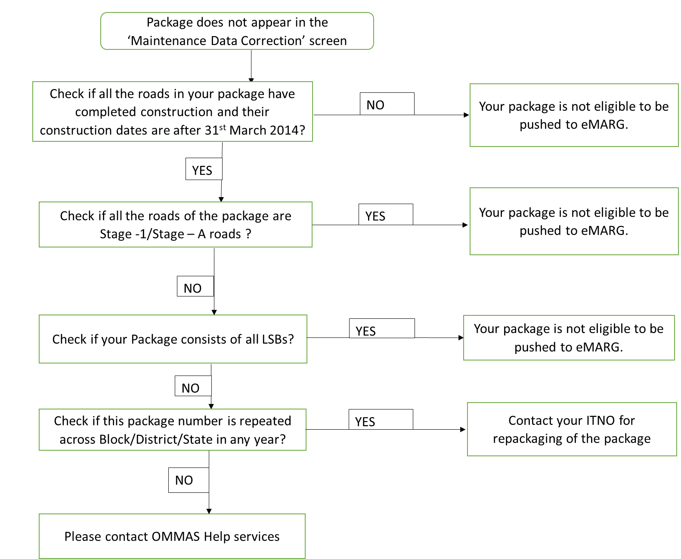
Issue-1: Checks to apply for packages not available in Data Pushing Screen of OMMAS

Slide 48
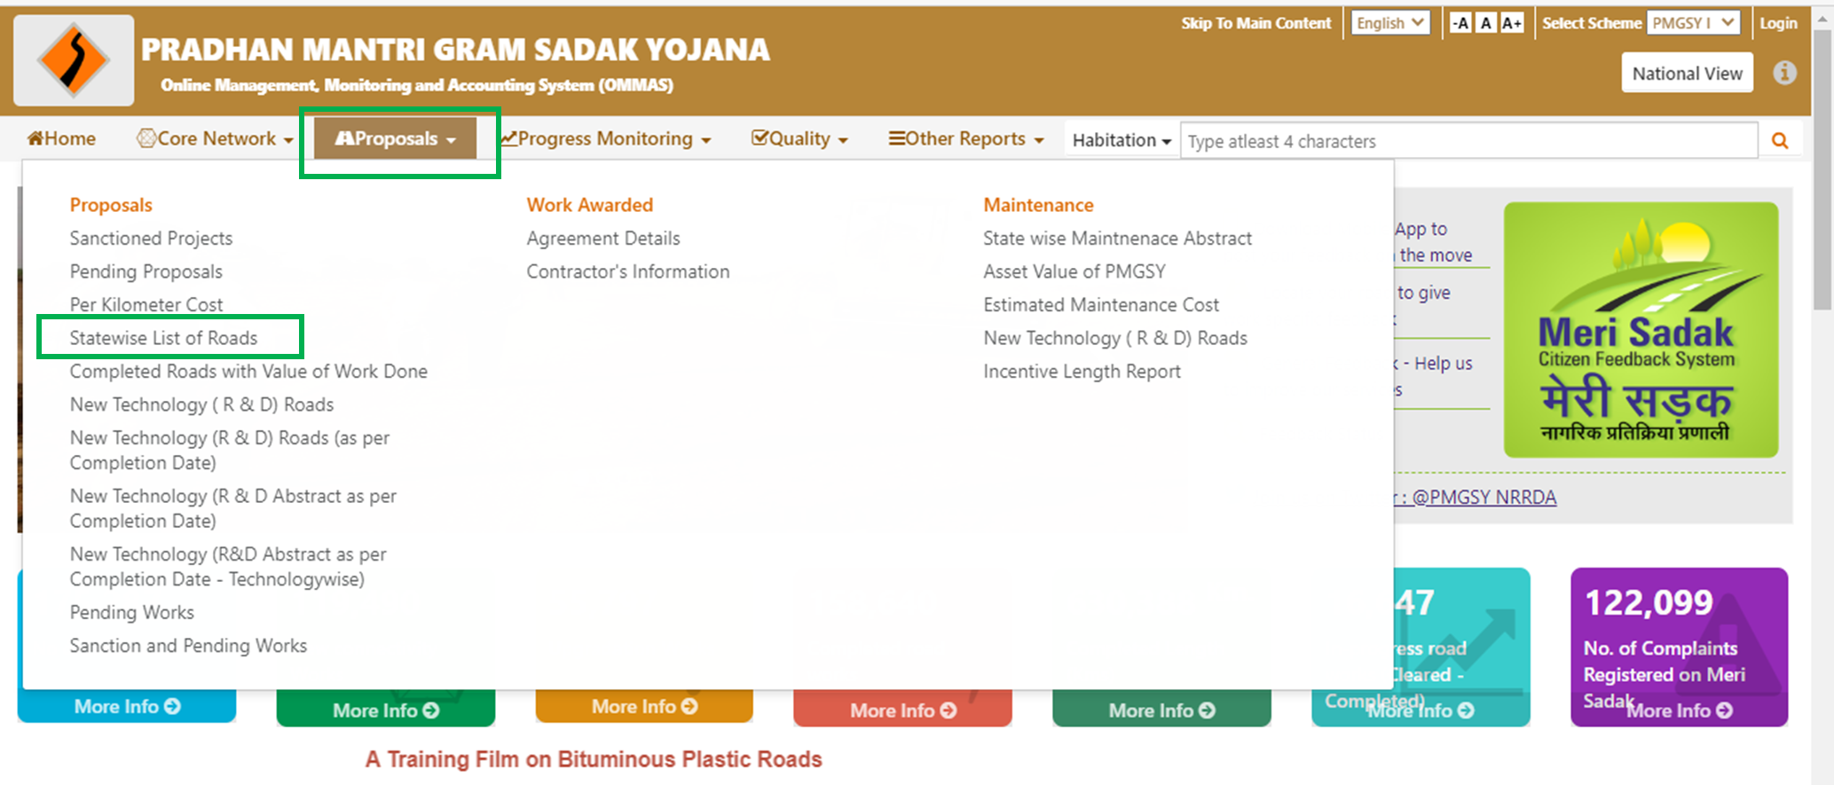
Check-1: If all roads of the Package are completed after 31st March 2014
Step 1: Go to http://omms.nic.in/ (OMMAS Home Page)
Step 2: Click on “Proposals → Statewise List of Roads”

Slide 49
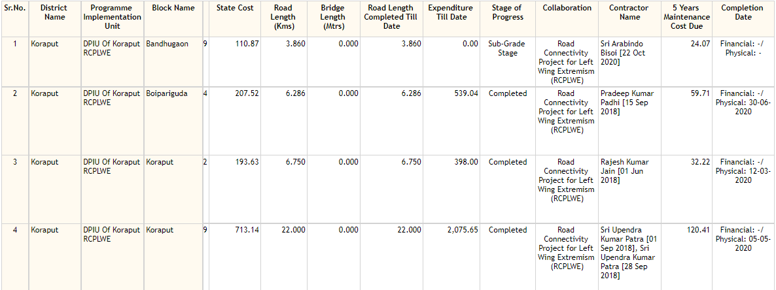
Step 3: Select State, Year – ‘All Years’ and check ‘Road wise’ checkbox
Step 4: Check the Physical Completion Date of Each Road of the package

Slide 50
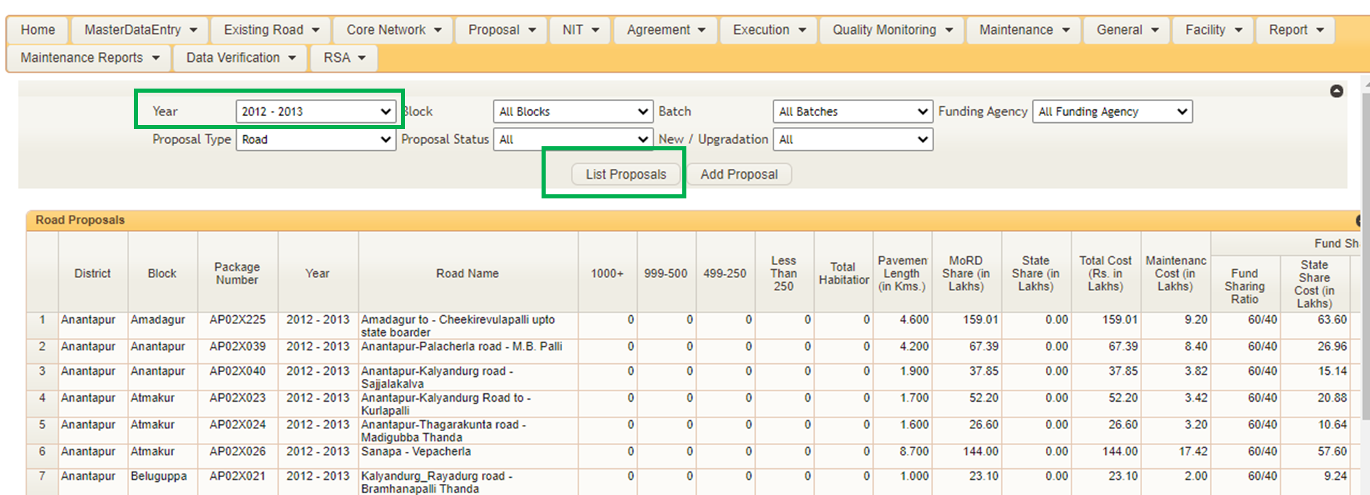
Check-2: Roads are of Stage-1 proposal
Step 1: PIU should login at OMMAS with his credentials (https://online.omms.nic.in/Login/Login/)
Step 3: Fill in the Sanction Year of the package and click on ‘List Proposals’

Slide 51
Step 4: Search for your package number on this screen.
If the package is not found here, this package data has not at all been entered on OMMAS.
If the package is found on this screen, Click on View against the package.
Step 5: Check if the Proposal Type is ‘Stage-1/Stage-A’

Slide 52
Step 6: Similarly, check for all roads under a package.
Your package is not eligible for pushing to eMARG if all roads of your package is a stage-1 construction
If all the roads in your package has ‘Proposal Type’ as ‘Complete’ (as shown below), follow the next set of checks.

Slide 53
Check-3: Package consists of LSBs:
Step 1: Go to http://omms.nic.in/ (OMMAS Home Page)
Step 2: Click on “Proposals → Statewise List of Roads”

Slide 54
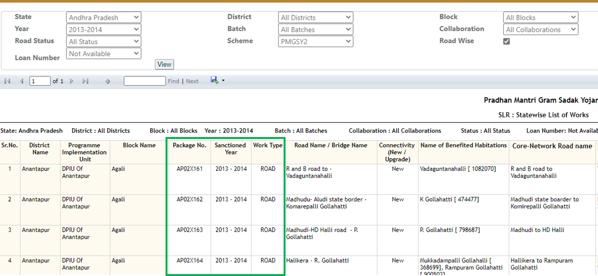
Step 3: Select State, Year – ‘All Years’ and check ‘Road wise’ checkbox
Step 4: The list of works with package numbers will get populated. Search for your package number in this list and check if this package consists of LSBs in ‘Work Type’? See Picture below.

Slide 55
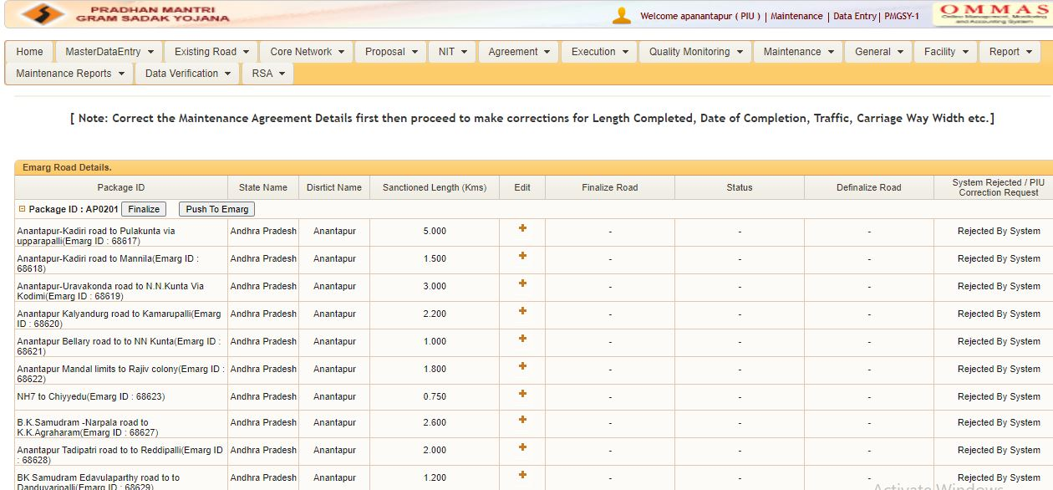
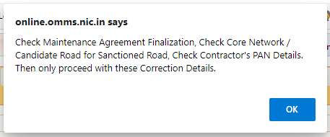
Issue-2: My package is visible in the Maintenance data correction screen but I get the below error while finalizing my package:

Slide 56
Understanding the reasons of the Issues:
eMARG System is designed to work for the ideal Case
Bidding for construction is done Package wise and not Road wise
Every Road of the Package is awarded to a single contractor on the same day
Every Road of the Package to have same Agreement Number and same Agreement Date
By clause of SBD, Now the package comes under DLP after every road of the package is completed
Checks Applied by eMARG system to accept Data from OMMAS:
Check-1:
Package | Roads | Maintenance Agreement No. | Maintenance Agreement Date
XYZ12 | Road 1 | ABCDEF/123 | 1/7/2020
 | Road 2 | ABCDEF/123 | 1/7/2020
 | Road 3 | ABCDEF/123 | 1/7/2020
All the roads of a package should have a common Maintenance Agreement No. and Date
Check-2:
All the relevant fields of a Road data, i.e. Contractor Name, PAN No. of Contractor, Agreement No., Construction Completion Date, Completed Length of Road, Carriage way width, Traffic Type, etc should be present in correct format

Slide 57
Checks on Maintenance Agreement Details:
Check the status of Maintenance Agreement Details
Check if maintenance agreement is present
No
Add the Maintenance Agreement Details
Yes
If the status is showing “Complete” then terminate the existing agreement and add new agreement
Check if the status of agreement details is “In Progress”
No
Yes
If the status is showing “Terminate” then simply add new agreement
No
Check if agreement is “Finalized”
Click on Lock button to finalize the agreement
NOTE: Check if there are more than one roads in a package then the maintenance agreement details like “Maintenance Agreement Number”, “Contractor Name” and “ Agreement Date” should be same for all roads

Slide 58
Some of the Known Issues:
Issue-2: My package is visible in the Maintenance data correction screen but I get error message
Even if after applying all the above mentioned checks if the error message still comes then please check if Package No. is repeated in same district or other district
If so, then contact your ITNO for repackaging of the package
Issue-3: I have pushed my package from OMMAS, however it is not visible in eMARG
Packages pushed from OMMAS are available in eMARG within a maximum of 24 hours. Please check in eMARG after this duration. If the package is still not visible, contact support team.
Issue-4: I have marked my package for correction in eMARG, however it is not visible in OMMAS ‘Maintenance Data Correction’ screen
Packages marked for correction in eMARG are available for correction at OMMAS within a duration of 24-48 hours. Please check after this duration. If it is still not visible, please check that The Package Completion Date is after 31st March 2014

Slide 59
eMARG Package Repackaging

Slide 60
When to Change Package No. of a package using Package Repackaging module??

Slide 61
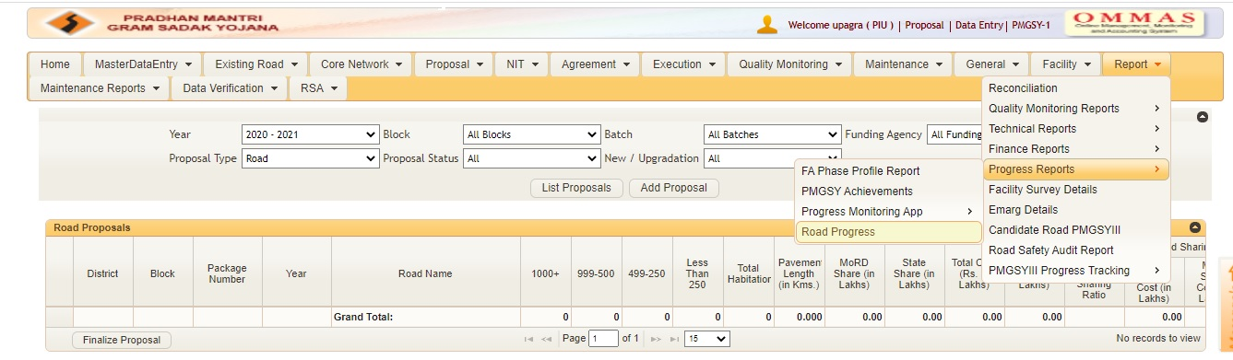
Check-1: If the package number is repeated across Block/District/State/Scheme in any year
Ideally, a package number should only be used once. If the package number is repeated and at least one road in any of the package has still not completed construction, the complete package will not show up on ‘Maintenance Data Correction’ screen
Step 1: PIU should login at OMMAS with his credentials (https://online.omms.nic.in/Login/Login/)
Step 2: Go to “Report---->Progress Report----->Road Progress”

Slide 62
Step 3: Select “All Blocks”, “All Collaborations”, “All Agencies” and “All Schemes”
The list of works with package numbers will get populated. Search for your package number in this list and check if all the roads displayed under your package are actually a part of single package. If not then the package will need to be splitted/Re Packaged.

Slide 63
Issue-1: Package is not available for pushing on OMMAS Data correction Screen even after checking eligibility criteria
S.No | State | District | Block | Sanctioned Year | Package ID | Road Name | Sanctioned Length | Completed Length | Completion Date
1 | Chhattisgarh | Bastar | Tokapal | 2019-2020 | CG0106 | MATKOT TO KURUSHPAL | 3.825 | 0 | -
2 | Chhattisgarh | Kondagaon | Keshkal | 2001-2002 | CG0106 | N.H.43 Gudaba para to Awanari | 6.2 | 6.2 | Jun 30 2013
3 | Chhattisgarh | Kondagaon | Keshkal | 2001-2002 | CG0106 | N.H.43 to Toshakapal | 5.7 | 5.7 | Feb 28 2013
4 | Chhattisgarh | Kondagaon | Baderajpur | 2001-2002 | CG0106 | Korohobeda to Kongera | 3 | 3 | Jul 15 2014
5 | Chhattisgarh | Kondagaon | Keshkal | 2001-2002 | CG0106 | Bedma, Amabeda road to Eragaon | 4.1 | 4.1 | Jun 10 2015
6 | Chhattisgarh | Kondagaon | Keshkal | 2001-2002 | CG0106 | Bedma, Amabeda road to Binjhe | 7.7 | 7.7 | Mar 31 2017
7 | Chhattisgarh | Kondagaon | Keshkal | 2001-2002 | CG0106 | Bedma, Amabeda road to Khaterapal | 2.75 | 2.75 | Mar 31 2017
8 | Chhattisgarh | Kondagaon | Keshkal | 2001-2002 | CG0106 | Bedma, Amabeda to Karmari | 1.15 | 1.114 | Jan 31 2017
9 | Chhattisgarh | Kondagaon | Keshkal | 2001-2002 | CG0106 | Boregaon, Adenga road to Surdihi | 12.8 | 12.8 | May 31 2017
9 Roads in Package No- CG0106 out of which 1 road sanctioned in Bastar District in 2019-20 is in progress
The complete Package CG0106 is in progress
Package No of Road No-6,7,8 and 9 needs to be changed
Introduce a “-” or add a suffix A at the end of package No. (i.e. CG-0106 or CG0106A)

Slide 64
Issue-1: Package is not available for pushing on OMMAS Data correction Screen
S.No | State | District | Block | Sanctioned Year | New Package ID | Road Name | Sanctioned Length | Completed Length | Completion Date
1 | Chhattisgarh | Bastar | Tokapal | 2019-2020 | CG0106 | MATKOT TO KURUSHPAL | 3.825 | 0 | -
2 | Chhattisgarh | Kondagaon | Keshkal | 2001-2002 | CG0106 | N.H.43 Gudaba para to Awanari | 6.2 | 6.2 | Jun 30 2013
3 | Chhattisgarh | Kondagaon | Keshkal | 2001-2002 | CG0106 | N.H.43 to Toshakapal | 5.7 | 5.7 | Feb 28 2013
4 | Chhattisgarh | Kondagaon | Baderajpur | 2001-2002 | CG0106 | Korohobeda to Kongera | 3 | 3 | Jul 15 2014
5 | Chhattisgarh | Kondagaon | Keshkal | 2001-2002 | CG0106 | Bedma, Amabeda road to Eragaon | 4.1 | 4.1 | Jun 10 2015
6 | Chhattisgarh | Kondagaon | Keshkal | 2001-2002 | CG-0106 | Bedma, Amabeda road to Binjhe | 7.7 | 7.7 | Mar 31 2017
7 | Chhattisgarh | Kondagaon | Keshkal | 2001-2002 | CG-0106 | Bedma, Amabeda road to Khaterapal | 2.75 | 2.75 | Mar 31 2017
8 | Chhattisgarh | Kondagaon | Keshkal | 2001-2002 | CG-0106 | Bedma, Amabeda to Karmari | 1.15 | 1.114 | Jan 31 2017
9 | Chhattisgarh | Kondagaon | Keshkal | 2001-2002 | CG-0106 | Boregaon, Adenga road to Surdihi | 12.8 | 12.8 | May 31 2017
The package No. of Roads of S.No-6,7,8 and 9 is now different with others
Package No. CG-0106 will now be available for data pushing in OMMAS

Slide 65
Issue-2: Getting Error message on pushing data from OMMAS data correction screen
Package No | Roads | Maintenance Agreement No. | Maintenance Agreement Date
XYZ123 | Road 1 | ABCDEF/123 | 1/7/2018
XYZ123 | Road 2 | GHIJKL/456 | 31/1/2019
XYZ123 | Road 3 | MNOPQ/789 | 15/9/2020
Different but correct Agreement Details for all roads of same package
Change Package No for Road 2 and Road 3 by introducing a “-” or add a suffix A at the end of package No. XYZ123 so that all roads have different package No.
New Package No | Roads | Maintenance Agreement No. | Maintenance Agreement Date
XYZ123 | Road 1 | ABCDEF/123 | 1/7/2018
XYZ-123 | Road 2 | GHIJKL/456 | 31/1/2019
XYZ123A | Road 3 | MNOPQ/789 | 15/9/2020
Package XYZ123, XYZ-123 and XYZ123A can be pushed from OMMAS data correction screen

Slide 66
Issue-3: Package has “Stage-1” and “Stage-2/complete” Roads both
Package | Roads | Completion Dates | Proposal Type
XYZ123 | Road 1 | 20 March 2018 | S1
XYZ123 | Road 2 | 10 December 2017 | Complete
XYZ123 | Road 3 | 10 December 2017 | Complete
Package has a combination of Stage-1 and Complete roads both
Change Package No for Road 2 and Road 3 by introducing a “-” or add a suffix A at the end of package No. XYZ123 so that road with S1 proposal can be split
Package | Roads | Completion Dates | Proposal Type
XYZ123 | Road 1 | 20 March 2018 | S1
XYZ-123 | Road 2 | 10 December 2017 | Complete
XYZ-123 | Road 3 | 10 December 2017 | Complete
Package XYZ-123 with Road 2 and Road 3 will be available for pushing from OMMAS data correction screen

Slide 67
Issue-4: Package has LSB and Roads both
Package | Roads | Completion Dates | Work Type
XYZ123 | ABC | 20 March 2018 | LSB
XYZ123 | Road 2 | 10 December 2017 | Road
XYZ123 | Road 3 | 10 December 2017 | Road
Package has a combination of LSB and roads both
Change Package No for Road 2 and Road 3 by introducing a “-” or add a suffix A at the end of package No. XYZ123 so that LSB and Roads can be split from package
Package | Roads | Completion Dates | Proposal Type
XYZ123 | ABC | 20 March 2018 | LSB
XYZ-123 | Road 2 | 10 December 2017 | Road
XYZ-123 | Road 3 | 10 December 2017 | Road
Package XYZ-123 with Road 2 and Road 3 will be available for pushing from OMMAS data correction screen

Slide 68
How to Change Package No. of a package using Package Repackaging module??

Slide 69
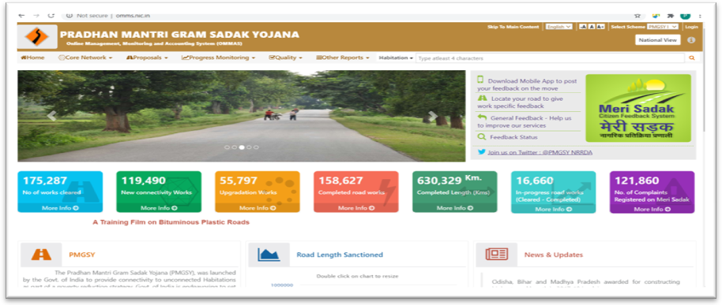
Step-1: ITNO Login To OMMAS:

Slide 70
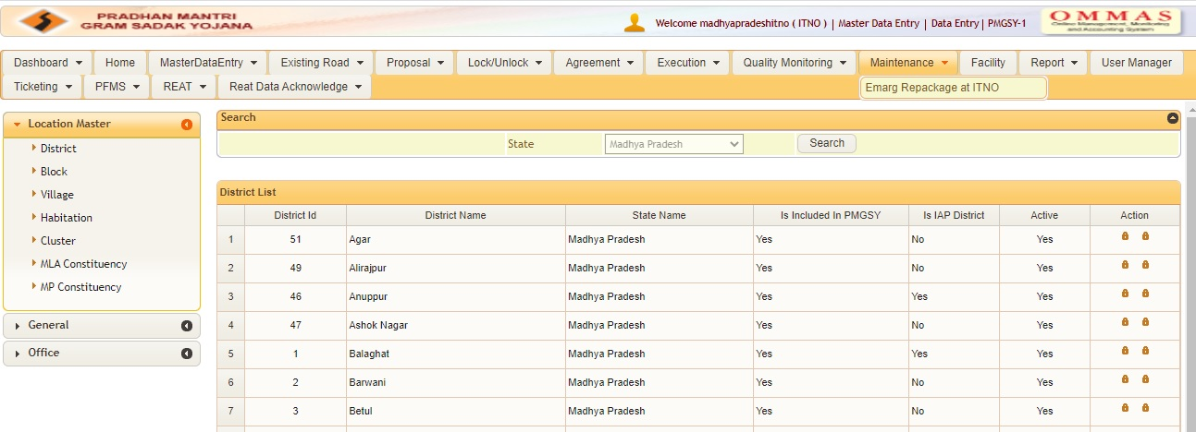
Step-2: Go to “Maintenance----->Emarg Repackage at ITNO”

Slide 71
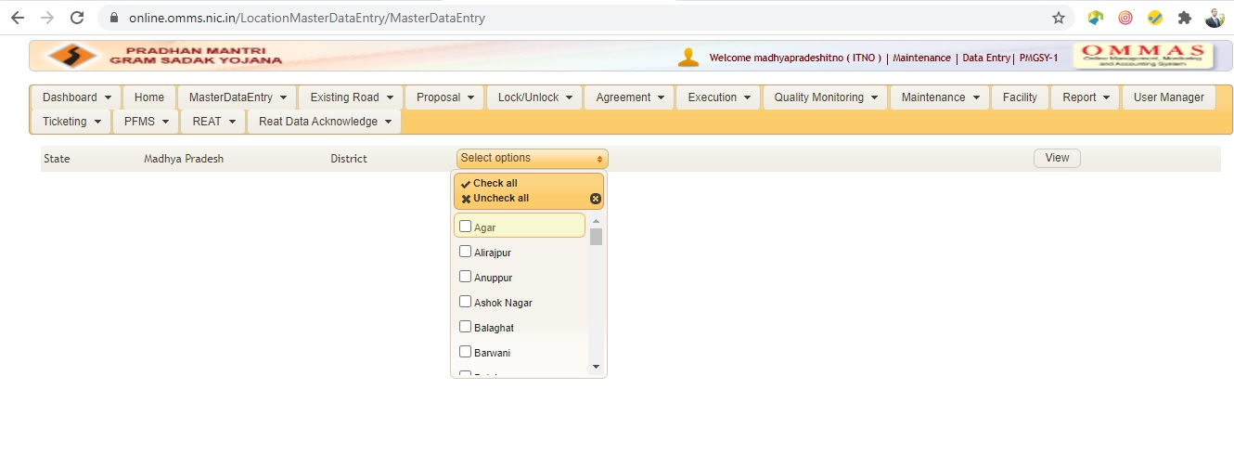
Step-3: Select District then click on view

Slide 72
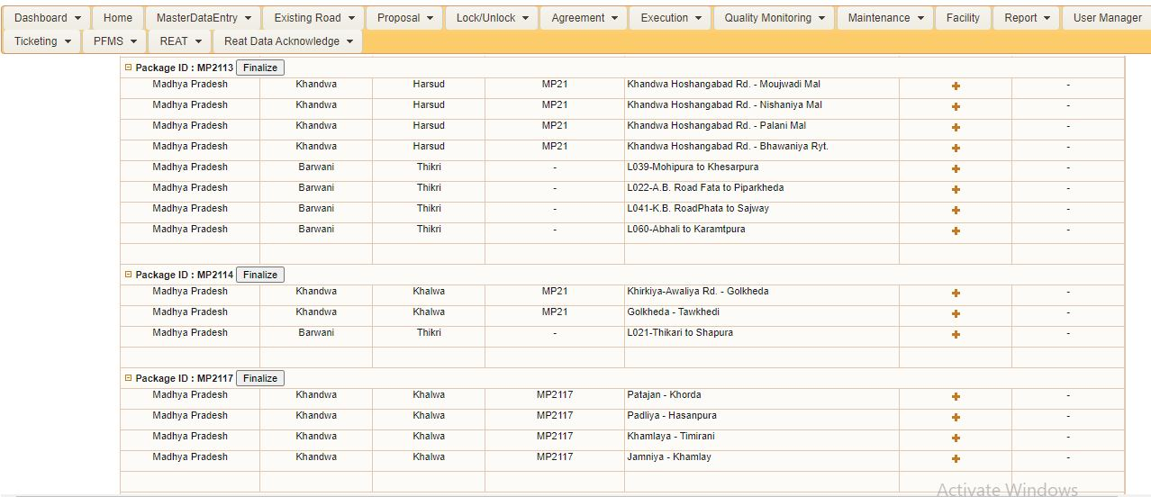
Step-4: Search Package No. and click on “+” sign for roads whose Package No. is to be changed

Slide 73
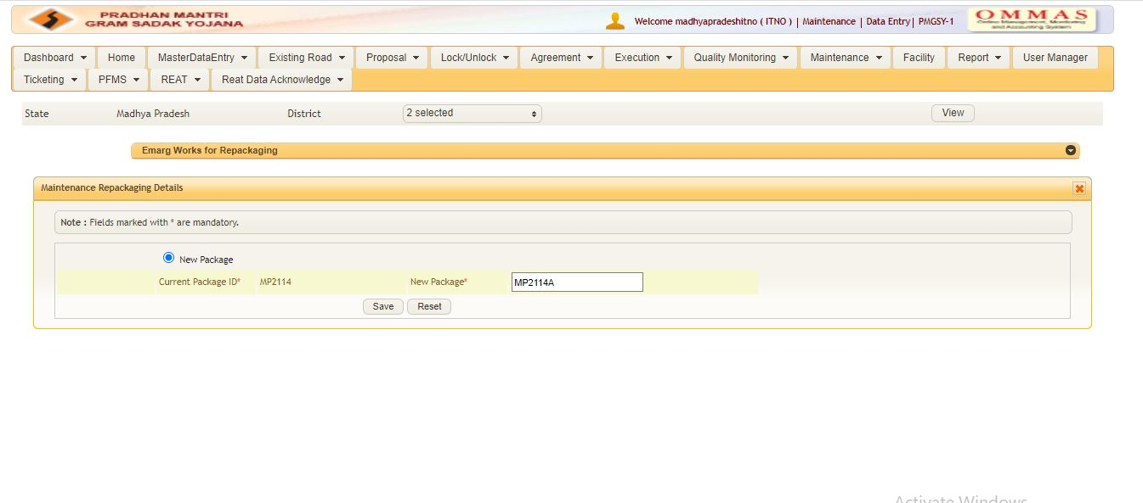
Step-5: Enter the new Package No. And click on Save

Slide 74
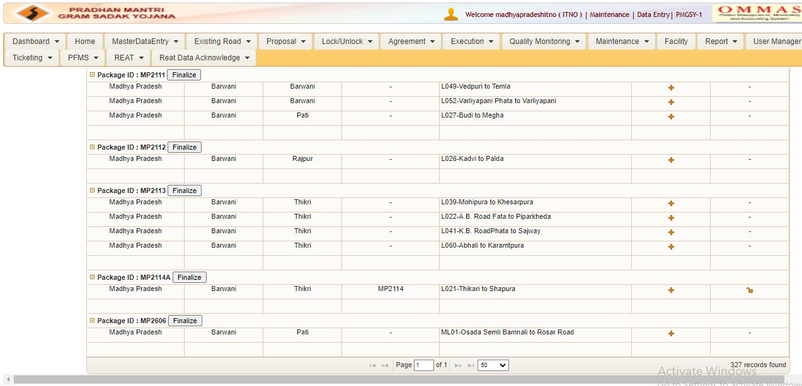
Step-6: Click on Lock sign to finalize Road Details
NOTE: If Package No. for more than one road is to be changed then finalize New Package No of every road first.

Slide 75
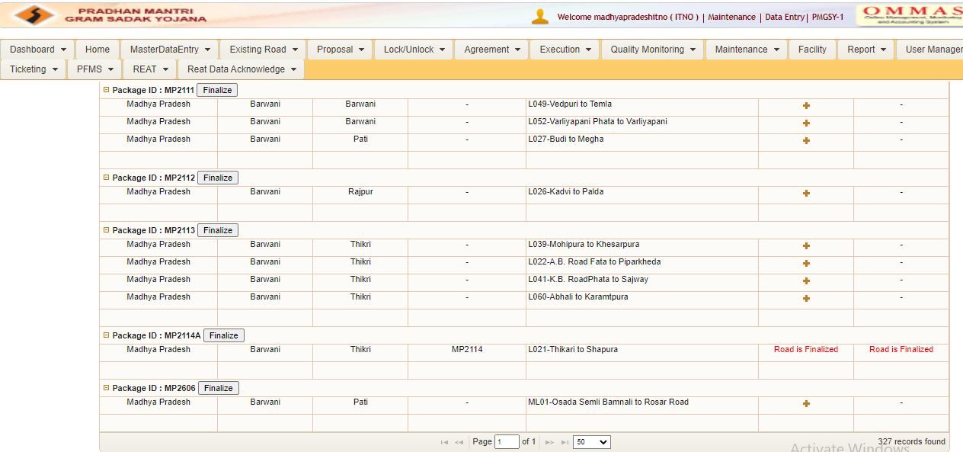
Step-6: Click on “Finalize” to finalize Package Details

Slide 76
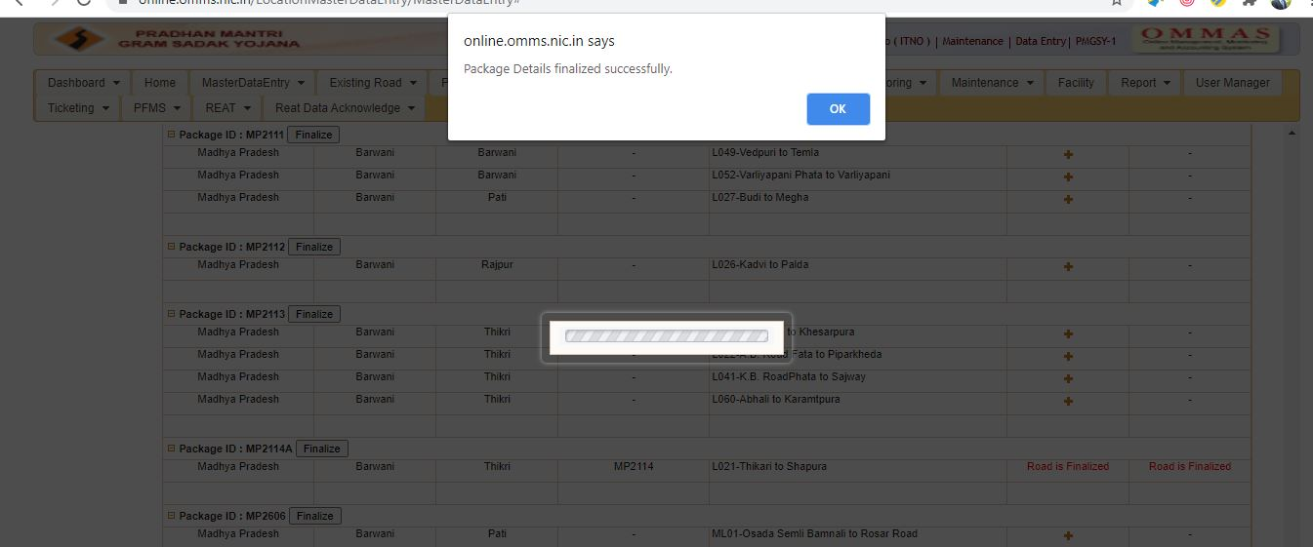
Step-7: Package is Repackaged successfully

Slide 77
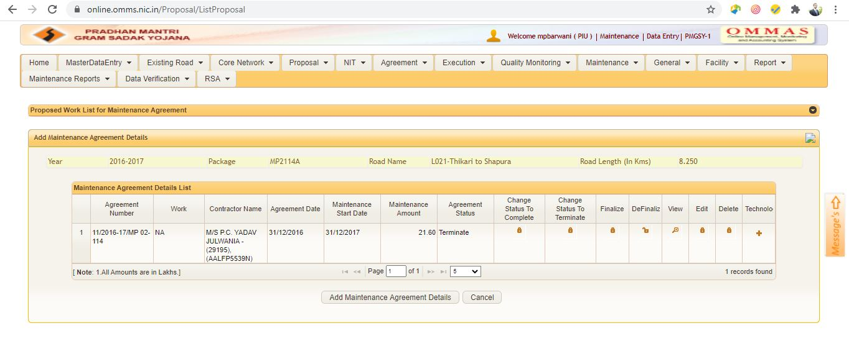
Step-8: PIU to enter Agreement Details again for the new package No.
Once a Package is Repackaged, the PIU has to enter the Maintenance Agreement Details again as the older agreement details will be automatically terminated
The old Agreement No. can not be re entered now

