Slide 1
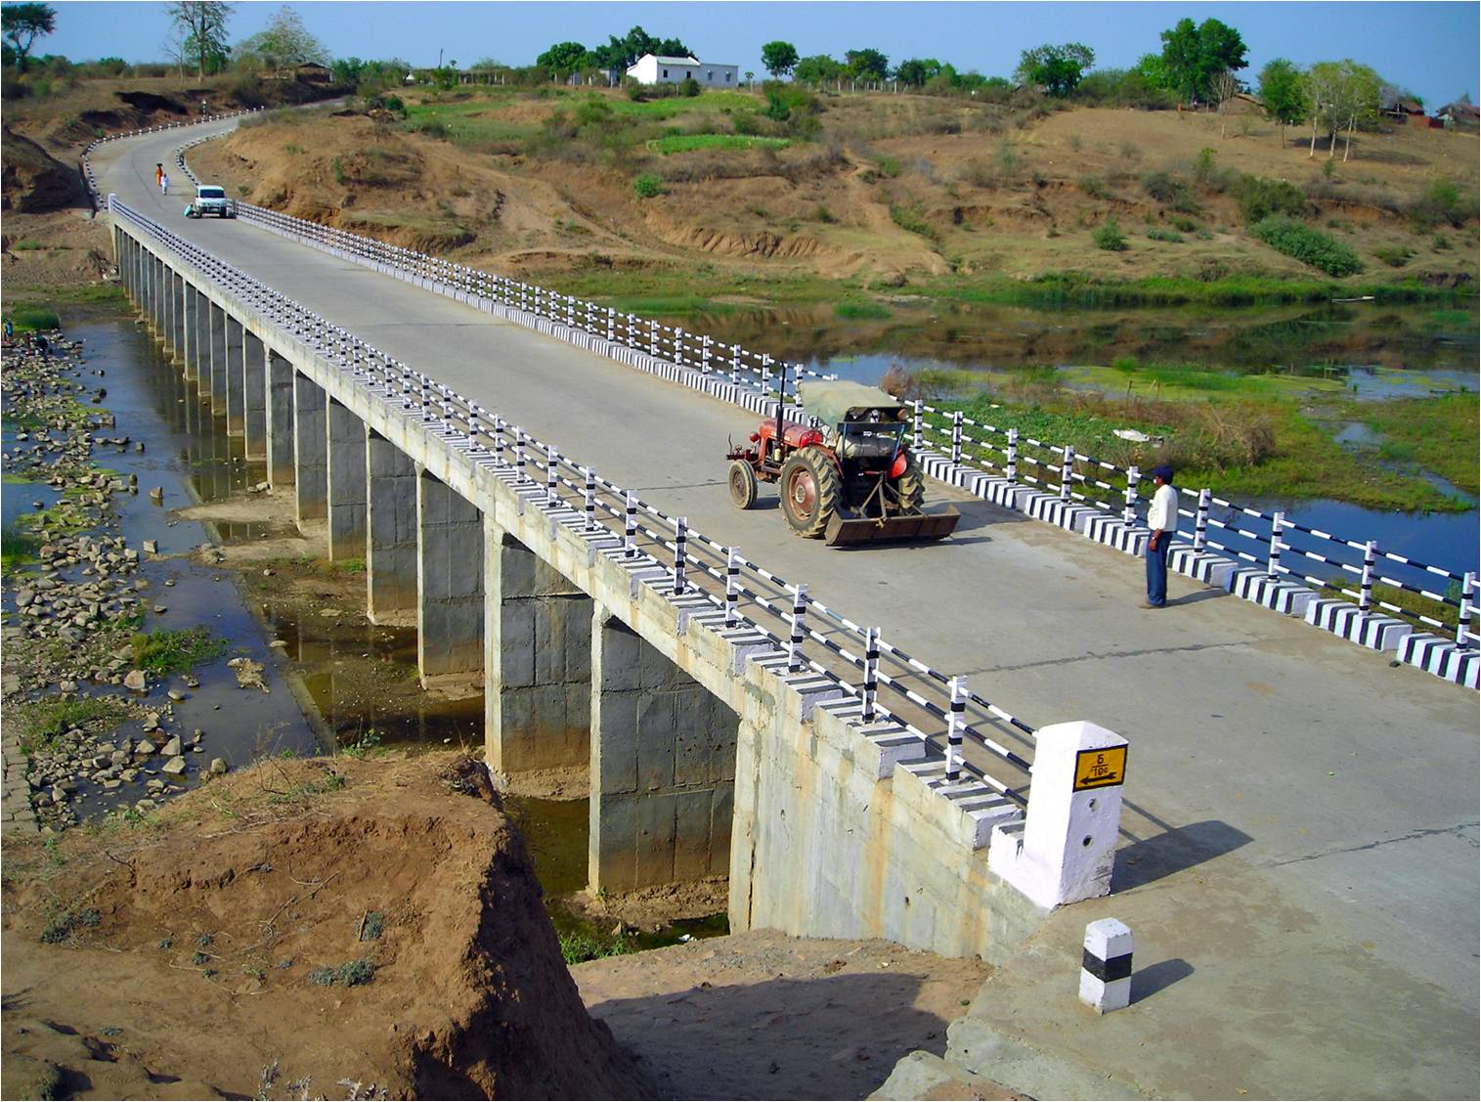
Pradhan Mantri Gram Sadak Yojana
eMARG
(electronic Maintenance of Rural Roads under PMGSY)
Performance Based Maintenance Contract (PBMC) & eMARG
THE ROAD TO DIGITAL TRANSFORMATION

Slide 2
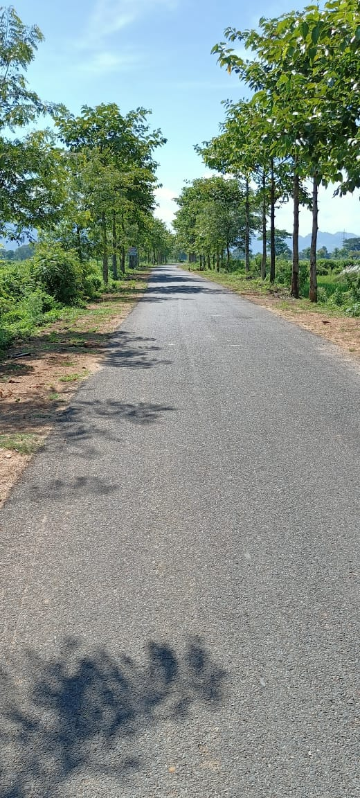
Need for timely maintenance of PMGSY Roads
If Roads are not maintained routinely and on time, the cost of repair increases exponentially, till the point the entire Roads need to be reconstructed, which isn’t feasible at this scale
Pradhan Mantri Gram Sadak Yojana
Types of Maintenance of PMGSY Roads
Rural Road Connectivity
Routine maintenance for 5-years post construction
Periodic Renewal of Roads which have completed 5 years of construction
Routine Maintenance of Roads post 5 years of completion
7,68,000 km of Roads sanctioned
6,67,000 km Roads constructed
3,32,500 Cr Asset value worth
DLP Maintenance
Post DLP Maintenance
12% of India’s entire Road network
Defect Liability Period (DLP)
The initial period of 5 years post construction completion date of a Road in which the same contractor who has constructed the Road has to carry out the routine maintenance also
No separate contract is signed for carrying out the routine maintenance for 5 years post construction
1,78,000+ habitations connected
40.5 Cr population (48% rural population) benefitted

Slide 3
MAINTENANCE OF ROADS BEFORE INTRODUCTION OF eMARG

Slide 4
Minimum Requirements of Routine Maintenance Standards:
(Source: Cl 32.4 of SBD)
Potholes on the Road surface to be repaired soon after these appear or brought to his notice either during the Contractor’s monthly inspection or by the Engineer
Road shoulders to be maintained in proper condition to make them free from excessive edge drop offs, roughness, scouring or potholes
Cleaning of surface drains including reshaping to maintain free flow of water
Cleaning of culverts and pits for free flow of water
Maintenance of Road signs, pavement markings and other traffic control devices
Any other maintenance operation required to keep the Road traffic worthy at all times during the maintenance period.

Slide 5
Roles and Responsibilities of Contractor and Engineers for carrying out DLP Routine Maintenance
(Source: Cl 32 of SBD, Ch-14 of Operations Manual)
Role of contractor
Conducts Inspection of Road once every month to record any defect which needs to be corrected
Rectifies the defect and Submits his record to engineer that the defect has been rectified
submits the bill every month within 10th day of succeeding month
Role of Engineers
Routine Inspections to be carried out by Engineers to record any defect in following order:
JE- Every month
AE- Every two months
EE- Every six months (one before monsoon and one after)
Inspections to be carried out by dividing each Road into km stretch and each km to 200m section
All Defects to be recorded and notified to contractor to rectify within a specified time limit
Maintenance log book to be maintained for each Road for keeping a record of status of defect if corrected or not

Slide 6
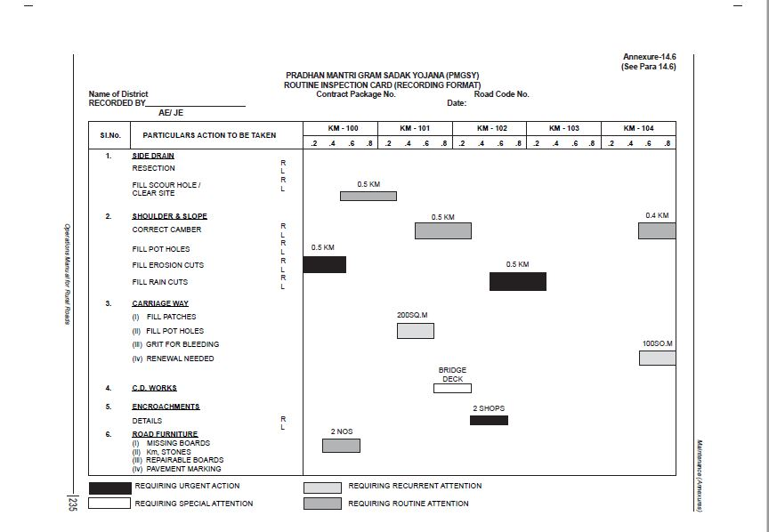
Sample of Maintenance Log Book
(Source:Ch-14 of Operations Manual)

Slide 7
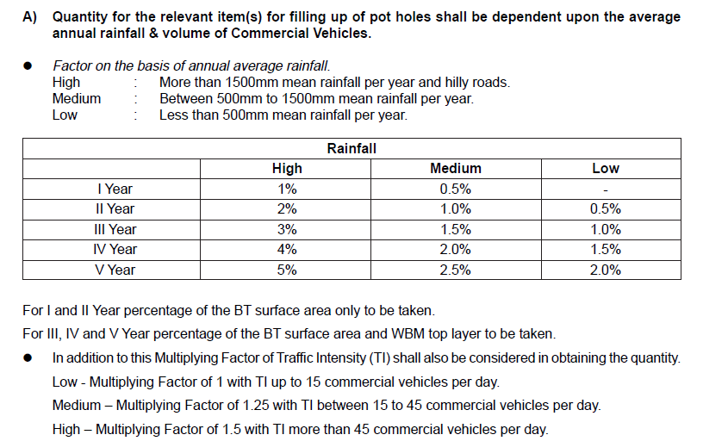
Payment to Contractor for DLP Routine Maintenance
(Source: Cl 32 of SBD, Ch-14 of Operations Manual)
Cost Estimation of Routine Maintenance (Cl 14.5.1 and Annex 14.4 of Operations Manual)
Example of Calculating estimate of quantity for filling up the pot holes:
Suppose the length of Road is 3km and CW width is 3.75m and the Road is in High rainfall area with Traffic of more than 45 CVPD
Calculation of estimate for filling up pot holes during 1st year:
Quantity required as per rainfall criteria= (1/100*3000*3.75) = 112.5 sqm
Total Quantity required by accounting for traffic also = 1.5*112.5 = 168.75 sqm
Let the rate of filling pot holes be 100/sqm
Lump sum amount for 1st year = 168.75*100
= Rs16875

Slide 8
Payment to Contractor for DLP Routine Maintenance
Raising of monthly bills of routine maintenance by the contractor
The bills of fixed amount based on the lump sum rate quoted by contractor will be raised by contractor every month
Example:
Year of Maintenance | Lump sum rate quoted by contractor | Amount for which monthly bill to be raised by contractor
I Year | 1,20,000 | (1,20,000/12)= 10,000
II Year | 2,40,000 | (2,40,000/12)= 20,000
III Year | 3,60,000 | (3,60,000/12)= 30,000
IV Year | 4,80,000 | (4,80,000/12)= 40,000
V Year | 6,00,000 | (6,00,000/12)= 50,000
Contractor has to raise the bill of this fixed amount only irrespective of the actual value of work done by him
Even though there was no defect in the Road and contractor has not done any work, then also the contractor needs to submit bill for that month
Payment to be made to the contractor
Cl 34.2 of SBD:
The payment for routine maintenance of Roads to the Contractor is performance based
Cl 38.2 of SBD:
The Contractor shall submit to the Engineer a bill every month for the routine maintenance of the Roads from the date the maintenance period starts i.e. from completion date as defined in Clause 1.1, it will be supported with a copy of the record of the Contractor’s monthly inspection and other instructions received from the Engineer
The payment will be made monthly for the monthly bills received and as certified by the Engineer based on performance by the Contractor
If the bill for a month is not received from the Contractor by the 10th day of the succeeding month or/ and if the Engineer has not certified that the Contractor has carried out the maintenance work for defects brought to his notice under clause 32.6 within specified period, no payment will become due to the Contractor for that month
If the Contractor has failed to carry out the maintenance within the period specified by the Engineer, no payment of any kind will be due to the Contractor for that month

Slide 9
Practice to be followed for carrying out DLP routine maintenance
(Source: Cl 32 of SBD, Ch-14 of Operations Manual)
Each Road is divided into km stretch and each km to 200m section
Routine Inspections to be carried out by Engineers to record any defect in following order:
JE- Every month
AE- Every two months
EE- Every six months (one before monsoon and one after)
Contractor Conducts Inspection of Road once every month to record any defect which needs to be corrected
All Defects to be recorded and notified to contractor to rectify within a specified time limit
Are defects found on Road
Contractor rectifies the defect and Submits his record to engineer that the defect has been rectified
Yes
Maintenance log book to be maintained for each Road for keeping a record of status of defect if corrected or not
No
Engineer to verify if defects are corrected
Bill for the month will not be paid to the contractor
Contractor submits the bill of fixed amount every month within 10th day of succeeding month
No
Yes
Bill for the month will be paid to the contractor

Slide 10
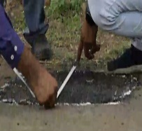
Issues in the system prior to eMARG for carrying out DLP routine maintenance
Even though it was mentioned in the SBD that the payment to contractor will be performance based still 15 states followed the Bill of Quantity(BOQ) based system for payment to contractor for routine maintenance works also:
Contractor measures the size of patch to be filled
Contractor submits the bill based on size of patch filled
PIU receives the bill
PIU inspects the Road to verify the bill is genuine
Payment is done to the contractor
Not allowed
This BOQ system of payment was not allowed for PMGSY Roads for routine maintenance but due to lack of a unified system, it was still followed in some of the states
Even though it was mentioned in the SBD that the payment to contractor will be performance based, but the performance is not defined clearly as to how the performance will be measured for making payments. There was a lack of well defined uniform performance matrix based on which the payment was to be made to the contractor
The whole process is manual in nature and too many physical records have to be maintained
Lack of transparency in the system. If the higher authority wanted to know the status of maintenance of any Road, then they had to rely on the physical record if maintained by the engineer
No system to monitor the maintenance of Roads by SRRDA/NRIDA. The only way to figure out was by monitoring the expenditure done against a particular Road and booked in OMMAS

Slide 11
PROBLEM
How to develop a single and robust management and monitoring system which ensures that Maintenance work for such a huge Road infrastructure is being carried out in to the required standard in an effective and transparent manner?
eMARG
Web based IT solution for all issues in carrying out and managing huge network of maintenance of Roads
eMARG implements the Performance Based Maintenance Contract (PBMC)
SOLUTION

Slide 12
eMARG and Performance Based Maintenance Contract (PBMC)

Slide 13
PERFORMANCE BASED MAINTENANCE CONTRACTS (PBMC)
A type of contract in which payment to the contractor is made based on the minimum condition of Road, CD works and traffic assets that have to be maintained by him/her
Payments are based on how well the contractor manages to comply with the performance standards or service levels defined in the contract, and not on the quantity of material that he has used in maintaining the Road
Measure if the Road finally is in good condition or not and is unrelated to how much effort contractor has put in to bring Road in a good condition
The Road is given marks out of 100 on various parameters and finally the amount to be paid to the contractor depends proportionately on the marks obtained by the Road
Advantages:
Measuring outcomes is easier than measuring inputs
Contractor incentivized to construct better Road such that less inputs in maintaining Road but still gets good outcomes
Evidence based assessment of Roads
S.No | Parameters | Marks
1 | Maintenance of surface of Road including filling potholes and patch repairs etc. | 50
2 | Making up of berms/shoulders | 20
3 | Restoration of rain cuts and dressing of side slopes/berms | 10
4 | Maintenance of drains | 3
5 | Maintenance of culverts and cause ways | 4
6 | Maintenance of guard rails and parapet rails | 1
S.No | Parameters | Marks
7 | Maintenance of Road signs, speed breakers, standing trees adjacent to Road wherever required | 2
8 | Maintenance of 200 m and Kilo Meter stones | 2
9 | Cutting of branches of trees, shrubs and trimming of grass and weeds etc | 3
10 | White washing parapets of Works including CD | 2
11 | Painting of guard stones | 2
12 | Re-fixing displaced guard stones | 1
 | Total | 100
PERFORMANCE MATRIX FOR MAINTENANCE OF Road
Score (?/100) | Payment
< 80 | NIL
Between 80 -100 (say 85) | 85% of maintenance amount

Slide 14
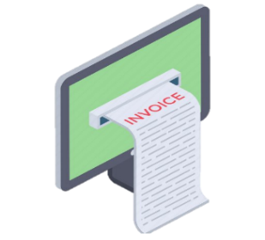
BASIC PROCESS FLOW FOR DESIGNING eMARG SOFTWARE
Start
Online Registration of Contractor
Generation of eBills by software
Submission of eBills by contractor on click of a button
Digital Payment to contractor in his account
Start
Inspections done by engineers through Mobile App by uploading photos
Outcomes Based Performance Evaluation of Road for giving marks out of 100 based on Inspections conducted
Processing of Bills based on Marks obtained in Performance Evaluation
Digitization of entire process
eBill Generation and Submission as the bill amount is fixed for every month
App based Routine Inspections to keep a record of inspections carried out
System generated vouchers based on score leading to less to-fro between account officers and District Engineers on amount
Evidence of Maintenance carried out for the Road is kept in the system for anytime access

Slide 15
Data Requirement for development of eMARG

Slide 16
DATA REQUIRED FOR DEVELOPMENT OF eMARG
Sanctioning of works by MoRD: State/SRRDA selects and gets approval for individual Roads which will be constructed/ upgraded in a district
Based on the ground condition/value of work, more than one Roads can be clubbed together to form a single Package
Every Road is assigned a package No. (A package can have one or more than one Roads)
Awarding of works: Bidding for construction/ upgradation is done for a Package and not for individual Roads
The complete package (by default every Road of package) is awarded/tendered to a single contractor
The data is required at Package level for development
Unless the construction/ upgradation of all the Roads of the package is complete, the DLP of the Road will not start
The complete package and not the individual Road will undergo DLP routine maintenance
The Agreement No., agreement start date and project completion date will be applicable for the complete package
Example: Suppose for a district XYZ of ABC state, 10 Roads are sanctioned
Sanctioned Roads
Road#1, Road#2, Road#3, Road#4, Road#5, Road#6, Road#7, Road#8, Road#9, Road#10
Details of Tenders of Road
Package# | Roads | Contractor | Agreement No. | Agreement Date | Project Completion Date as per contract
Package 1 | R1,R2, R3, R4, R5 | Contractor-A | XYZ/12345 | 1/1/2020 | 1/12/2020
Package 2 | R6, R7 | Contractor-B | XYZ/67891 | 1/2/2020 | 1/1/2021
Package 3 | R8 | Contractor-C | XYZ/24782 | 10/1/2020 | 10/12/2020
Package 4 | R9, R10 | Contractor-D | XYZ/76543 | 20/1/2020 | 20/12/2020
Packaging of Roads
Package 1: Road#1, Road#2, Road#3, Road#4, Road#5
Package 2: Road#6, Road#7
Package 3: Road#8
Package 4: Road#9, Road#10

Slide 17
DATA REQUIRED FOR DEVELOPMENT OF eMARG
District-1
DPIU-1
Package-1
Package-2
Package-3
Administrative Hierarchy of PMGSY Works
STATE
District-2
DPIU-2
Package-4
Package-5
District-3
DPIU-3
Package-6
District Project Implementation Unit (DPIU):
If a district is large in size or large no. of works are sanctioned in a district is , then to have a better administrative control, a district is further divided into divisions and then DPIU is formed by joining these divisions
A district can have one DPIU or more than one DPIU
The unit which is responsible for construction and maintenance of Roads assigned to them.
It generally has three level of Engineers, i.e. JE/AE/EE
Every package is associated with a single unique DPIU on ground
*DPIU is more commonly called as PIU. So DPIU and PIU mean the same
Additionally the lump sum maintenance rates are dependent on CW width and Traffic Density also
Summary of Data/Information Required for a package for its routine maintenance
State | District | Block | DPIU | Package No. | Road Name | Traffic Category | CW Width | Completed Length | Completion Date | Agreement No. | Agreement Date | Contractor Name | PAN No. of contractor

Slide 18
SOURCE OF DATA AND ITS EXCHANGE
All data of a road, from sanction to award/tender till completion is entered by PIU in OMMAS. Thus OMMAS is the source of parent data and the relevant data for development of eMARG needs to be sent from OMMAS to eMARG
To start the development process in eMARG, first time data was exchanged manually in excel sheet on 11th July 2019 and 4th Dec 2019:
Master list of Names of States, Districts, Blocks, DPIUs and Departments maintained in OMMAS sent to eMARG
List of Packages completed between 1/10/2013 to 31/10/2019 in the required format sent to eMARG
eMARG puts the following validations on the package data received from OMMAS:
1. Maintenance Agreement No. is present
2. One package should have one maintenance agreement No.
3. Traffic category Data should be present
4. CW width data should be present
5. Completed Length and completion date of road should not be zero
6. Contractor’s PAN No. should be present and should be in correct format
Is the data valid
The following Data was shown to concerned PIUs in eMARG and was asked to confirm if it was correct:
Completed length, Completion Date, Agreement No., Agreement Date, Contractor Name, Contractor PAN, CW width, Traffic Density
Yes
The package was accepted by eMARG
The Data was used for development of eMARG
No
The package was rejected by eMARG
Is the data Correct
No
Yes
The Package was allowed to proceed further in eMARG
Need to correct data in OMMAS

